Slide 1
Preparing Your Syllabus
Faculty Assembly
New Faculty Resources
Nita McKinley, FA Chair 2014-15

Slide 2
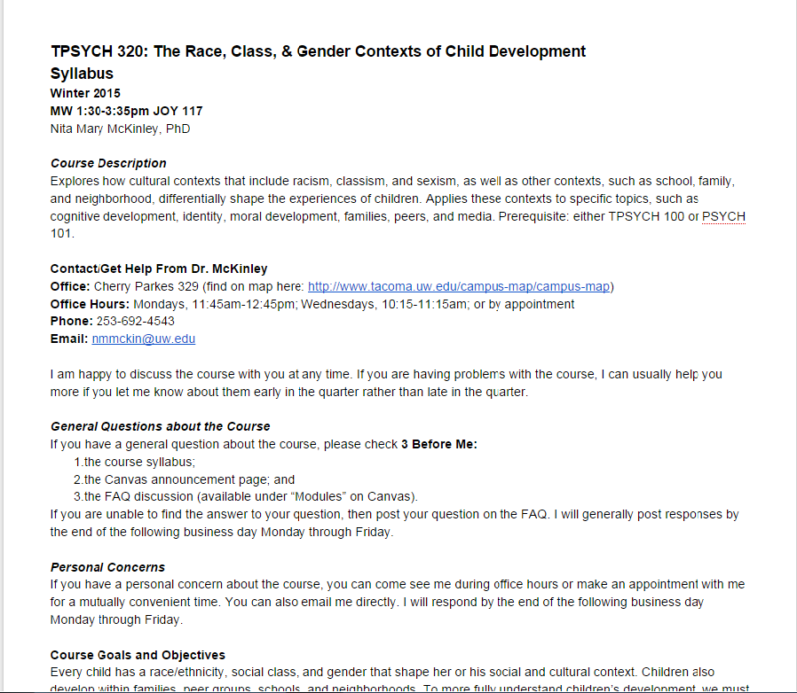
The course syllabus …
is a contract with your students.
is a permanent record for accreditation purposes.
must contain certain specific information and policy statements.

Slide 3
Full information about the course, including catalog description
How to get in touch with you

Slide 4
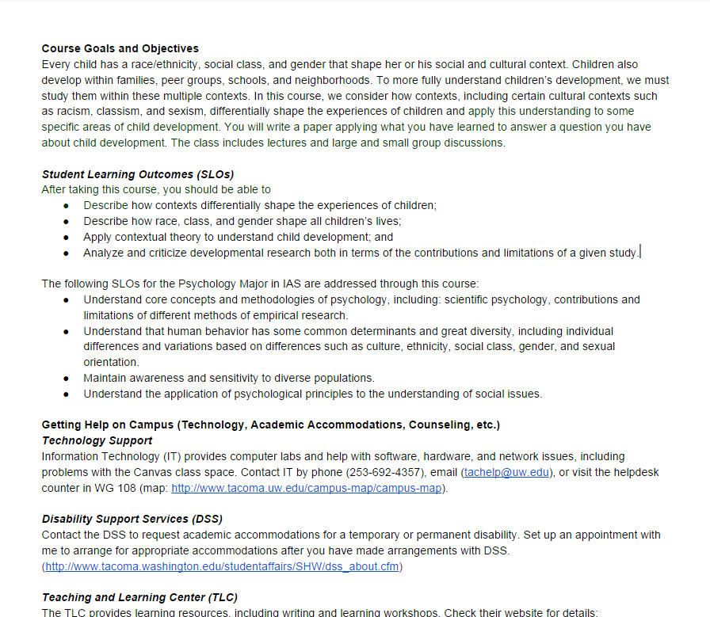
Student learning outcomes (SLOs) approved for this course
May include SLOs for a particular major or program

Slide 5
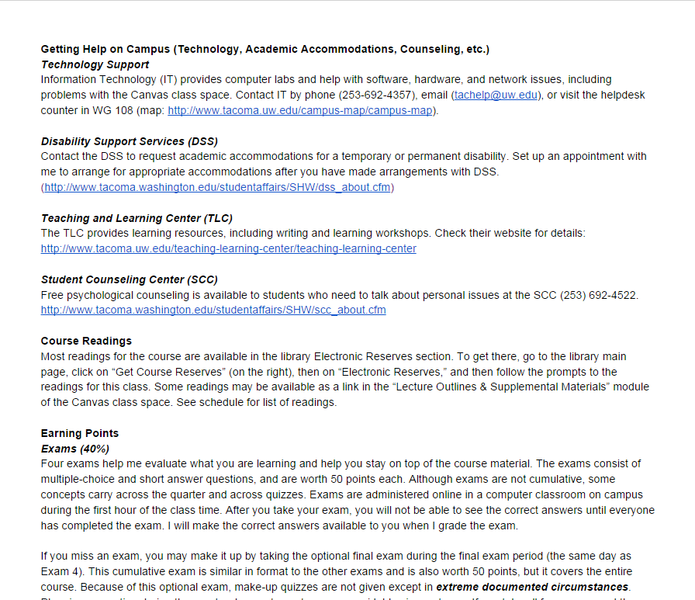
Campus services information, including disability support
Textbooks and other materials required for the course

Slide 6
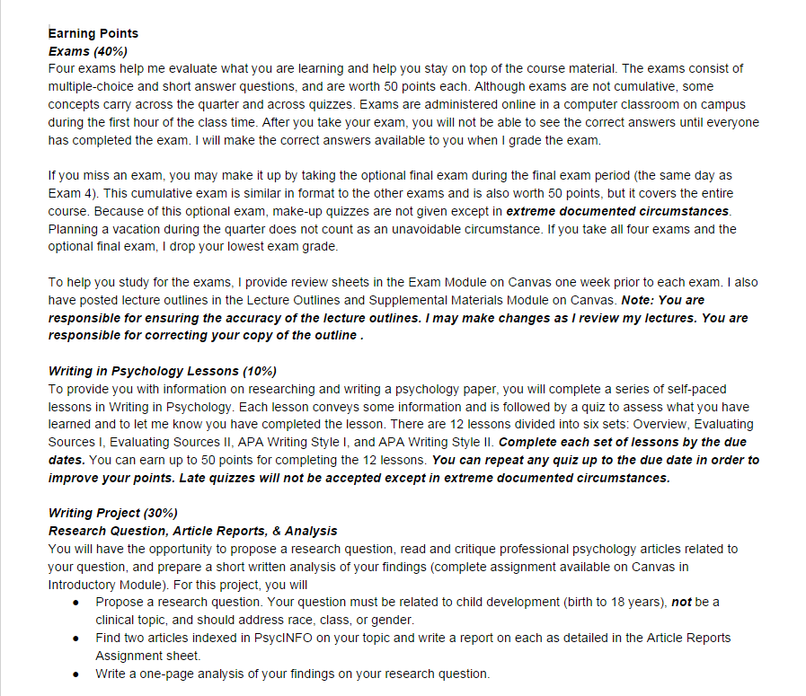
Assignments for the course and how they contribute to course grade
Policies for late assignments and make-ups; you are responsible for arranging any make-ups.

Slide 7
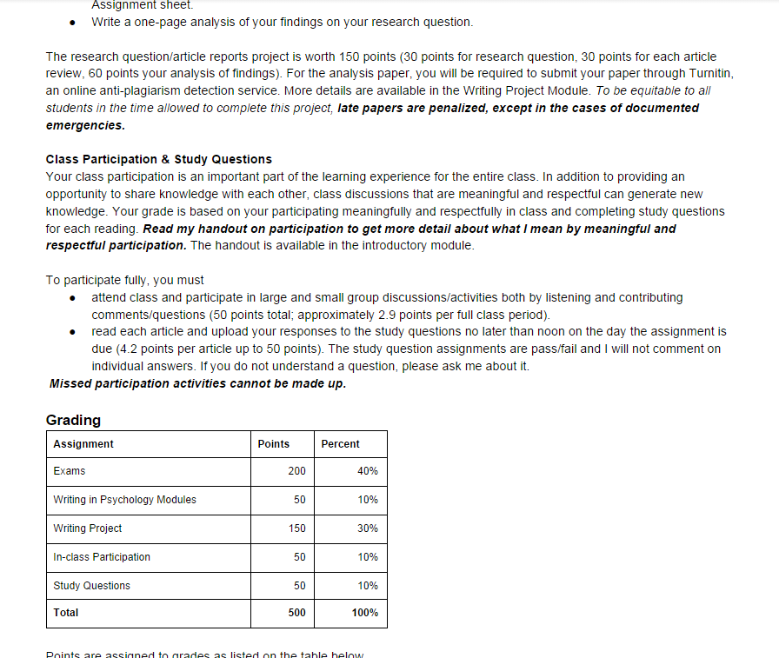
Attendance cannot be part of the grade. Participation can.
How participation is evaluated

Slide 8
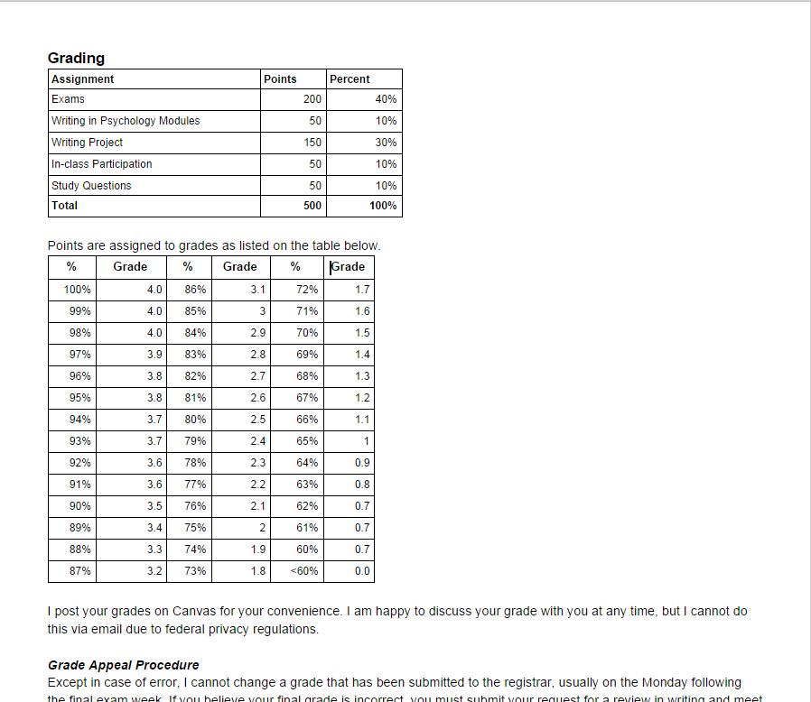
Weights for each assignment
Grading scale used for class

Slide 9
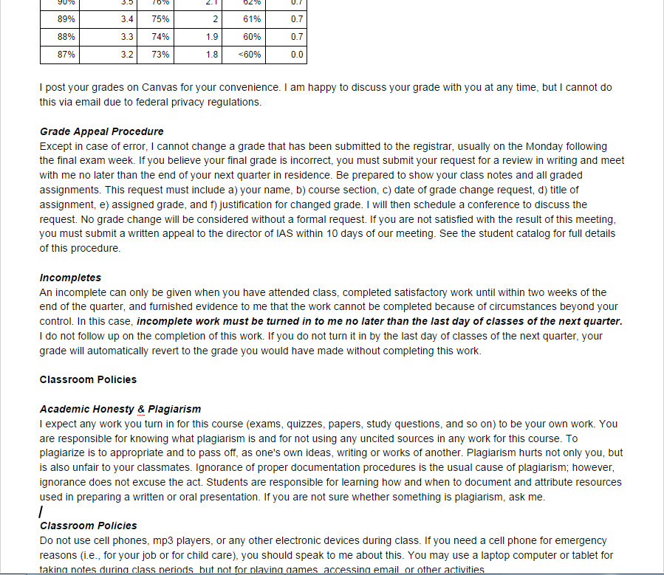
Grading policies
Be careful about discussing grades via email
Grade appeal procedure from catalog
Incompletes policy

Slide 10
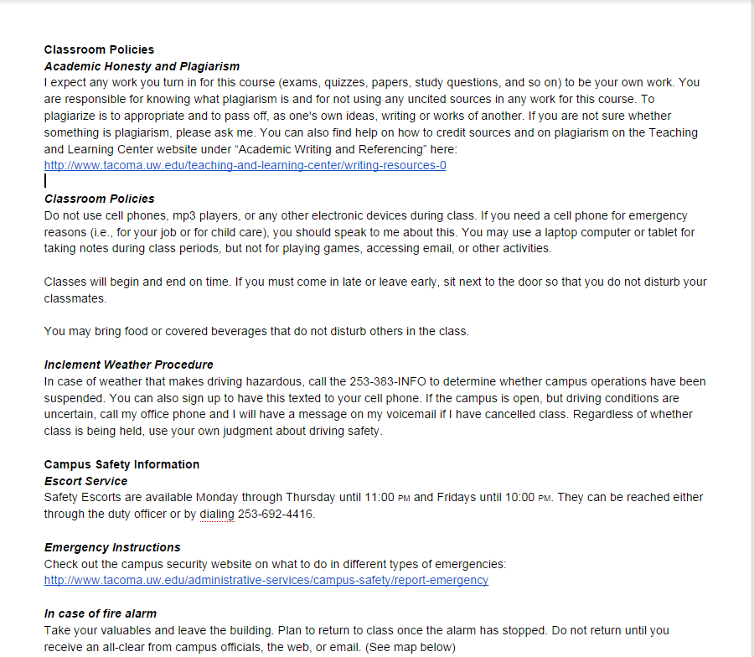
Classroom behavioral expectations
Academic honesty expectations and resources
Inclement weather procedure

Slide 11
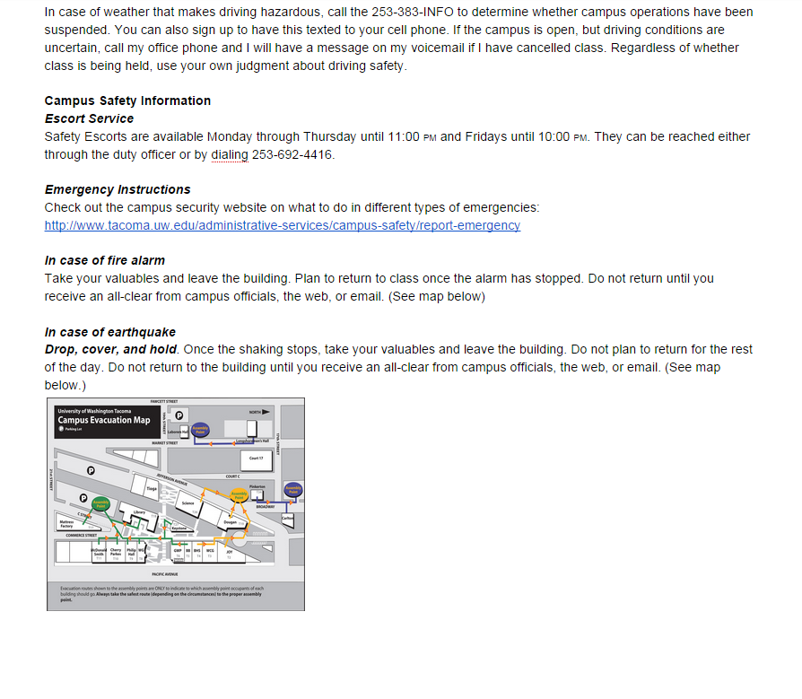
Include safety information

Slide 12
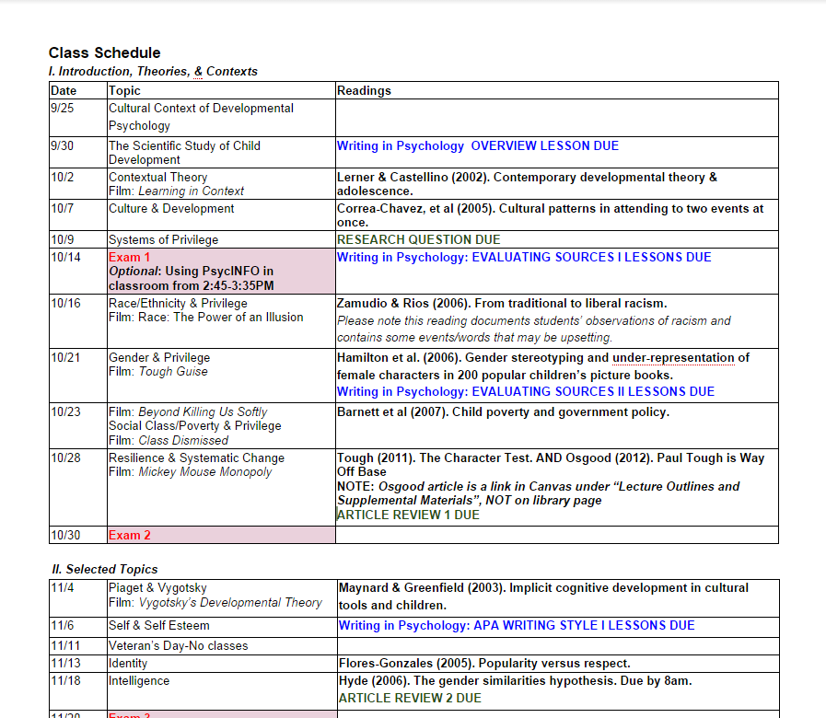
Include safety information
All exams and assignments scheduled

Slide 13
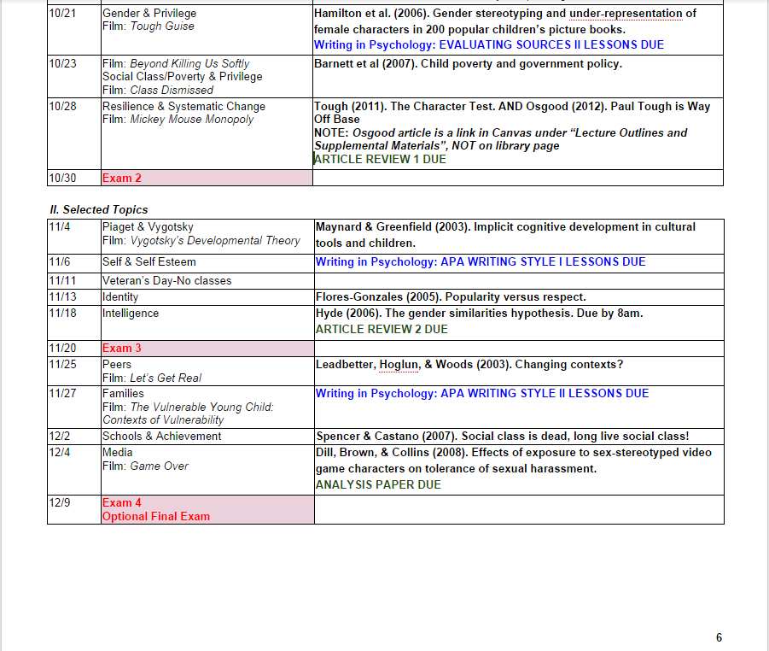
No major exams scheduled in final week of classes.
May have assignments due that were completed over several weeks
Final exam must be scheduled in assigned exam period.

Slide 14
Check with your program for any other requirements.
Ask to see sample syllabi.
Have a colleague review your syllabus.
Provide final syllabus to program for archiving.
Questions?

