Slide 1
Interdisciplinary
Community Engaged
Public Impact Research
UW Tacoma
Research Enterprise
Inclusive
Basic & Applied Research
Urban Serving
Social Justice
Use Inspired Research
Scholarship of Teaching
Undergraduate Research

Slide 2
Update on Research & Scholarship at UWT
Current Research Support Model
Proposals, Sponsored Research Awards & Internal Awards
Initiatives
Workshops
Collaborations

Slide 4
Faculty Assembly
Research Advisory Committee (RAC)
RAC is an ad-hoc subcommittee of UW Tacoma Faculty Assembly started in 2019.
Main responsibility is to ensure faculty have a direct role in shared governance related to issues pertaining to research and scholarship.
RAC has five members among full-time UW Tacoma faculty appointed by Executive Council. Associate Vice Chancellor for Research and the Office of Research Director are ex-officio members of the committee.
The term of service is two years.

Slide 5
Research Advisory Committee (RAC)
Members during academic year 2021-2022:
John Finke (Chair) - School of Interdisciplinary Arts & Science, SAM Division (Associate Professor)
Robin Starr Zape-tah-hol-ah Minthorn - School of Education (Associate Professor)
Yonn Dierwechter - School of Urban Studies (Professor)
Alison Gardell - School of Interdisciplinary Arts & Sciences, SAM Division (Assistant Professor)
Eyhab Al-Masri - School of Engineering & Technology (Assistant Professor)
Committee meets at least twice each quarter.
Working on this year – Setting up new Catalyst Funding Initiative Process & Review; Endowment Award Review; Policy Questions & Faculty Development Ideas

Slide 7
Funding for Research
Fiscal Year 2022 – Starts July 1 2021
Sponsored Research Proposals & Awards
$13.1 million proposals & $4.5 million grant received
Internal UWS Funds:
- Fall 2021 Royalty Research Fund
5 written; 2 funded (Emily Thuma (SIAS/PPPA) & Zhiquan (Andy) Shu (SET)
- CoMotion Innovation Gap Fund – 1 funded (Weichao Yuwen (Nursing & HCL)
Internal UWT Founders Endowment Funds & Internal Mini-RRFs:
($15K planned & $10K immediate need)
- 6 FE awards made last year & 3 Mini-RRFS

Slide 8
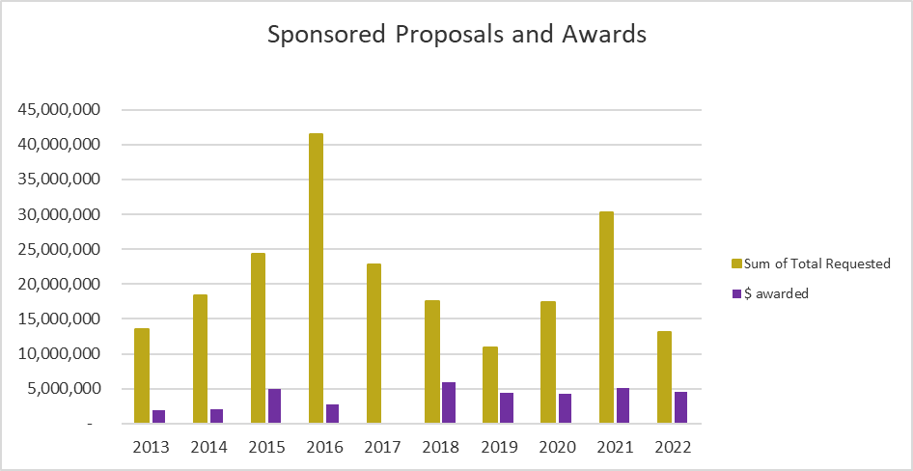
Sponsored Research Proposals and Awards*
*Data is from UW BI Portal and represents proposals and awards that are submitted and administered by
UW Office of Sponsored Programs with UWT unit as lead organization only.
Gifts and service contract funds are not included here.

Slide 9
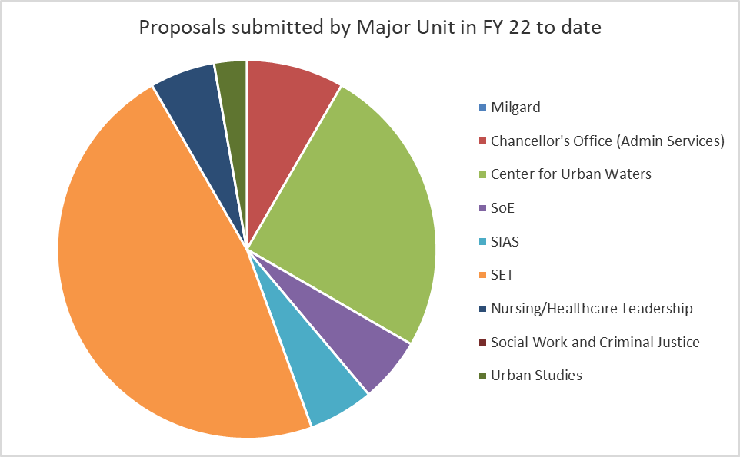
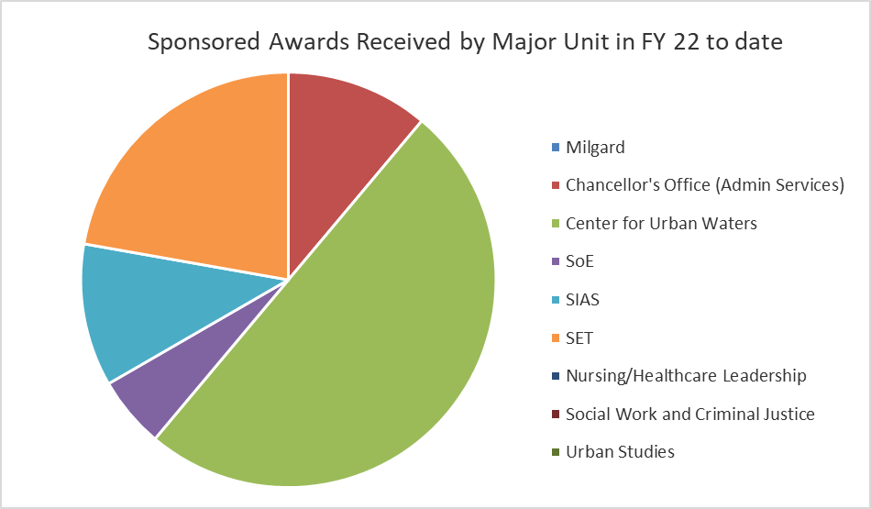
Sponsored Research Proposals & Awards by Unit

Slide 10
Initiatives
Capacity Building Grants – AANAPISI, USU, KEEN, SLOAN, SUMMIT-P, ACCESS STEM
Catalyst Funding Initiative – ($100K – jointly funded by EVCAA & Advancement)
Founders Endowment funding again this year ($25K)
Social Justice and Equity Scholarship Initiative (First gathering 2/24/22)
Dr. JaeRan Kim (Social Work & Criminal Justice)
Dr. Robin Zape-tah-hol-ah Minthorn (Education)
Dr. David Reyes (Nursing & Healthcare Leadership)
Dr. Anaid Yerena (Urban Studies)
Dr. M. Billye Sankofa Waters (Education)
With Tanya Velasquez at OEI

Slide 11
Workshops
Fall
Qualitative Forum Revived – Riki Thompson - hybrid
Winter
RRF Informational Workshop - zoom
Qualitative Forum 2 - zoom
Finding Funding - zoom
Social Justice Research Learning Circle – zoom
Spring
Grants Management 101 – zoom

Slide 12
Workshops
Planned and Requested:
Endowment Award Research Lightning Talks
Qualitative Forum 3
Social Justice and Equity Scholarship
UW Hyak Supercomputer & Modeling Workshop – Tarang Khangaonkar
Applying to be a Fulbright Scholar
Book Projects
Lightning Talks – Interdisciplinary Research; Research Involving Undergraduates

Slide 14
Collaborations & Partnerships
UWS/UWB
Library/Office of Community Partnerships
- Database
- Scholarly Identity Project
- Coordinate Workshops
Research Centers
- CUW Salish Sea Modeling Center
- CUW UWT Engineering collaboration with City of Tacoma
Student Success
- Capacity Building Grants
- UG Student Research & REU
Office of Equity & Inclusion
- Capacity building grants
- Social Justice & Equity Scholarship Series
Office of Advancement
- Catalyst Funding
Center for American Indian and Indigenous Studies

Slide 15
Office of Research Logistics & Budget
Lost three staff in past 2 months – working to replace
Office of Research funded by ICR
Requesting UWT funding for half-time Grant Writer & continued funding for Catalyst & Social Justice and Equity Scholarship Initiatives

