Slide 1
Resources for employee well-being
Kathleen Farrell | Director of Work-Life
UW Tacoma Faculty Assembly
February 11, 2022

Slide 2
UWHR Resources for employee well-being
UW Work-Life
  UW CareLink
  Child care
  Adult / elder care
  COVID-19 Employee Emergency Fund
The Whole U
Professional & Organizational Development

Slide 3
UW CareLink
UW CareLink is a confidential, 24/7, multi-lingual service available for benefits eligible employees and their household members.
EAP: 5 free sessions virtual or telehealth sessions per issue; can request in-network provider for continuity of care
Family Source: unlimited child and adult care consultations and research
Work-Life Solutions: unlimited help planning moves, travels, home repair and more
Legal Connect: per issue, free 30 minute consultation & 25% fee reduction
Financial Connect: unlimited consultation
Management consultations & team support

Slide 4
Child care
Care finding
UW CareLink Family Source
Sittercity
Priority access
Bright Horizons – nationwide & some partners
KinderCare - select locally centers
Discount programs
KinderCare - 10% tuition discount at all early learning centers and Champions school-aged programs
Right at School - 20% tuition discount through Bright Horizons
Tutoring and academic support - discounts with Bright Horizons partners
Nanny services - discounts through Bright Horizons and The Whole U

Slide 5
Backup care for adults and children
Bright Horizons
5 uses per employee each calendar year
In-home care for children or adults
In-center care for children aged 5 and under
KinderCare
10 uses per employee each calendar year
In-center care for children aged 5 and under
Limited school-aged care for children up to age 12
Both providers’ services are available nationwide.

Slide 6
Adult and elder care
Care finding
UW CareLink Family Care Specialists
Sittercity
Years Ahead search tool
Backup care through Bright Horizons
5 uses per employee each calendar year
In-home care
Consultation and support
UW CareLink Family Care Specialists, Legal Connect and Financial Connect
Years Ahead assessment tool

Slide 7
UW COVID-19 Employee Emergency Fund
The UW COVID-19 Employee Emergency Fund helps eligible employees who are experiencing a critical, temporary and unforeseen financial hardship due to COVID-19.
Employee Eligibility
  PEBB-eligible position of .5 FTE or greater
  Continuous service at the UW of six (6) months or longer
  Total base salary is less than $75,000
Application process
  Describe and document qualifying hardship
  Document eligible expenses: housing; utility bills; medical expenses not covered by insurance; Critical transportation costs, not including parking or car payments; child and adult care expenses.
Employees may receive up to $750 for any eligible expense.
Those who are required to work onsite may qualify for a $750 child care supplement.

Slide 8
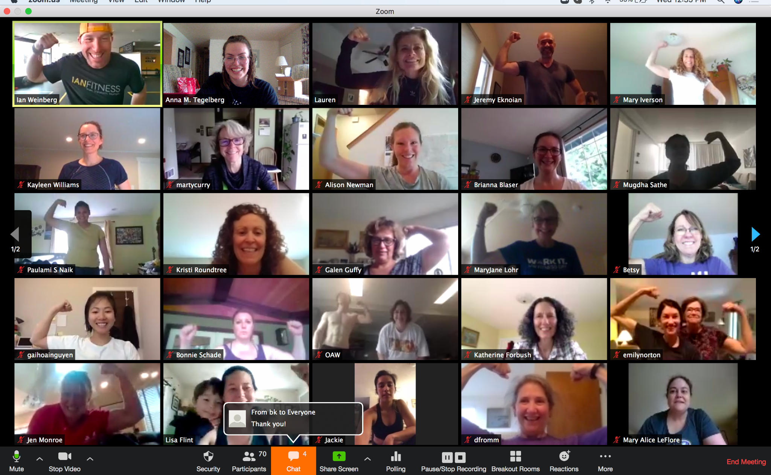
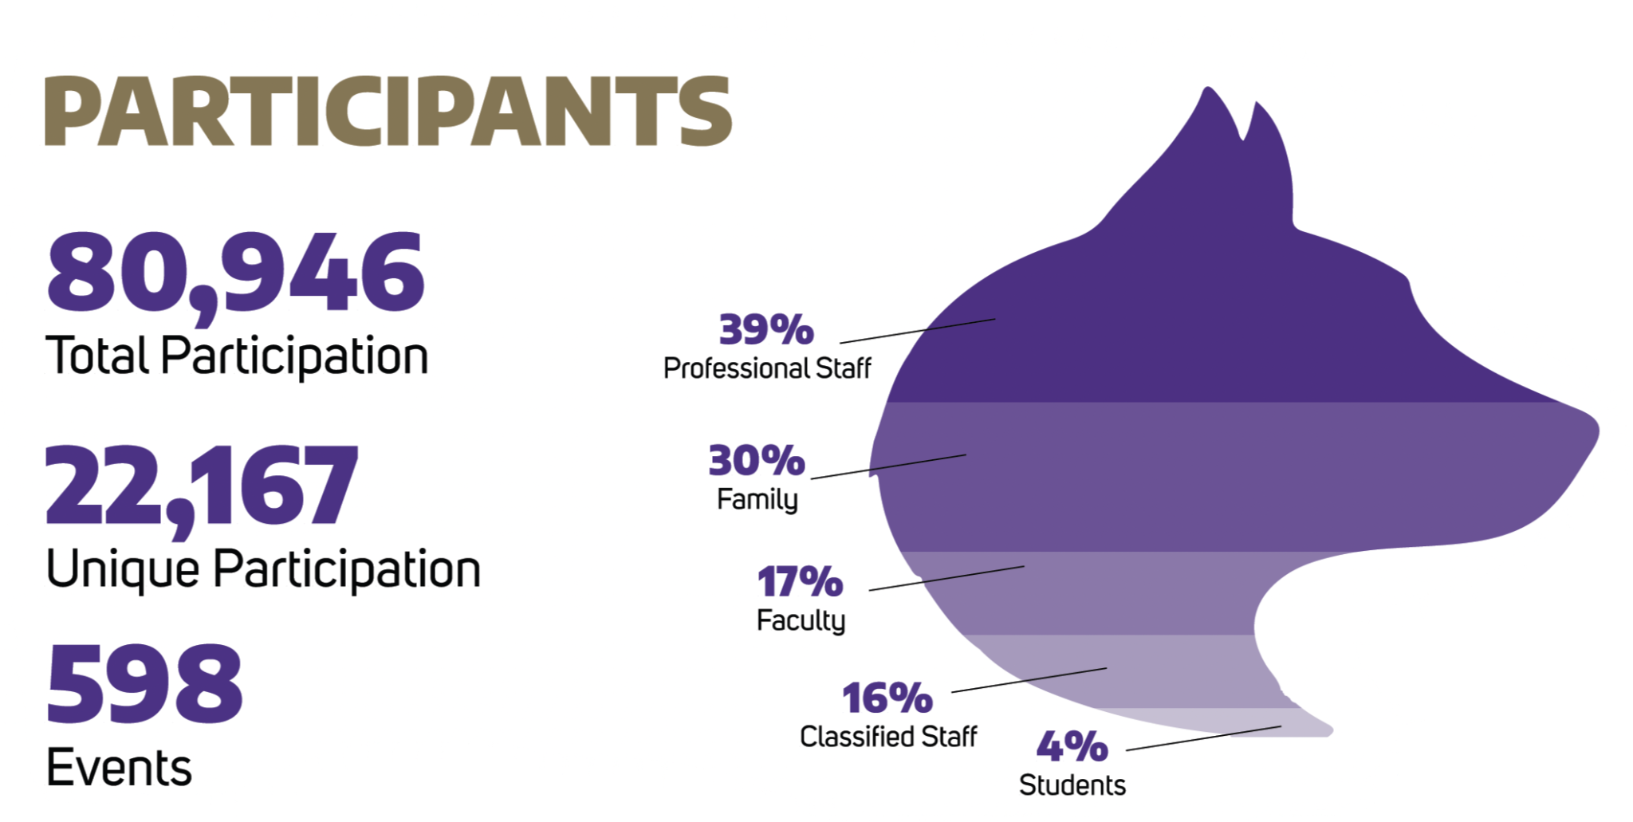
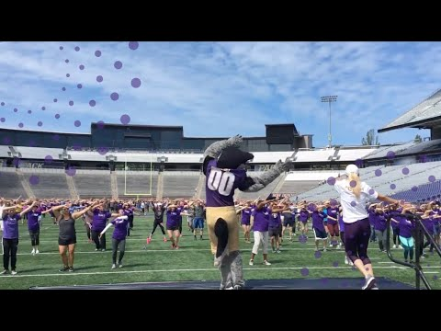
THE WHOLE U: FOR UW, BY UW
IN 2020 THE WHOLE U PIVOTED TO REACH THE UW COMMUNITY IN NEW AND INNOVATIVE WAYS, MAKING AN IMPACT ACROSS UW CAMPUSES AND EMPLOYEE TYPES.

Slide 9





Overview of Offerings
Seminars and Self-Paced Programs
  UW Faculty & UW Medicine expert-led seminars
  Nutrition, parenting, volunteerism, and health workshops
  Financial & sustainability seminars & challenges
  Fitness & mindfulness training
Daily Virtual Fitness Breaks
  Yoga and strength conditioning
Additional, Ongoing Virtual Classes
  Zumba, yoga, exercise, meditation
For UW, By UW Podcast
The Whole U YouTube
Articles Published Twice Weekly

Slide 10
PROFESSIONAL AND ORGANIZATIONAL DEVELOPMENT (POD)
OUR PEOPLE ARE OUR GREATEST STRENGTH. DEVELOPING OUR LEADERS AND TEAMS IS ONE OF OUR GREATEST INVESTMENTS. POD COMBINES TRAINING, COACHING AND CONSULTING IN THEIR MISSION TO FOSTER POSITIVE CHANGE IN INDIVIDUALS AND ORGANIZATIONS ACROSS THE UW.
  Leadership coaching and consulting
  Ongoing and customized training for faculty and staff
  Strategic Leadership Programs
  Grant management
  In-person new employee orientation
  UW tuition exemption program

Slide 11
Learn more
UW CareLink
https://hr.uw.edu/benefits/uw-carelink/
Child care
https://hr.uw.edu/child-care/
Adult & elder care
https://hr.uw.edu/elder-care/adult-and-elder-care
UW COVID-19 Employee Emergency Fund
https://hr.uw.edu/vphr/emergencyfund
Professional and Organizational Development
https://hr.uw.edu/pod/
The Whole U
https://thewholeu.uw.edu

