Slide 1
Conducting a Search
Records Management
October 28, 2015

Slide 2
If it is a record
Then the retention from an approved retention schedule must be applied

Slide 3
What is a record?
Definition of a Record
  “….information regardless of physical form or characteristics, and including such copies thereof, that have been made or received by any agency of the state of Washington in connection with the transaction of public business…”

Slide 4

Keep in mind…
Regardless of format, the retention rules apply
Email
PDFs
Word Documents
Text Messages
Videos

Slide 5
Two main Record categories
Personnel and Payroll Records Section 8 of the UW General Schedule
Applicants Search Committee
Applications for Faculty/Academic Employment -- Not Hired
Appointment Packets (Faculty)
Search Committee for Deans and Directors
Search Committee for Faculty and Chairpersons

Slide 6
Search process
Planning the Search
Search Committee
Applicants
Interviewed
Hired
Applications for Faculty/Academic Employment -- Not Hired
Applications for Faculty/Academic Employment -- Not Hired
Appointment Packets (Faculty)

Slide 7
Search Committee Records
Procedures and decisions
List of committee members
Hiring a search firm
Correspondence
  Planning for the search,
  Development of criteria for the selection of a candidate
Job/position description
NOTE: Does not include materials submitted by an applicant.

Slide 8
applying Records Management
Search Committee
Search Committee Record
Search Firm or Post?
Search Committee Record
Position Description
Search Committee Record

Slide 9
Receive applications
Applicants are Weeded
Applications for Faculty/Academic Employment—Not Hired
Applicants Chosen for 1st Interview
Applications for Faculty/Academic Employment—Not Hired
Phone Interviews
Applications for Faculty/Academic Employment—Not Hired

Slide 10
Interviews and Deliberations
In-Person Interview
Applications for Faculty/Academic Employment—Not Hired
References
Applications for Faculty/Academic Employment—Not Hired
Deliberations
Applications for Faculty/Academic Employment—Not Hired

Slide 11
Finalists
Faculty Presentation
Applications for Faculty/Academic Employment—Not Hired
Meet with Groups
Applications for Faculty/Academic Employment—Not Hired
Comments
Search Committee Record

Slide 12
Offer
Offer Letter
Appointment Packet
Negotiation
Appointment Packet
Acceptance
Appointment Packet

Slide 13
What about Financial Records?
Interview Expense
ARIBA
Like Other Financial Transactions
Moving Expense
Scanning policy in place; scan and shred

Slide 14
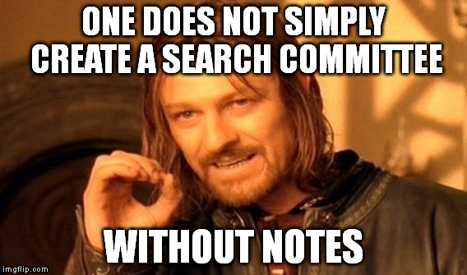
What about the handwritten notes?

Slide 15
What about the handwritten notes?
Make a note? It is considered a record.
Choice 1
Choice 2
Choice 3
Everyone keeps their notes and applies the 3 year retention individually.
At the end of the search:
collect all notes on applicants and manage (apply retention) centrally.
Collect all notes and summarize all notes into one document.
The individual notes are considered drafts of the summary document.
Individual notes can be shredded once summary document is finalized.

Slide 16
Hired vs. Not Hired
Not Hired
Applications for Faculty/Academic Employment -- Not Hired
Retention: 3 years after completion of hiring process
EXCEPT
Search is for Assistant Professor, Research Assistant Professor level or higher
AND
Hired candidate is sponsored by the UW for a green card
THEN 6 years after date of filing the Application for Permanent Employment Certification

Slide 17
Hired vs. Not Hired
Hired
Appointment Packet (Faculty)
UWT Finance and Administration
Retention: 3 years after termination of employment

Slide 18
Search Committee
Search Committees for Deans and Directors
Retention: 10 years after end of search
Disposition Method: Transfer to Archives for review
Search Committees for Faculty and Chairpersons
Retention: 6 years after end of search
Disposition Method: Shred or Delete

Slide 19
Questions?
Resources:
Records Management Website:
http://f2.washington.edu/fm/recmgt/
Section 8 Personnel and Payroll Records
http://f2.washington.edu/fm/recmgt/retentionschedules/gs/general/uwgs8
Barbara Benson
543-7950
bbenson@uw.edu
Cara Ball
543-6512
ballc2@uw.edu
Albert Ybarra
543-0573
aybarra@uw.edu

