Slide 1


Human Rights at Home: Immigrant Rights in WA

Slide 2
About the UWCHR
The University of Washington Center for Human Rights (UWCHR) was established by an initiative of the Washington state legislature in 2009
Advance real world change for human rights in partnership with community groups, locally and globally

Slide 3
How we work
Partnerships with community groups
La Resistencia, ACLU of WA, NWIRP, WDA, CLS, OneAmerica, Liberation not Deportation, &c.
FOIA and public records act research
Strategic FOIA litigation
Student researchers

Slide 4
Human Rights at Home
Immigrant rights in WA state
2017: What does the immigration enforcement, detention and deportation pipeline look like in WA?
Where to start?
What kinds of records to seek?

Slide 5
Detention/deportation pipeline in WA
Identification
Apprehension
Detention
Deportation

Slide 6
Detention/deportation pipeline in WA
Identification
Apprehension
Detention
Deportation
ICE Air transfers via local airports
Commercial flights
Federal prosecution

Slide 7
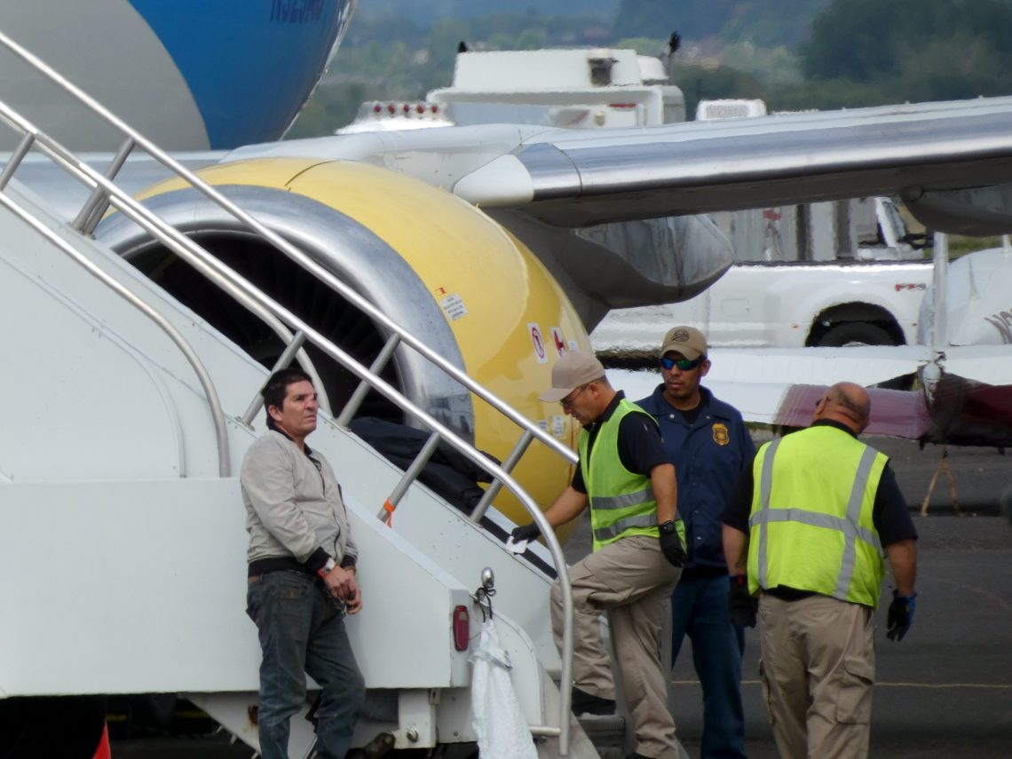
ICE Air Operations
Deportation via for-profit private charter flights
34,400 people via Boeing Field on 466 flights 2010-2018
Voluntary decision to stop servicing flights, May 2019
Flights shift to Yakima; record transfers during summer 2021
Notes:
José Velarde Quiñónez (left), with visible facial scars from a partially-healed surgery, is prepared for deportation via Yakima Air Terminal-McAllister Field on July 9, 2019. Photo courtesy Yakima Immigrant Response Network.

Slide 8
Detention/deportation pipeline in WA
Identification
Apprehension
Detention
Deportation
NWDC Tacoma
IGSAs with county jails
Seatac Federal Detention Center
DHS hold rooms
ICE Air transfers via local airports
Private flights
Federal prosecution

Slide 9
Detention
NWDC (Northwest ICE Processing Center)
1575 capacity
For-profit private immigration prison owned by GEO Group under contract with ICE
County jail contracts with ICE, BP, USMS (IGSAs)
Yakima, Okanogan, Cowlitz, others
DHS hold rooms
Ferndale, WA

Slide 10
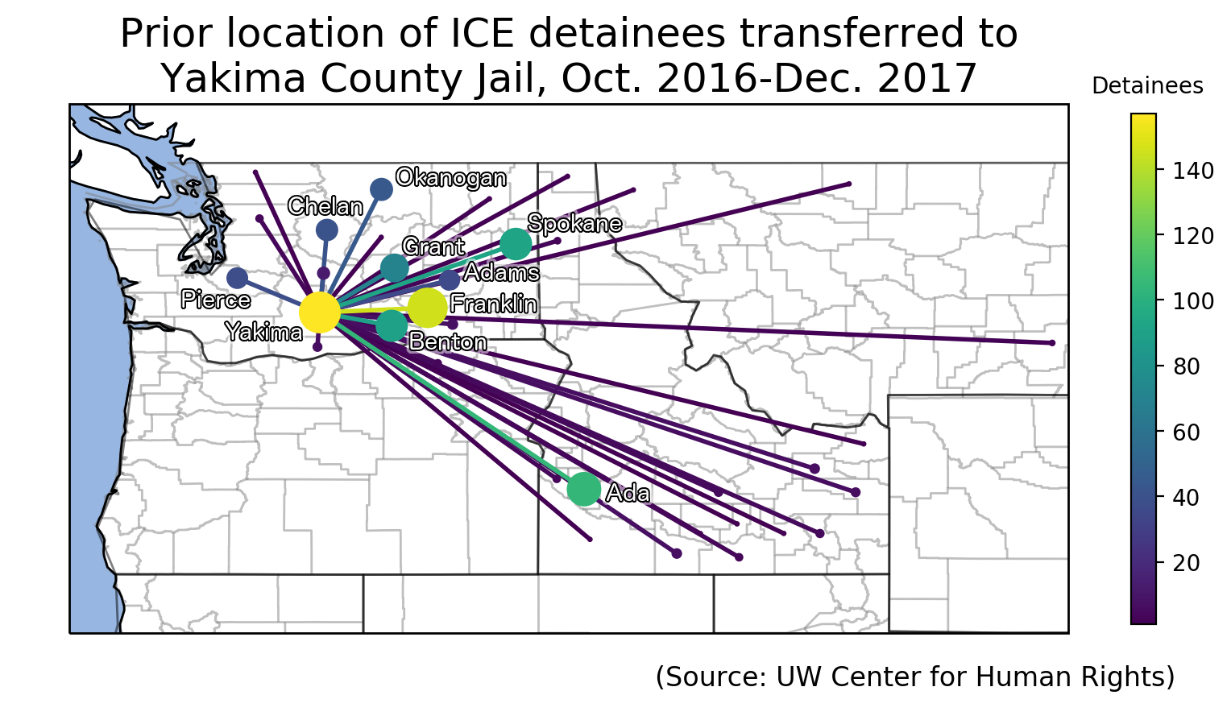
County jails
Deportation pipeline “hubs”
Yakima: illegal detainer practices
Cowlitz County juvenile jail
Held youth from across country in civil detention

Slide 11
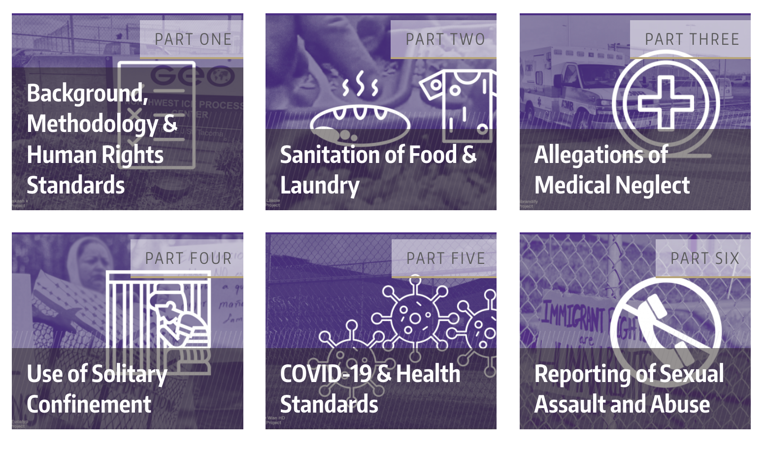
NWDC Conditions

Slide 12
Sources
Detained people’s testimony
ICE & GEO documents
ICE standards
Significant Incident Reports
Grievances filed by detained people
Solitary confinement logs and reporting
ICE/GEO contract
Other DHS documents
CRCL complaint logs

Slide 13
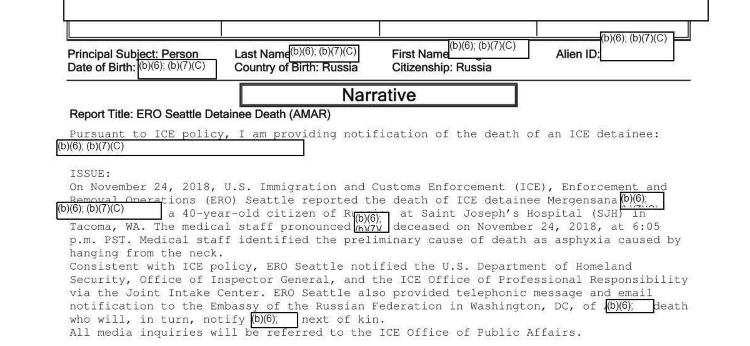
Significant Incident Reports
Notes:
Death of Mergensana Amar

Slide 14

Reporting of sexual assault/abuse
Failure to follow multiple, stringent reporting standards
More oversight is not the answer
Notes:
18 of the 20 sexual abuse/assault cases reported using the facility’s grievance system were never documented in ICE’s SEN system

Slide 15
Detention/deportation pipeline in WA
Identification
Apprehension
Detention
Deportation
Ports of entry
Detainers, release notification at jails, DOC
Community arrests
Raids
Transportation checks
NWDC Tacoma
IGSAs with county jails
Cowlitz juvenile jail
Seatac Federal Detention Center
DHS hold rooms
Hotels
ICE Air transfers via local airports
Private flights
Federal prosecution
Notes:
October 2014 to May 2018 - 47% via CAP

Slide 16
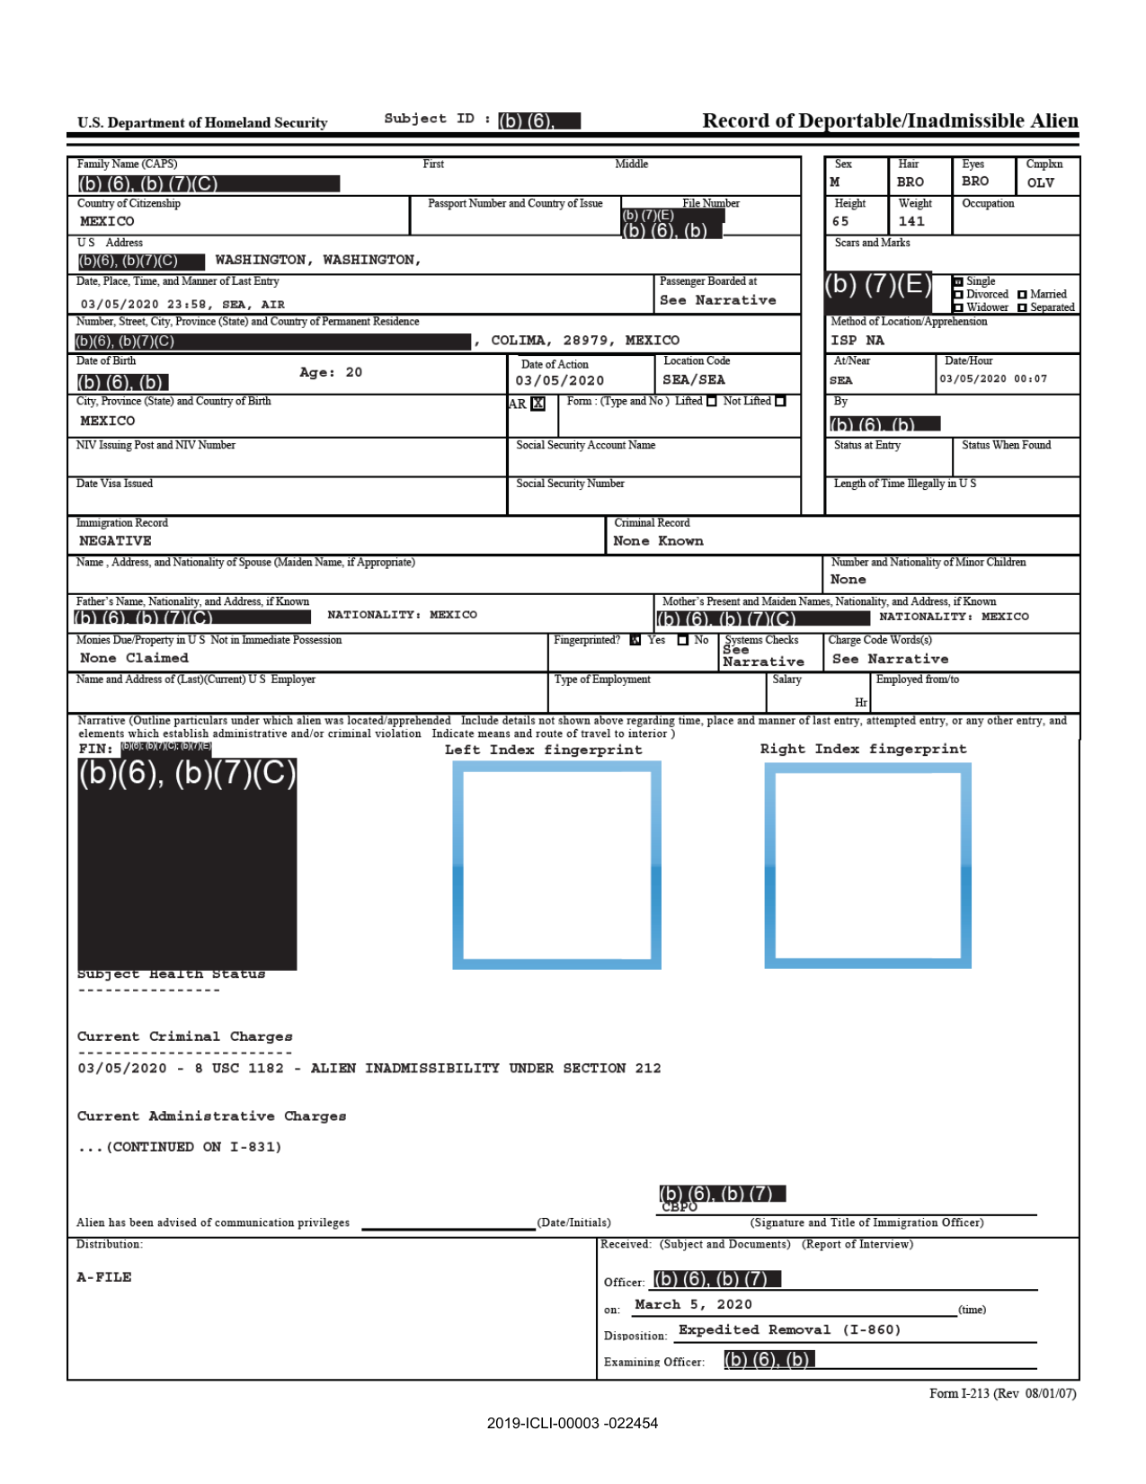
I-213 forms
4000+ forms documenting apprehensions in Seattle Area of Responsibility, Jan. 2019 - Apr. 2020
Most detailed source, including narratives

Slide 17
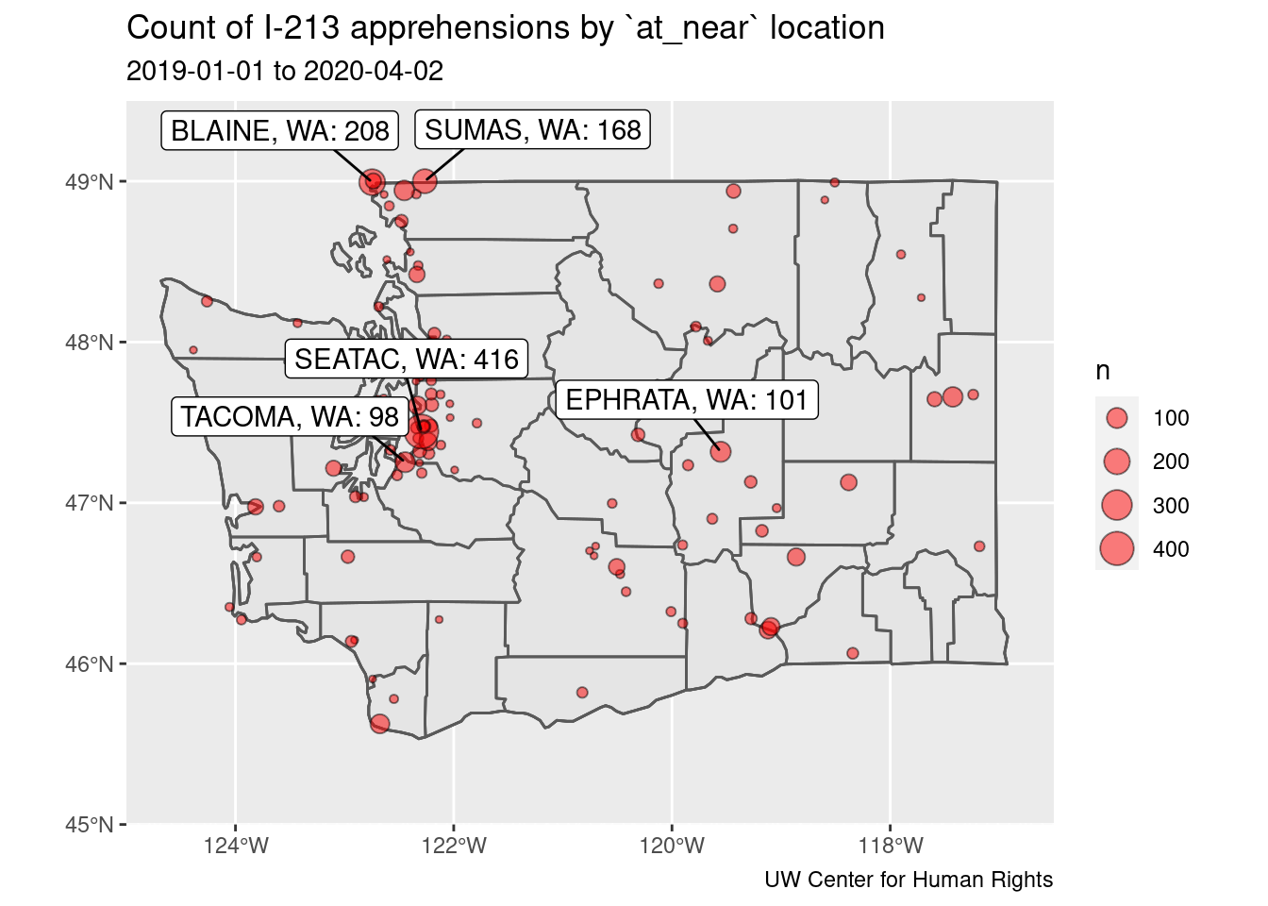

Slide 18
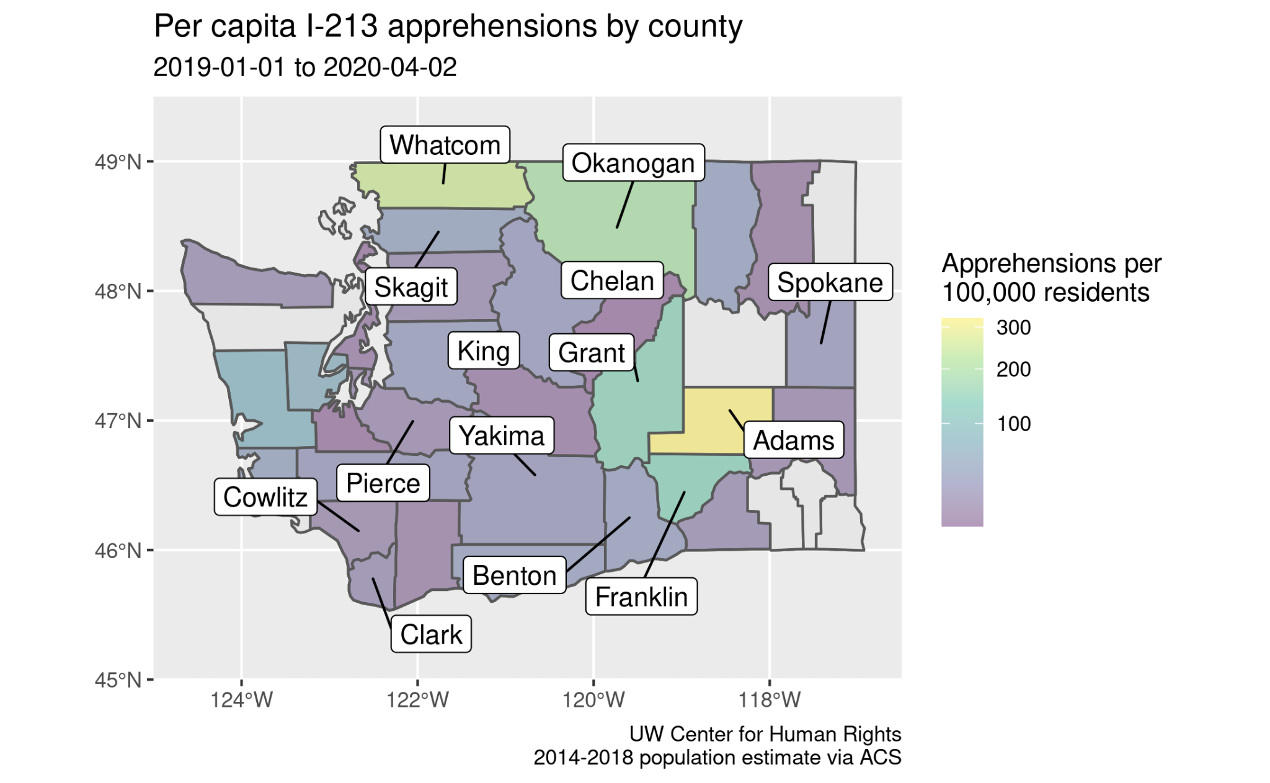

Slide 19
Detention/deportation pipeline in WA
Identification
Apprehension
Detention
Deportation
Jail records
DOL records
Court records
Local/federal databases
Surveillance
Local LEA collaboration
Ports of entry
Detainers, release notification at jails, DOC
Community arrests
Raids
Transportation checks
NWDC Tacoma
IGSAs with county jails
Cowlitz juvenile jail
Seatac Federal Detention Center
DHS hold rooms
Hotels
ICE Air transfers via local airports
Private flights
Federal prosecution

Slide 20
Pro-immigrant policies
Seattle (2003) and King County (2018) ordinances
Keep Washington Working Act (2019)
Courts Open to All Act (2020)
HB1090 [for-profit detention ban] (2021)

Slide 21
Keep Washington Working (2019)
State and local agencies may not:
Collect place of birth or citizenship status
Share release notification or non-publicly available info with federal immigration authorities in a noncriminal matter
Detain or hold for purpose of determining immigration status
Enter into immigration detention contracts
*DOC exception

Slide 22
Findings
Violations
Sharing and collecting prohibited information including place of birth, citizenship status; other non-public info
Jails accepting detainers, release notifications to ICE
Local police/sheriff involvement in civil immigration enforcement

Slide 23
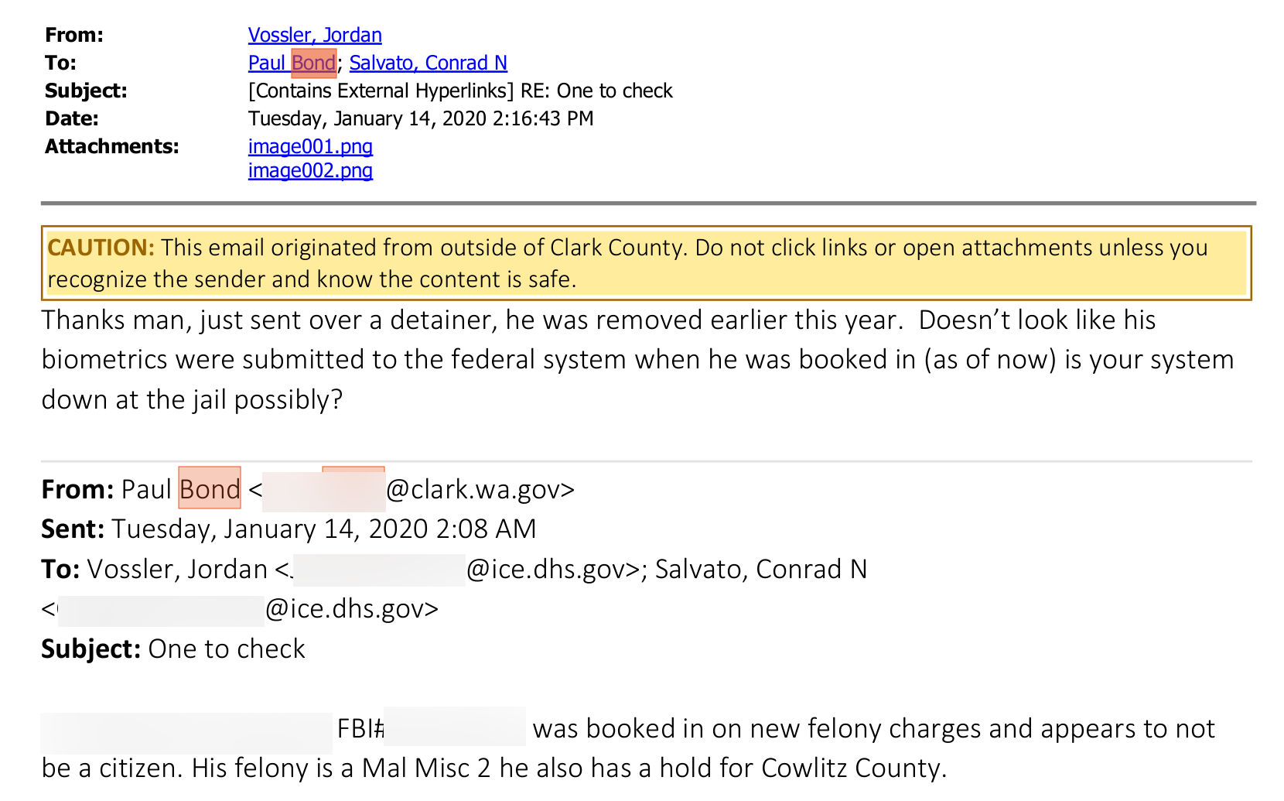

Slide 24
Restricting the Detention/deportation pipeline in WA
Identification
Apprehension
Detention
Deportation
Jail records
DOL records?
Court records?
Local/federal databases
Surveillance
Local LEA collaboration
Ports of entry
Detainers, release notification at jails, DOC
Community arrests
Courts
Raids
Transportation checks
NWDC Tacoma
IGSAs with county jails
Seatac Federal Detention Center
DHS hold rooms
ICE Air transfers
KBFI
KYKM
Commercial flights
Federal prosecution

Slide 25
More information
Learn more: humanrights.washington.edu
Reach out: philneff@uw.edu

