Slide 1
Reflective Teaching

Slide 2
Why do I use Reflective teaching?
To get continuous feedback and act upon the feedback.
To improve classroom engagement.
For better retention of key concepts.

Slide 3
How do I reflect?
Paper Feedback
  Two anonymous paper feedback forms during the quarter (Week 3, Week 6)
  Compile the responses and go over them.
  If many of the students are asking for a specific topic, prepare and present or poll the students.
Panopto Recordings Usage
  Look at which topic is being reviewed using video more often
Active learning strategies
  Paper problems
  Poll Everywhere software (linked to our Canvas)

Slide 4
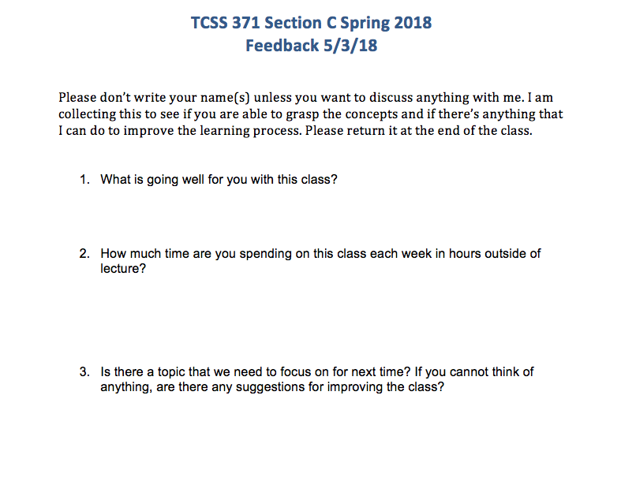

Slide 5
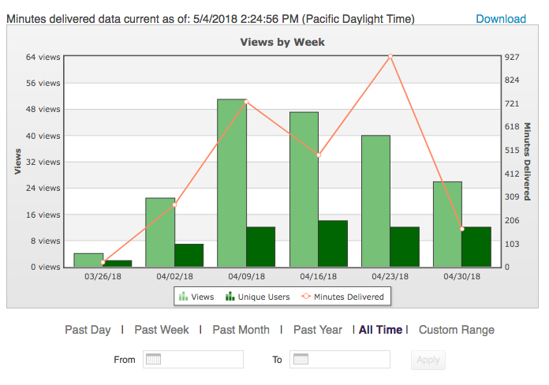

Slide 6
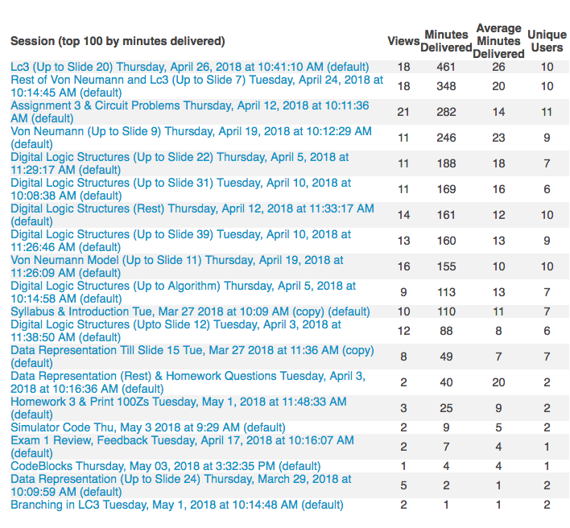

Slide 7
Demo Poll Everywhere

