Slide 1


#HOUR
OF
CODE
Faculty Organizer: Ravi Gandham
ravi.gandham@seattlecolleges.edu
Student Organizer: Tyler Dillon
t.dillon4884@gmail.com

Slide 2


What is Hour of Code?
Weekly coding/programming workshop
Open to all students
New demonstration each week
Multiple student leaders
Hundreds of students
Sponsored by Women in Stem Club (WinSTEM)

Slide 3
Mission
We want to bring coding to everyone on campus!
We want to show that its easy and accessible, and you don’t have to be a computer science major to do it!
We hope to get students excited about computer science and encourage them to continue learning outside of class, regardless of major.

Slide 4

Why Hour of Code?
“Everyone in society uses computers these days, but how many can say they know how they work?”
This year we’ve focused on web design.
Learn useful skills
Experience for student leaders
Grow campus culture

Slide 5


Some Flyers
New flyers every quarter!
Left: Fall ‘17
Right: Winter ‘18

Slide 6
Typical Session
1:00 - 1:10 | Intro and Introduction
1:10 - 1:30 | Instructional Slides
1:30 - 1:40 | Exercise
1:40 - 1:45 | Resource Showcase
1:45 - 2:00 | Code Assistance

Slide 7
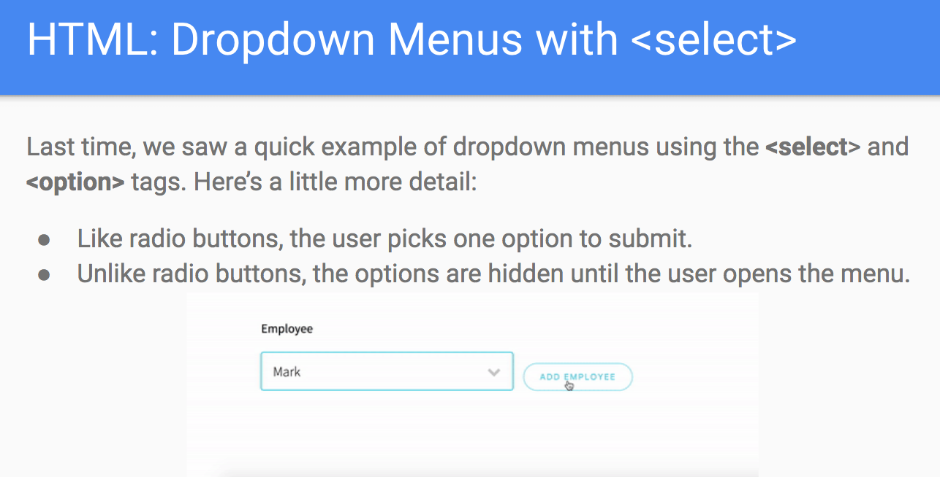
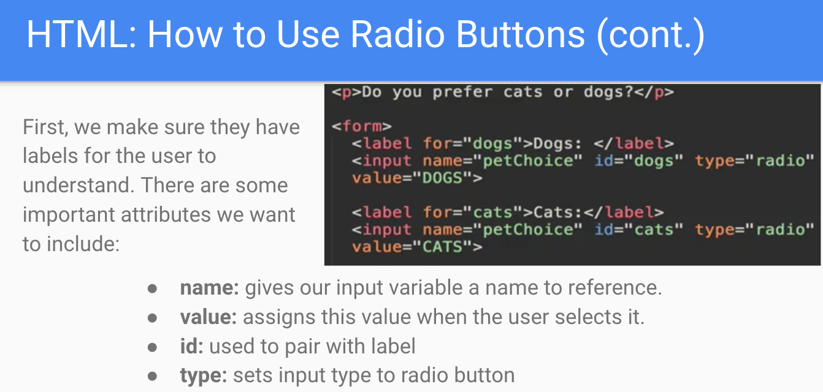
Instructional Slides
Slides use graphics to demonstrate and keep students engaged! All slides are saved in our Google Drive so they can be referenced later.

Slide 8
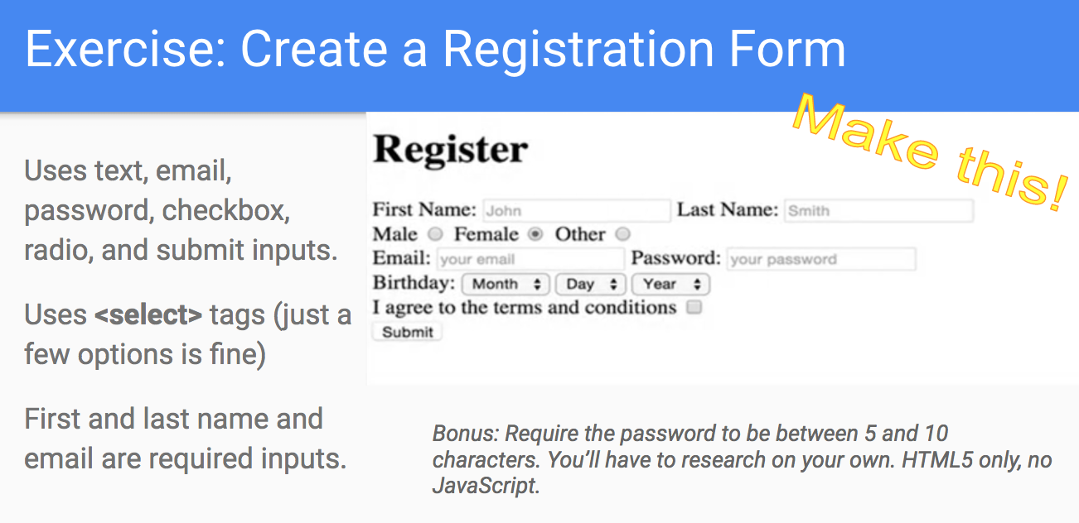
Exercises
Exercise Types:
Code-alongs
Recreations
Research
HTML/CSS Manipulation

Slide 9
Resource Showcases
We use this time to introduce and demonstrate useful resources for designers and developers!
Some of our previous Resource Showcases include:
Mozilla Developer Network
GitHub
Stack Overflow
Bootstrap
Codepen
Google Fonts
Google Chrome Inspector
Udacity

Slide 10

Code Assistance
This quarter, we have begun offering tutoring at the end of our sessions to help students with programming assignments from their classes.
Several students have come for help with code, and found they enjoyed the other aspects of Hour of Code.

Slide 11
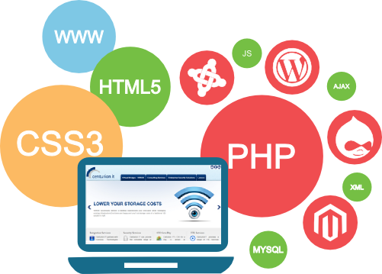
Benefits
New learning opportunity and outreach to encourage student interest in computer science, especially in underrepresented groups.
Increases interest in computer science
Excellent experience in teaching and leadership for student organizers.

Slide 12

Challenges
Finding accessible but interesting coding demonstrations
Creating material for a transient audience
Marketing and audience
Room issues
Finding student leader successors

Slide 13
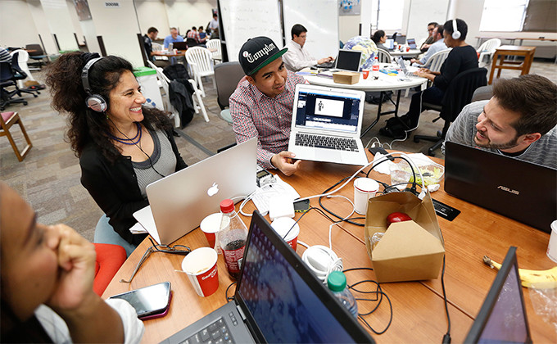


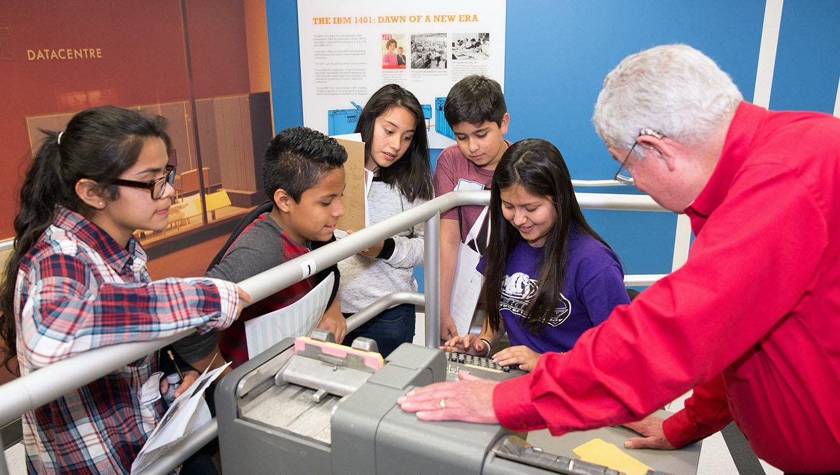
The Future of #HoC
HACK-A-THONS
DATA SCIENCE
CLOUD COMPUTING
FIELD TRIPS

Slide 14

Questions?

