Slide 1


Academic Planning Refresher and Brainstorming

Slide 2
Academic Planning Last Cycle
Focused on growth
Policy and process were created by Executive Council of the faculty assembly
Academic Planning and Curriculum Committee (APCC) prioritized and reviewed program proposals
Minors and Certificates were not part of the process

Slide 3
Current state of undergrad programs
New undergrad programs that were created last cycle
BA in Education BA in Economics and Policy Analysis BS in Civil Engineering BS in Mechanical Engineering
Undergrad program proposed but not yet on the books
BA in Arts

Slide 4
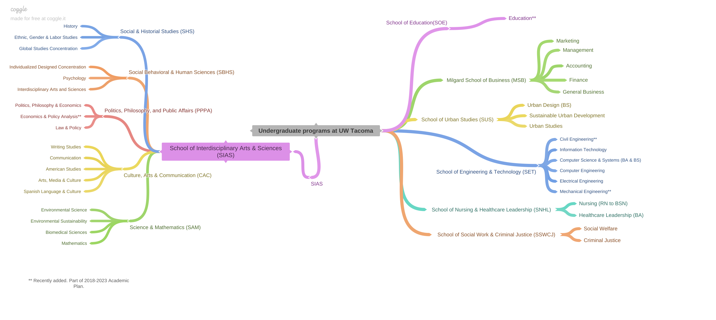
Notes:
https://coggle.it/diagram/Yult1uPT1iLZmouQ/t/undergraduate-programs-at-uw-tacoma/96373f03d1ead5b0766ac0e5b9b4640589492f1bd301a5f04c3bf7b09d875b98

Slide 5
Current state of grad programs
New Grad programs from last cycle MS in Electrical & Computer Engineering Ed.S in School Psychology Ph.d in Computer Science
Grad programs not yet on the books
MS in IT Doctor of Nursing Practice MS in Environmental Science

Slide 6
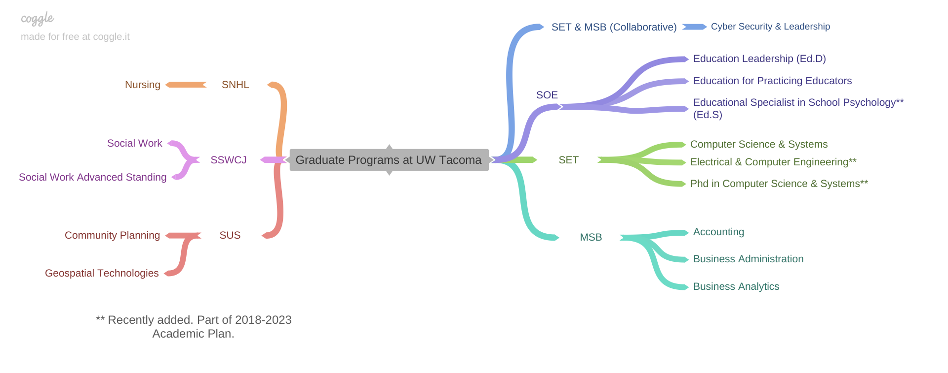
Notes:
https://coggle.it/diagram/YumF-bndxQl8_ZQI/t/graduate-programs-at-uw-tacoma/278c570e89813abc9328452d6a71a3521273d530f3eadbcd41b4ab3ca281ddf2

Slide 7
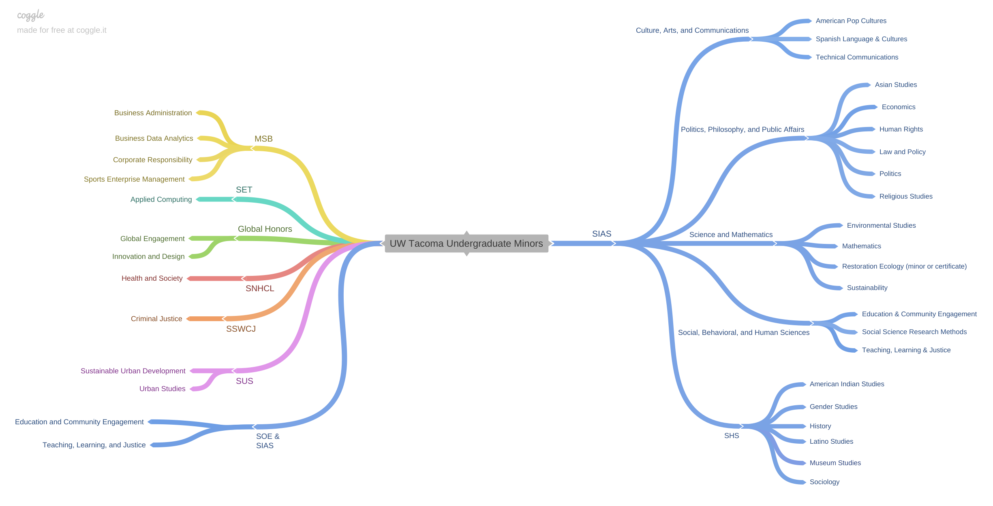
Notes:
https://coggle.it/diagram/YumF-bndxQl8_ZQI/t/graduate-programs-at-uw-tacoma/278c570e89813abc9328452d6a71a3521273d530f3eadbcd41b4ab3ca281ddf2

Slide 8
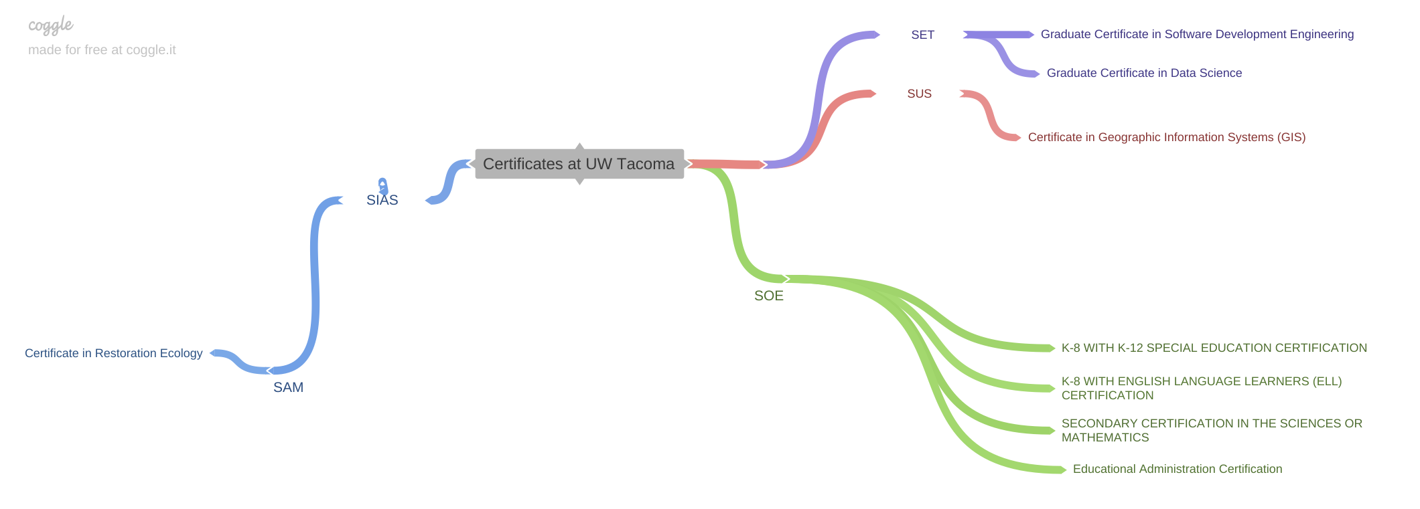
Notes:
https://coggle.it/diagram/YumF-bndxQl8_ZQI/t/graduate-programs-at-uw-tacoma/278c570e89813abc9328452d6a71a3521273d530f3eadbcd41b4ab3ca281ddf2

Slide 9

APCC Survey of last academic plan (n=13)
(n=13, Staff=3, NTT=3, Tenure Track=7)
Question: What worked well in the last cycle for your unit or program?
Positive: Not “customer oriented” and career building, campus messaging, programs and priorities, positive experience for the first-time implementation
Negative: Lack of transparency, lack of institutional support for some programs

Slide 10
Question: What are some of your concerns regarding this academic plan? Provide some constructive ways to address the concerns, if possible.
Disproportionate growth across schools
Rushed and did not engage all stakeholders
Budget decision making
Communication about deferrals from last review
Lack of tracking of proposals. Allowing for modifications. (Send back with changes?)
Unclear deadlines, process, and stakeholders
Lack of involvement of academic units
Slow movement from design to implementation
Locked into a plan without room for new proposals(2)
Use of word “empowerment” in the language
Lack of writing and communication in lower division
Talking about respect, acceptance, inclusivity (strategic priority 5) while there is no plan in place
Workload realities not addressed

Slide 11
Question: Do you have any suggested changes to the current academic planning policy and process? Cont..
Use field-tested industry metrics and models to engage in a program-prioritization process.
Include greater staff and student input, including in key decision-making processes.
Clarify if/when new degrees or majors can be added outside of the plan, and the process for doing so.
I think we learned a considerable amount during the first process cycle and have strengthened the process along the way. Plan for any changes once approved.
Perhaps a simplified checklist (based on a flowchart) for the Schools to maintain would be helpful. The Schools should be tracking their majors/degrees as to where they are in the process.

Slide 12
Question: Do you have any suggested changes to the current academic planning policy and process? Cont..
Role clarification of APCC, EVCAA, Council of Deans, EBC, etc.
Re-education or refresher on academic plan
APCC allowed a greater role. Is that fair?
Needs to be inclusive
Think sustainability instead of growth

Slide 13
Question: Do you have any suggested changes to the current academic planning policy and process? Cont..
Balancing faculty oversight with timeliness would seem helpful, especially given barriers to distance learning/instruction formats.
Provide funding for all the work that goes into building a new program.
Find ways of building in equity into the balance of research, teaching, and service faculty do; right now, the balance is not there, and what people are asked to do often proves untenable and not compensated well enough.
Involve more people, and let this process be driven and guided by those who are most vulnerable by the processes and procedures we currently have in place and are purporting to change through these policies and procedures.
Continue to premise learning, growth, and intellectual attainment.

Slide 14
Preliminary work this Summer
A small group of faculty worked on preparing these slides, brainstorming ideas, and putting together information.
Challenges ahead:
Previous plan focused on growth
New EVCAA started in September
Transition on campus
Budget situation
Strategic plan not in place

Slide 15
We need your input!
Brainstorm with the colleagues at your tables to figure out the direction we need to take for the next cycle. Use the paper and pens provided at each table

Slide 16
Which one of the following areas do you think that the academic plan should focus on given our budget deficit?
Assessing the performance of existing academic programs.
Enhancing the quality of existing academic programs
Growing enrollment
Adding new programs with clear indication of resource needs for launching each program.

Slide 17
Questions to brainstorm!
How does your school review program success? How would you measure success? Develop criteria to measure success.
Are there opportunities within your school to refresh or revamp some of the existing programs?
What information or data do you need/ want to know about your programs for program assessment?

