Slide 1


Welcome to
Faculty Assembly Fall Retreat
September 19th 2022 1 to 4 PM

Slide 2
Land acknowledgement
Before we begin our retreat of the UW Tacoma faculty assembly, let's take a moment to recognize that our university sits on the ancestral homelands of the Puyallup Tribe of Indians, whose ancestors have lived on and cared for this land for thousands of years. Please join me in expressing our deepest gratitude to the Puyallup and other coast salish people for their long-enduring and continued care for this region's land and waterways

Slide 3
Agenda
Introductions
Campus Updates or Announcements
Meet with EVCAA
Academic Plan Refresher
Academic Plan Collaborative Spaces
Faculty time with Chancellor
Faculty Assembly Priorities for 2022-23 & Wrap Up

Slide 4
Agenda
Introductions
Campus Updates or Announcements
Meet with EVCAA
Academic Plan Refresher
Academic Plan Collaborative Spaces
Faculty time with Chancellor
Faculty Assembly Priorities for 2022-23 & Wrap Up

Slide 5
Chair of Faculty Assembly
Menaka Abraham (Pronounced ME-NA-KA)
She/her pronouns
Loves to hike/run/read

Slide 6
Vice Chair of Faculty Assembly
Huatong Sun (pronounced hwa-tohng)
she/her pronouns
Loves to write, daydream, & go for a walk

Slide 7
Program administrator of Faculty Assembly
Andrew Seibert
he/him pronouns
Loves to bowl and play video games

Slide 8
Executive vice chancellor of Academic affairs (EVCAA)
Andrew Harris (goes by Andy)
He/him pronouns
Loves to hike and cook

Slide 9
Introduce yourself to your table mates
Name & How to pronounce
Pronouns
Loves to ??

Slide 10
Agenda
Introductions
Campus Updates or Announcements
Meet with EVCAA
Academic Plan Refresher
Academic Plan Collaborative Spaces
Faculty time with Chancellor
Faculty Assembly Priorities for 2022-23 & Wrap Up

Slide 11
Meet with Vice chancellor of the Center for Equity & Inclusion (CEI)
Dr. Elavie Ndura

Slide 12
Diversity & Inclusive Excellence:
A Transformative Nexus
Dr. Elavie Ndura, VCEI
Diversity, Access, Inclusion, and Equity are fundamental and inseparable pathways to Inclusive Excellence.

Slide 13
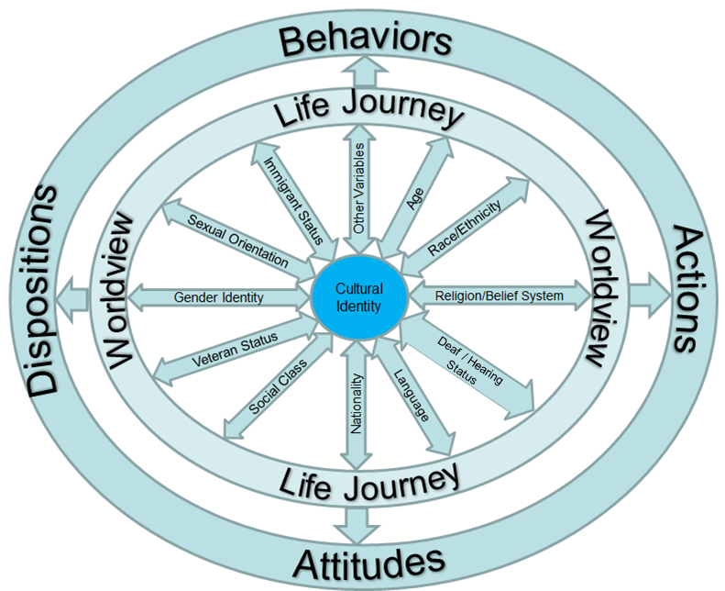
Foundation 1:
Socio-cultural identities shape our daily academic, professional & personal experiences and relationships
E. Ndura, 2017

Slide 14
Inclusive Excellence in Higher Education: Definition (draft)
The practice of centering diversity, equity, and inclusion in pedagogy, policies, and procedures to nurture barrier-free learning and working environments where all students and employees from all socio-cultural backgrounds feel empowered to bring their authentic best selves and to realize their academic and professional dreams (Ndura, 2022).

Slide 15
A safe and Welcoming community
Collaborative Leadership and Shared Accountability
Equitable Opportunities and Outcomes
Six Pillars of Inclusive Excellence
Inclusive
Excellence
Investing in the work: Organizational Resources
Strategic Partnerships
Intercultural Competency and Cultural Humility Development
Listen – Collaborate – Transform
Dr. Elavie Ndura, 2022

Slide 16
Faculty Are Central to Inclusive Excellence
Teaching & Learning: Heart of educational institutions & UWT
Faculty teach more than WHAT we know
We teach WHO we are
We transform student’s trajectory and inspire them to thrive, elevate their families and communities.
Invitation
Bring your authentic BEST Self to the classroom, UWT campus, Tacoma community
Join UWT quest for inclusive excellence
THANK YOU!

Slide 17
Student Affairs Updates
Mentha Hynes-Wilson
Vice Chancellor for Student Affairs

Slide 18
Student affairs updates
Admissions will launch a series of strategic enrollment sessions for faculty – all are welcome to attend;
Convocation will take place on the first day of class at 12:30 pm;
UWT will administer the Washington Basic Needs survey in October;
The Purple Folder, Sexual Assault resources; Virtual Basic Needs Hub, and other essential student support information can be found at Student Affairs | Student Affairs | University of Washington Tacoma (uw.edu).

Slide 19
Student Success
Dr. Bonnie Becker
Associate Vice Chancellor for Student Success

Slide 20

Faculty Assembly Retreat
September 16, 2022
Bonnie J Becker
Associate Vice Chancellor for Student Success

Slide 21


Slide 22






TACOMA COMPLETES STUDENT VOICES REPORT:
Why do students leave UW Tacoma?
Sense of Purpose and Belonging
Financial and Basic Needs
Family Care and Life Events
Mental Health
Physical Health
Classroom Experience
College Navigation
https://tinyurl.com/TacomaStudentVoices

Slide 23
WHY DO STUDENTS LEAVE UW TACOMA AND TACOMA COMMUNITY COLLEGE?
“I didn't really have any idea what I wanted to do. And I think that's kind of the reason why I didn't continue with school…I really just think that I didn't have much motivation to be there because I didn't see what I was actually gaining by being in school. It was just kind of doing what everybody had always told me to do, that I was supposed to be at school…So I left …”
“It just wasn't until I realized that I just really didn't want to continue going to school. It wasn't something I was passionate about at the time, so I withdrew again…”

Slide 24
OUR STUDENT SUCCESS FRAMEWORK
Sense of Purpose
Sense of Belonging

Slide 25
SENSE OF PURPOSE
An active commitment to goals that are both meaningful to the self and of consequence to the world beyond the self (Damon, 2008).
Purpose is “developed”, not “discovered” ready-made.
Purpose is “associated with academic and vocational success, motivation, resilience, and psychological and physical well-being throughout life.”
Colby 2020, J of Coll and Character

Slide 26


Slide 27
ACADEMIC SUCCESS PROGRAMS
ORGANIZATIONAL STRUCTURE
Executive Vice Chancellor for Academic Affairs
Dr. Andrew Harris
Associate Vice Chancellor for Student Success
Dr. Bonnie Becker
Office of Digital Learning
Dr. Darcy Janzen
Teaching and Learning Center
University Academic Advising
Dr. Lorraine Dinnel
Quantitative Skills
Dr. Dwayne Chambers
Writing
Dr. Rebecca Disrud

Slide 28
ACADEMIC SUCCESS PROGRAMS
AVCSS Ongoing Initiatives
Career-Connected Learning
Transfer Student Success
Support Campus Level Planning
  Academic Plan
Connection, Collaboration, and Data

Slide 29
CAREER-CONNECTED LEARNING
Urban Serving University Collaborative Opportunity Grant
  Partners: UWT Student Transitions and Success/Student Affairs, Faculty, TCC, SEED Internships, Graduate Tacoma
  Develop employment-ready students and student-ready employers
  Focus on health care (broadly)
AAC&U Career to Curriculum Institute
  Led by UWT Career Services/Student Affairs
  Partners: TCC, SEED Internships, Faculty

Slide 30
TRANSFER STUDENT SUCCESS
Aspen Institute Transfer Intensive
  Partners: UWT Enrollment Services/Student Affairs, Pierce College
  Barrier-free, equity-minded pathways that connect
Community College Research Institute Faculty STEM Transfer Intensive
  UWT Environmental Science with Pierce College
  UWT Engineering with Highline College

Slide 31
“ELEVATE” SERIES
Monthly events to elevate good work around student success and build community around what works
  Partner with us!
Celebration of Teaching—Teaching Professional Development
  October 21, 11AM-12PM

Slide 32
Academic Success Programs foster a sense of belonging and purpose in our students by providing direct academic support and collaborating with faculty, staff, students, and campus leadership to develop and strengthen academic success across campus.
Contact me:
bjbecker@uw.edu

Slide 33
Learn about student resources
Dr. Christine Stevens
Associate Professor
School of Nursing and Healthcare Leadership

Slide 34
Basic Need Resources for Faculty to share with Students
September 2022
The Pantry The Pantry | Center for Equity and Inclusion
Location: Dougan 104
The Pantry exists to provide supplemental, nutritional, and culturally relevant food as well as hygiene items to all UWT students. Anyone with a Husky ID may access the Pantry. The Pantry provides a variety of different food options, both perishable and non-perishable food items that accommodate different dietary needs such as gluten-free, vegan, vegetarian, halal, kosher, and lactose-free items. There is also a self-serve selection area that includes seasonings and baking products. Hygiene items are also available such as shampoos, conditioners, toothbrushes, toothpastes, baby diapers ranging from assorted sizes,
The Office of Student Advocacy and Support Student Advocacy & Support
Student Advocacy and Support - The Office of Student Advocacy and Support provides referral and support services to students. Social Workers assist students in developing strategies to overcome and address barriers that prevent them from achieving their educational and life goals. Students also receive assistance in navigating on and off campus resources.

Slide 35
Basic Need Resources for Faculty to share with Students
September 2022
EMERGENCY AID Emergency aid
We understand life can be unpredictable. Unexpected costs and needs can cause significant stress and impact your academic success and personal wellbeing. Emergency Aid assists students who are experiencing unexpected financial hardships that may disrupt their education or prevent them from earning their UW degree, including:
· Emergency medical/dental costs
· Housing and living expenses
· Family emergencies
· Natural disasters
· Loss of income
· And more…

Slide 36
Basic Need Resources for Faculty to share with Students
September 2022
Center for Equity & Inclusion Center for Equity and Inclusion
Located: Snoqualmie 150
First Generation Initiative First Generation Initiatives
Through our programs and services we seek to support first-generation students to successfully transition into college life and provide opportunities for the academic and personal success of all our first-gen students on campus.
Psychological & Wellness Services (PAWS) Psychological & Wellness Services
Psychological & Wellness Services (PAWS) provides confidential mental health counseling and related services for currently enrolled UW Tacoma students at no additional costs. We also provide consultation to faculty, staff, and university student families.
We provide intentional, problem-focused mental health counseling, aimed at building better skills and exploring alternative ways of coping. Psychological & Wellness Services provides confidential crisis, individual, and group counseling; educational workshops and classroom presentations; consultation for students, faculty, staff, and student families; and referrals (when appropriate) to community mental health and social service providers and other UWT student services and resources.

Slide 37
Agenda
Introductions
Campus Updates or Announcements
Meet with EVCAA
Academic Plan Refresher
Academic Plan Collaborative Spaces
Faculty time with Chancellor
Faculty Assembly Priorities for 2022-23 & Wrap Up

Slide 38
Meet with our new EVCAA (Exec. Vice chancellor for academic affairs)
Dr. Andrew Harris

Slide 39
Agenda
Introductions
Campus Updates or Announcements
Meet with EVCAA
Academic Plan Refresher
Academic Plan Collaborative Spaces
Faculty time with Chancellor
Faculty Assembly Priorities for 2022-23 & Wrap Up

Slide 40
Agenda
Introductions
Campus Updates or Announcements
Meet with EVCAA
Academic Plan Refresher
Academic Plan Collaborative Spaces
Faculty time with Chancellor
Faculty Assembly Priorities for 2022-23 & Wrap Up

Slide 41
Agenda
Introductions
Campus Updates or Announcements
Meet with EVCAA
Academic Plan Refresher
Academic Plan Collaborative Spaces
Faculty time with Chancellor
Faculty Assembly Priorities for 2022-23 & Wrap Up

Slide 42
Faculty time with chancellor
Dr. Sheila E Lange

Slide 43
Agenda
Introductions
Campus Updates or Announcements
Meet with EVCAA
Academic Plan Refresher
Academic Plan Collaborative Spaces
Faculty time with Chancellor
Faculty Assembly Priorities for 2022-23 & Wrap Up

Slide 44
FA Priorities for 2022-23
Covid funds
Academic Plan
Priorities from EC

