Slide 1
12:50 Pre-Meeting Snacks & Social
1:00 Land Acknowledgement & Welcome
1:10 Campus Updates
Dr. Andrew Harris, EVCAA
Dr. Sheila Edwards Lange, Chancellor
Campus Safety
Student Success
Mentoring
1:55 Faculty Assembly Bylaws Revision
APT Project Refresher
Q&A with EVCAA & Academic HR
Faculty Discussion
Report out
Faculty Assembly
Fall Retreat
september 29
1-3 pm

Slide 2
Land acknowledgement
Before we begin our retreat of the UW Tacoma faculty assembly, let's take a moment to recognize that our university sits on the ancestral homelands of the Puyallup Tribe of Indians, whose ancestors have lived on and cared for this land for thousands of years. Please join me in expressing our deepest gratitude to the Puyallup and other coast Salish people for their long-enduring and continued care for this region's land and waterways.
Land Acknowledgement

Slide 3
Welcome and Introductions
Andrew Seibert
Program Coordinator, Faculty Assembly
Anne Taufen, Ph.D.
Vice Chair, Faculty Assembly 2023-2024
Professor, School of Urban Studies
Huatong Sun, Ph.D.
Chair, Faculty Assembly 2023-2024
Professor, School of Interdisciplinary Arts & Sciences

Slide 4
Inform & Engage
Community Building
Faculty Advocacy
Well-being & Resilience
Chair’s Message

Slide 6
Campus Updates

Slide 7
EVCAA Updates
Andrew T. Harris, Ph.D. Executive Vice Chancellor for Academic Affairs

Slide 8
Chancellor Updates
Sheila Edwards Lange, Ph.D. Chancellor

Slide 9
Campus Safety Updates
Susan B. Wagshul-Golden
Director, Emergency Preparedness & Campus Safety
Sylvia James
Vice Chancellor for Finance and Administration
Safety and Security Administrator
Campus Safety page https://www.tacoma.uw.edu/fa/safety

Slide 10
Student Success
Bonnie J. Becker, Ph.D.
Associate Vice Chancellor for Student Success
Amanda Figueroa
Senior Director, Student Transitions & Success

Slide 11
STUDENT SUCCESS TEAM 2022-23
Name | Affiliation
Andy Harris | Academic Affairs / Co-Executive Sponsor
Mentha Hynes-Wilson | Student Affairs / Co-Executive Sponsor
Bonnie Becker | Academic Success Programs / Co-Chair
Amanda Figueroa | Student Transitions & Success / Co-Chair
Andrew Chamberlain | Institutional Research
Donald Chinn | School of Engineering and Technology
Lorraine Dinnel | University Academic Advising
Stan Emert | Milgard School of Business
Natalie Eschenbaum | School of Interdisciplinary Arts & Sciences
Johnica Hopkins | School of Nursing & Healthcare Leadership
Kira King | School of Engineering and Technology
Joe Lawless | Chancellor's Office
Nedralani Logotala | Equity & Inclusion
Tina Peterman | ACE (American Council on Education) Fellow
Deirdre Raynor | Undergraduate Education
David Ross | School of Social Work and Criminal Justice
Stephen Ross | School of Interdisciplinary Arts & Sciences
Ashley Walker | School of Education
Key Outcomes
Assembled a cross-unit, cross-disciplinary team and met seven times to create a collaborative student success strategy.
Developed and assessed a Student Success Asset Inventory.
Identified five urgent actions and developed a structure to drive collaborative work in the 2023-24 academic year.
Notes:
Bonnie
Ask members to stand and be recognized.
Can we create a QR code to the report?

Slide 12
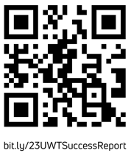
STUDENT SUCCESS STRATEGY 2023-24
Link to report
Notes:
Bonnie
Briefly describe each?

Slide 13
2023-24 STUDENT SUCCESS STEERING COMMITTEE/CO-CHAIRS
First Year Experience
Deirdre Raynor
Office of Undergraduate Education
Joyce Dinglasan-Panlilio
SIAS – Science and Math
Stephon Harris
Undergrad orientation programs
Graduate Student Experience
Anaid Yerena
Urban Studies
Ashley Walker
Education
Conor Leary
Student Life
Removing Curricular Barriers
David Ross
Social Work & Criminal Justice
Natalie Eschenbaum
SIAS
High Impact Practices
Annie Downey
Library
Dawn Williams
Career Development
Emma Rose
SIAS – Culture, Arts & Communication
Common Student Data System
Andrea Coker Anderson
Registrar
BethAnn Hoover
SIAS – Academic Services
Notes:
Amanda
Ask to stand and be recognized.
Briefly mention the orientation.

Slide 14
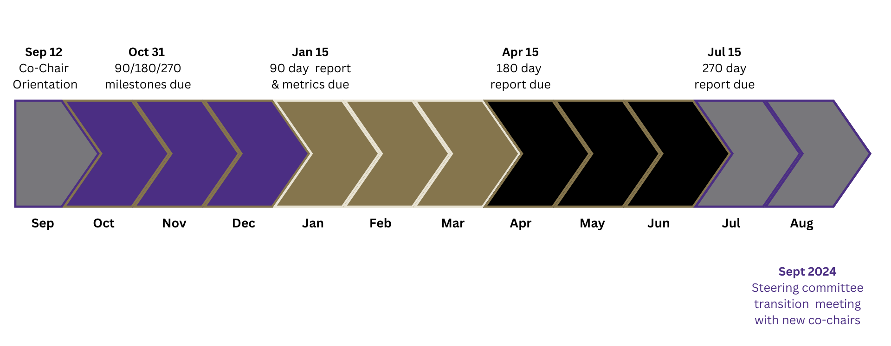
2023-24 STUDENT SUCCESS STEERING COMMITTEE TIMELINE
Notes:
Amanda
Snapshot of action-orientation continuous improvement with fast learning and change
Briefly describe how we’re going to assemble the teams.
Talk about how there will be multiple ways to engage, not just serving on the committees.

Slide 15
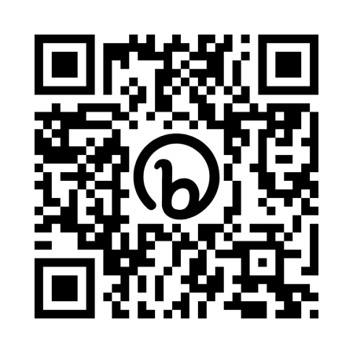
HOW TO PARTNER WITH FACULTY AND SHARED GOVERNANCE?
Link to give anonymous feedback
How can the 2023-24 Student Success Steering Committee partner with faculty governance with intentionality and authenticity?
https://bit.ly/46Lo0gj?r=qr

Slide 16
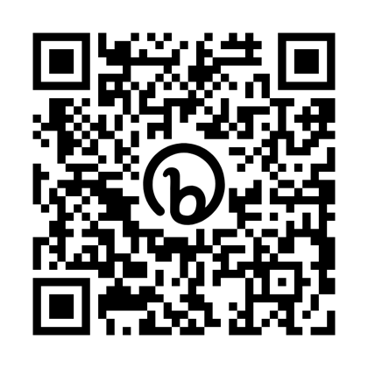
SAVE THE DATE! Student Success Strategy Kick Off
Link to self-nominate
Data snapshot
First Gen Student Experience: NASPA Center for First Generation Success
Transfer Student Experience: Aspen Institute
Introduce the Strategy and ask for committee nominations
bit.ly/2023-UWT-SSengage
October 5, 12:30 to 2, BHS 106
Notes:
Bonnie
To learn more, go here! (Have a QR code to self-nominate!

Slide 17
Multi-Level Mentoring Program
Anaid Yerena, Ph.D.
Associate Professor, School of Urban Studies
Founding Faculty, Social Justice Research & Scholarship Initiative (SJRSI)

Slide 18
UWT Multi-level Faculty Mentoring Program
Overview
Funded and supported by the Executive Vice Chancellor for Academic Affairs

Slide 19
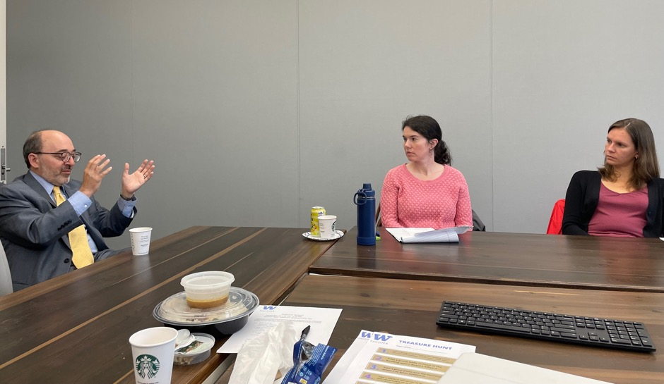
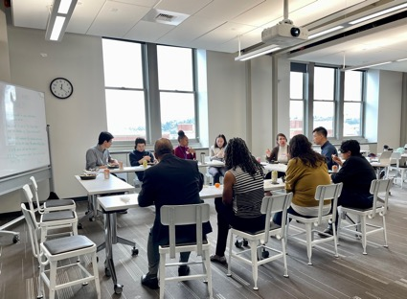
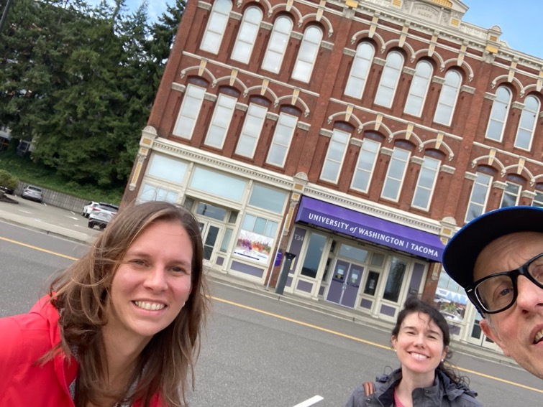
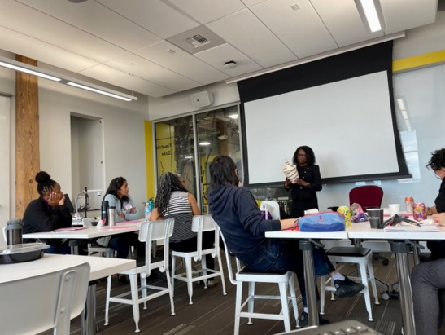
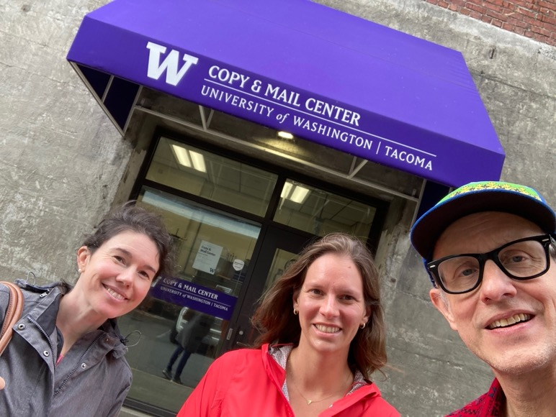
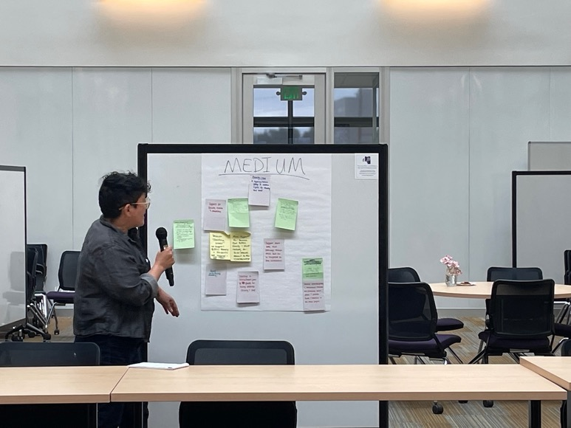
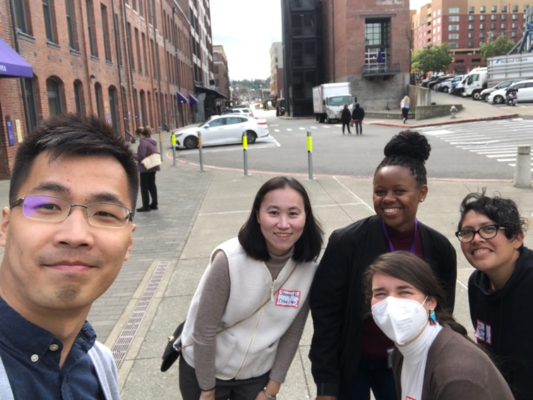

Slide 20
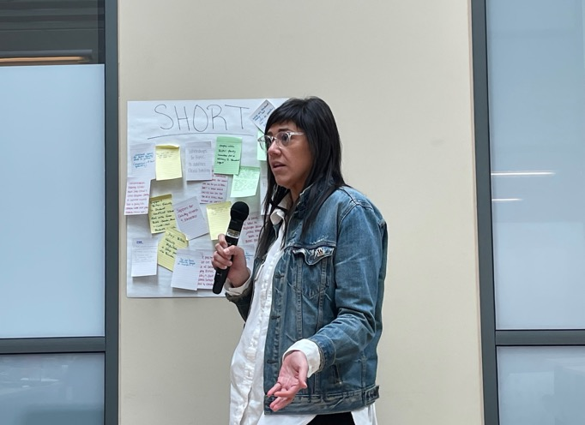
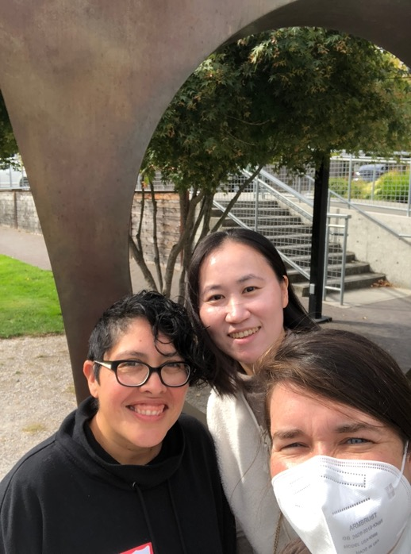
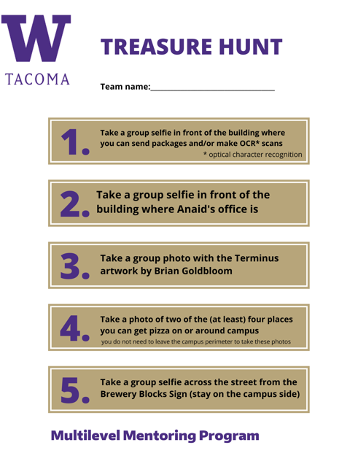
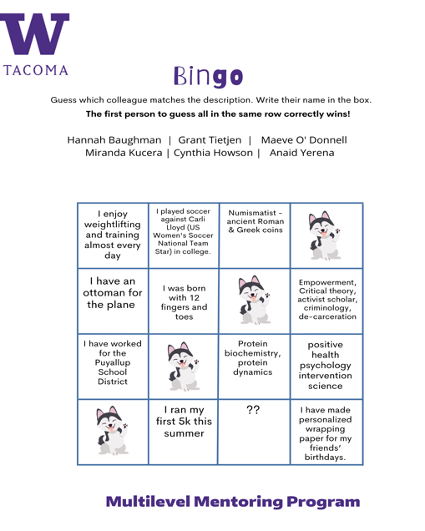
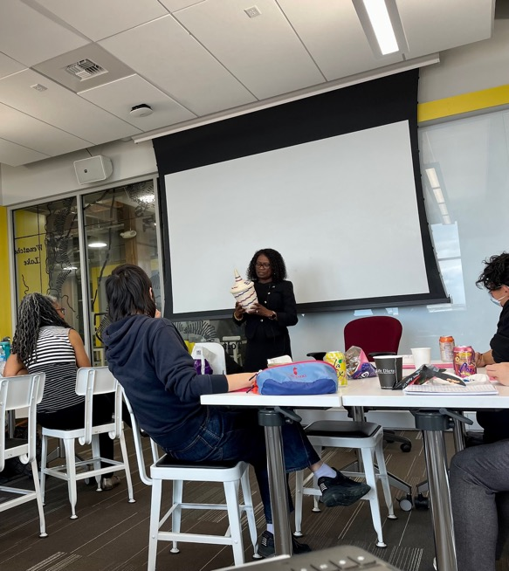
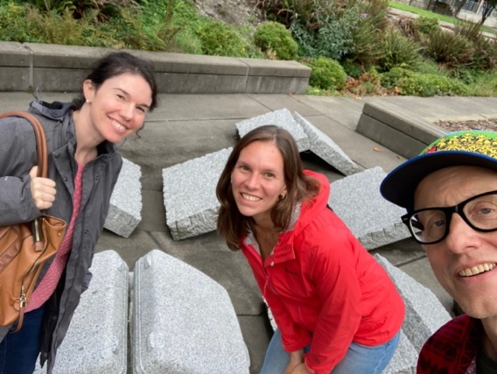

Slide 21
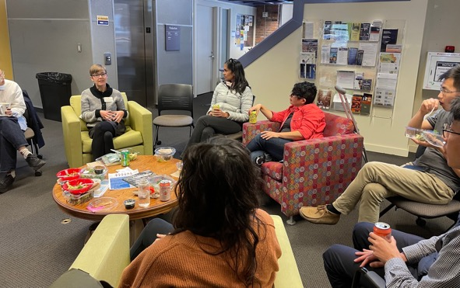
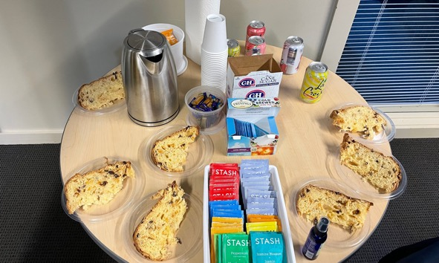
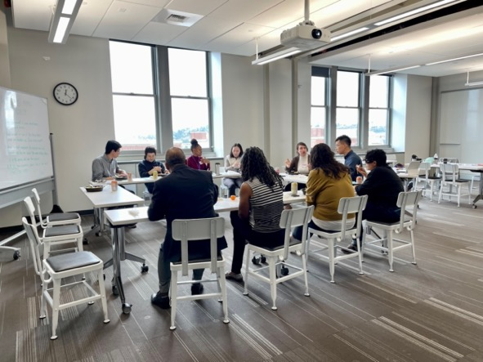
What stood out to YR1* participants
Provides support for new faculty
Is a safe space to build meaningful relationships
Centers BIPOC* faculty identity and belonging
Normalizes the experience of being new to academia
Promotes community building through intentional interactions (e.g., sharing meals, informal conversations w leaders, one-on-one check-ins, consultations)

Slide 22
International faculty welcome lunch: Oct. 13
New faculty orientation (Part 2): Oct. 13
Listening session with EVCAA: TBA
Distinguished faculty award ceremony: November
Community building
Events

Slide 23
FA Bylaws revision
APT
Discussion

