Slide 1
UWT Faculty Assembly Bylaws Revision: APT's charge & function

Slide 2
APT’s Charge: UWT Faculty Assembly Bylaws
“Faculty Committee on Appointment, Promotion and Tenure
1. Charge - The Faculty Committee on Appointment, Promotion and Tenure shall advise the Chief Academic Officer on cases involving promotion and tenure of the faculty in accordance with Sections 24-54.C and 25-41.B of the University of Washington Faculty Code. The Committee coordinates discussion of appointment, promotion, and tenure procedures and expectations across academic units and with administration. It shall also be the responsibility of the Faculty Committee on Appointment, Promotion and Tenure to review and, if necessary, propose changes to policies and procedures related to campus-level implementation of University appointment, promotion, and tenure policy in accordance with Section 13-23.A.5 and 13-31.A.4 and A.5 of the University of Washington Policy Directory. Proposed changes shall be referred to the Executive Council, which shall determine whether to refer the proposed changes to the Faculty Assembly for approval or may adopt them as provided in Article V, Section 1, Part C of these bylaws. “ (p. 8)

Slide 3
APT's Role in the Process
APT committee is a confidential committee in which they work on cases forwarded for either appointment, promotion, or tenure.
The committee recommends an action in which the Executive Vice Chancellor for Academic Affairs will also recommend an action for the UW Provost. Ultimately it is the decision of the Provost.
Tacoma campus is considered as a college unit in the UW system, but we don't function in the same way as a college of a Seattle campus does, lacking interactions and synergy between units.
Provost Office annually reviews a few hundreds of P&T files. APT decision could be a more important voice in a multiple-level review process.
APT reviews, but doesn't advise: UW faculty code advisor suggests that APT should not provide normative guidance on how to prepare faculty's P&T files.

Slide 4
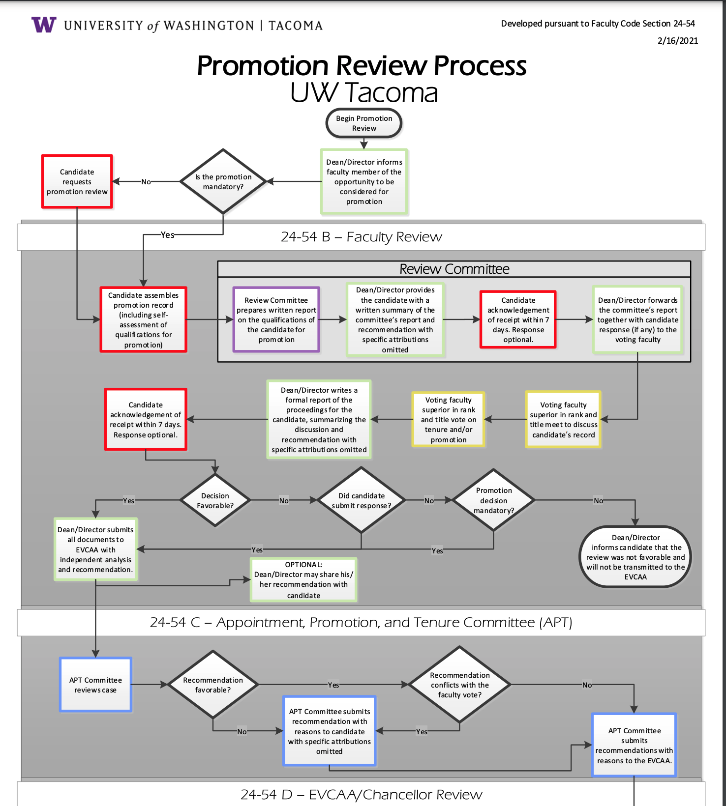
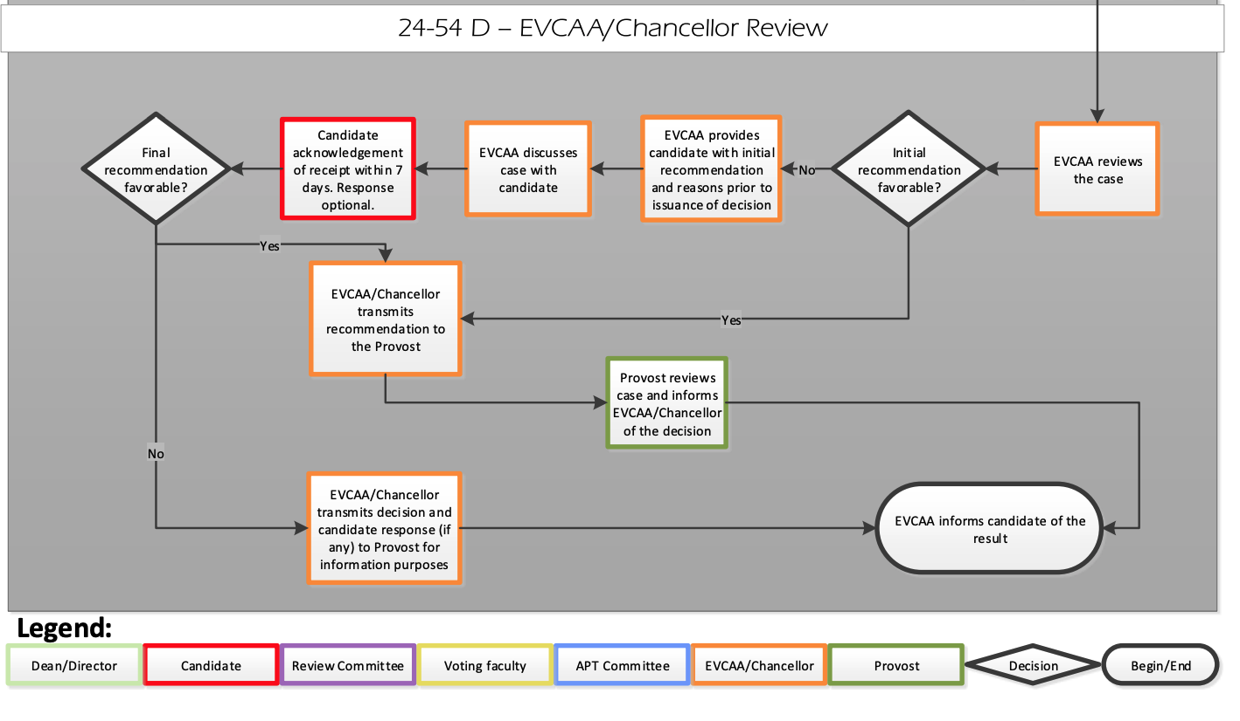

Slide 5
Goals
Broad question: How can the UWT shared governance support your career advancement?
Short-term question: How should we revise the UWT FA Bylaws concerning APT’s roles and charge to achieve the big goal above?

Slide 6
Agency & advocacy

Slide 7
Project History

Slide 8
Timeline
May 2019: Updated guidelines for the P&T process proposed by the APT were voted & approved by EC
2020: Initiatives proposed by Lecturer Affairs Committee to revise policies and processes surrounding the promotion of faculty on the teaching professor track
May 2021: APT committee gave a presentation titled "APT’s future" at the Faculty Assembly Spring Meeting
June 2021: FA leadership hosted a campus town hall meeting with Provost Richards and Vice Provost Cameron on issues related to tenure and promotion.
Notes:
Updated Guidelines from APT -APT Chair, Eugene Sivadas, presented updated process guidelines for the P&T process at the 5.6.19 EC meeting -The Updated Guidelines from APT were voted on and approved by EC on 5.6.19.
Meeting minutes: APT presented proposed changes to promotion and tenure guidelines from their committee.
Motion to approve Updated Guidelines from APT
20 yes, 0 abstain, 0 no
APT’s Future? Concerns, questions, opportunities for the UWT faculty

Slide 9
Timeline (cont.)
October 26, 2021: FA invited the Secretary of Faculty, Mike Townsend, to speak about APT and P&T process from the UW faculty code perspective.
2021-2022: EC appointed the APT Task Force in Autumn, which delivered a recommendation report to the EC in March. Based on the report, ad-hoc EC committee drafted bylaws revisions.
September 2022: Four UWT Bylaws amendments were voted by faculty, and three of which passed. However, the first amendment conflicts with the UW Faculty Code, and the vote results were revoked.
Notes:
Randy Nichols, Ellen Moore, and Anne Taufen drafted language to propose bylaw revisions,

Slide 10
ISSUES Raised
Has due process been followed
Have decisions been justified
Were published criteria consistently applied
Who is eligible to vote on which cases
Who is eligible to serve on APT committees

Slide 11
Faculty’s concerns
Procedural review or substantial review?
Does faculty have a chance to respond to APT’s review in the process?
How is the urban-serving campus mission reflected in the APT review process?
How to assess faculty’s work on DEIAJ (Diversity, Equity, Inclusion, Accessibility & Justice) and Community-engagement?
How to implement and enforce procedural justice to address implicit systemic biases?

Slide 12
 | Full Rank (%) | Assistant Rank (%)
White males | 53 | 34
White females | 27 | 39
Asian/Pacific Islander males | 8 | 7
Asian/Pacific Islander females | 3 | 7
Black males | 2 | 3
Black females | 2 | 5
Hispanic males | 2 | 3
Hispanic females | <1 | 3
American Indian/Alaska Native individuals | <1 | <1
Two or more races | <1 | <1
Females Total | <33 | <56
Racial/ethnic and sex distribution of tenure-track faculty by academic rank in fall 2018
(Source: National Center for Education Statistics)
Notes:
https://nces.ed.gov/fastfacts/display.asp?id=61
(Link accessed: July 2022)

Slide 13
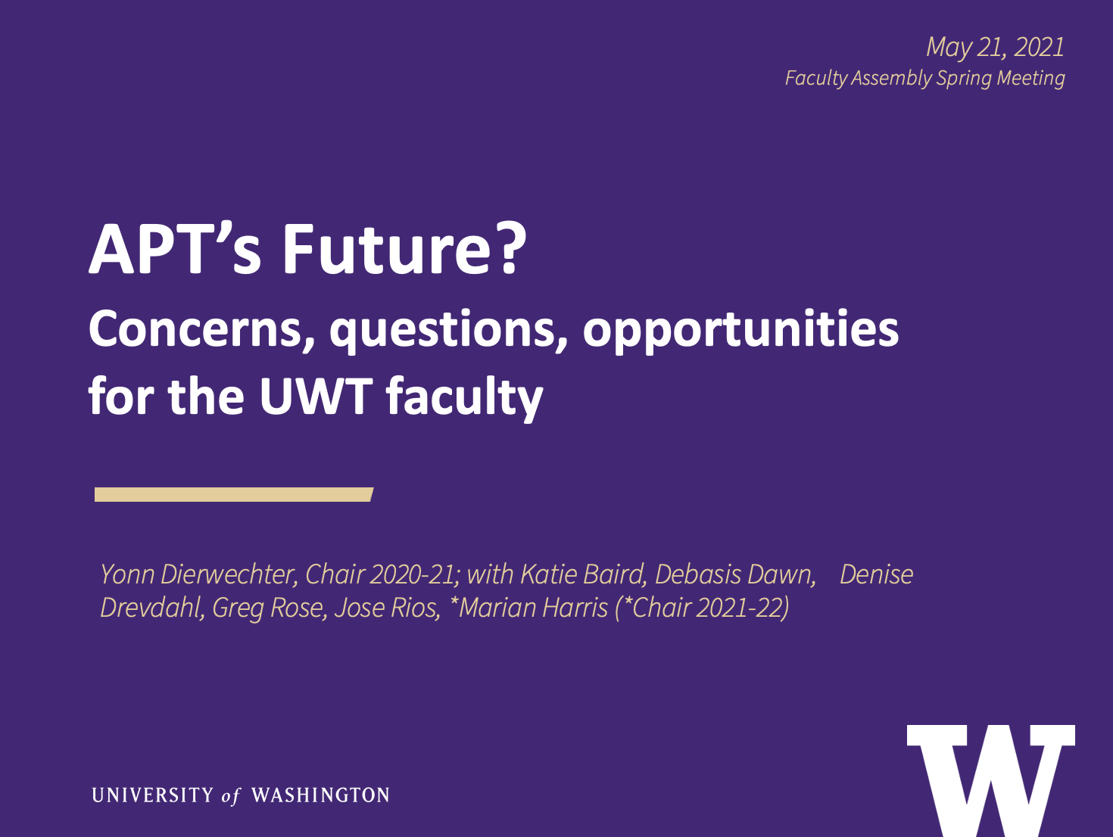
Challenges APT have been facing

Slide 14
FA's Goals After consultation with APT co-chairs
We aim to complete the FA bylaws revisions this year:
Carrying forward code-compliable objectives endorsed by 2022's faculty vote
Reviewing proposed changes for legality and compliance, before EC and faculty votes
Identifying areas of university-wide procedural concern to be addressed compliant to Faculty Code
Providing guidance on language for unit-level P&T criteria that protect and support DEIAJ work in teaching and research, based in evidence-driven best practices

Slide 15
Time Wasted?
Thanks for all the hard work people have put into this project!
What is doable within the current UW Faculty Code System.
We developed a deeper understanding of campus priorities as the campus continues growing
We as faculty understood the workload and challenges of each other is facing

Slide 16
Tentative Timetable
Autumn 2023:
Forming APT taskforce
Workload incentives provided. Please consider applying!
Winter 2024:
Taskforce delivers a recommendation report
Bylaws revision vote on EC level
Spring 2024:
Faculty vote

Slide 17
Q &A with EVCAA & Academic HR 15 min

Slide 18
Faculty's voices! Roundtable Discussion 20 min
What resources and structure do you hope the shared governance to assemble and implement to support and sustain your career development at UWT?
What do you expect Faculty Assembly support your career advancement and advocate for you in this process?

Slide 19
Faculty's voices! Report Out 10 min
What resources and structure do you hope the shared governance to assemble and implement to support and sustain your career development at UWT?
What do you expect Faculty Assembly support your career advancement and advocate for you in this process?

