Slide 1

Education Specialist (EdS) in School Psychology|School of Education
Information Session | 2024

Slide 2
Land Acknowledgement
School of Education at UW Tacoma Land Acknowledgement
The School of Education community here at UW Tacoma acknowledges that we learn, live, reflect, and teach on the ancestral lands of the Coast Salish people. As our campus is specifically situated on the traditional homeland of the Puyallup Tribe of Indians, we will make intentional efforts to create inclusive and respectful partnerships that honor Indigenous cultures, histories, identities, and sociopolitical realities.
We in the School of Education also have a moral responsibility to fully acknowledge our Indigenous connections, as well as critically reflect on the histories of dispossession and forced removal that have allowed for the growth and survival of this institution.
Let us continue to advocate for and partner with our Indigenous neighbors as we continue our lifelong work together as a dynamic and inclusive community of educators, leaders, and learners.

Slide 3

Introductions
What is your name?
What interests you about the School Psychology Program?

Slide 4
The EdS Program
Educational Specialist (EdS) Degree in School Psychology
Career as a School Psychologist
Not a Master’s degree
Earn your Educational Staff Associate (ESA) Certification
Full-time, 3-year program (part-time option available)
  Includes 2 years of course work
  Practicum
  One year of school-based internship

Slide 5
The EdS Program (cont.)
EdS Core Values: Anti-racism, culturally relevant practice, and equity
Multi-tiered systems of prevention and intervention
Prepares school psychologists for an expanded, contemporary role, which directly connects to our core values
  (equity-centered SEL, systemic change, reflective practices, empowering students/families, mutually beneficial partnerships)
Program built from current NASP Standards (March 2020)
Empowering youth, families, educators, and school communities

Slide 6
School Psychologists in High Demand
One of the top 20 Best Social Service Jobs
National Median Salary approx. $78,200
Long-standing shortage of school psychologists, specifically over the last decade
Employment growth rate of 14.7% between now and 2028
School Psychologists are needed as soon as possible

Slide 7
Program Framework (Courses)
QUARTER | YEAR ONE | YEAR TWO | YEAR THREE
AUTUMN | Foundations + assessment coursework | Advanced coursework + Practicum | Internship + Reflective Seminar
WINTER
SPRING
SUMMER |  | No Classes
Plan to take 4 courses per quarter for the first 2 years (with the exception of summer). Year 3 of the program is internship/seminar, only (1 course per quarter; beginning in autumn).

Slide 8
Program Framework (Courses cont.)
Designed for students who are working part-time
Most courses are offered in the evenings, 4:30-7:00pm.
Students are in classes four days a week.
Includes majority in-person, with hybrid and online course options sprinkled in, infrequently.

Slide 9
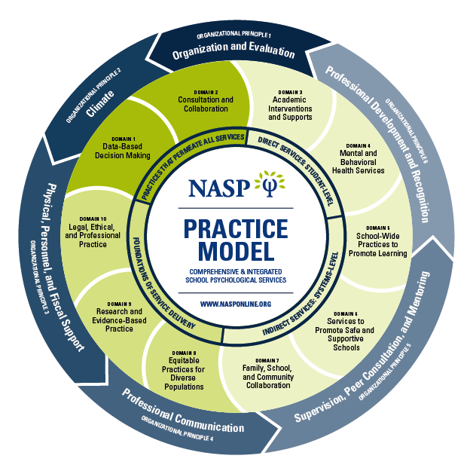
Major Degree Requirements
Capstone Portfolio: includes case studies and demonstrates integration of all practice domains in school psychology as determined by the National Association of School Psychologists (NASP).
Praxis Exam in School Psychology
Internship: During year three in the program, students complete a one year, full-time, school-based internship

Slide 10
Program Outcomes
Upon successful completion of the required coursework, practicum, and internship, portfolio defense, and a passing score on the Praxis examination, candidates will receive an Educational Specialist Degree and a recommendation for Washington state certification in school psychology.

Slide 11
Admission Requirements
(Priority deadline is Jan 17, 2025 for AUT 2025 admissions)
UW Graduate School Application
Bachelor’s Degree (in any discipline)
  From a regionally accredited institution
3.0 Grade Point Average
  Student must have at least a 3.0 grade-point-average on a 4 point scale for those credits earned at the institution awarding the bachelor’s degree OR at least a 3.0 grade-point-average (on a 4 point scale) for the last 90 graded quarter credits or 60 graded semester credits.
Unofficial Transcripts
  Unofficial transcripts from every college or university you have attended must be uploaded into the online application
2 Letters of Recommendation
  Please seek recommendations from those who can offer a recent and objective assessment of your knowledge, skills, and behaviors
  Recommenders may complete our reference form instead of a letter. See website for details.
Professional Goal Statement
Current/Up-to-Date Resume
Writing Sample

Slide 12
Tuition (as of Autumn 2024)
Credits | Resident | Non-resident
7-18 credits** | $6,599 | $11,441
6 credits | $5,688 | $9,839
5 credits | $4,777 | $8,327
4 credits | $3,866 | $6,635
3 credits | $2,955 | $5,033
2 credits | $2,044 | $3,431
Year 1 – Students register for 6-13 credits, per quarter
Year 2 – Students register for a maximum of 14 credits, per quarter
Year 3 (Internship) – Students register for one course (internship & reflexive seminar), 5 credits, per quarter

Slide 13
Financial Aid & Scholarships
UW Tacoma Financial Aid Office - https://www.tacoma.uw.edu/finaid
  FAFSA
  Summer Aid
  UW Tacoma scholarships by degree and school
  Emergency Aid
2. UW Seattle Graduate School - https://grad.uw.edu/graduate-student-funding/fellowships/
3. UW Tacoma School of Education - https://www.tacoma.uw.edu/soe/scholarships-funding
4. Project EXPAND Grant
There may be more opportunities found through School Psychology Organizations like NASP – www.nasponline.org

Slide 14
Project EXPAND Grant
Expanding the Roles of School Psychologists as Equity-Centered Leaders in Mental Health. U.S. Department of Education Mental Health Service Professional Grant Program, a $4,778,992 5-year grant project, beginning January 1, 2025.
Key financial supports for participating graduate students:
Tuition stipends for successful completion of coursework (roughly $18,000, per student, across the three years of the program)
Financial support for course fees, exam fee, transportation costs, and childcare expenses during practicum
Financial support for Ed.S. student led activities, outreach, retention and building community across cohorts
Four graduate student assistantships for Ed.S. students to support teaching, research and school psychology related activities
Financial support for state and national professional organization memberships and for attending and presenting at state and national conferences
*Funds are contingent upon the following conditions:
Students receiving funds must agree to work in a high-needs district for the time commensurate with funds received.
Students must successfully complete field, coursework, and program requirements.

Slide 15
Questions
Thank you so much for your time and
for joining us!

