Slide 1

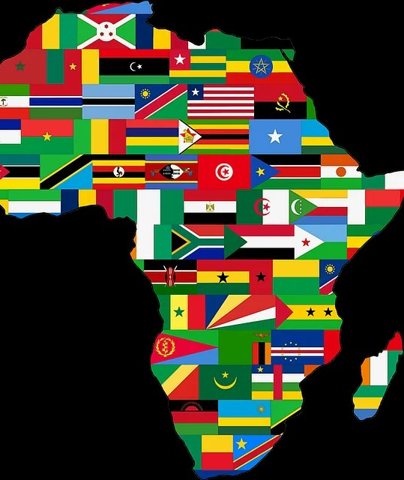
Migration Trends out of Africa Through the Lense of African Migrants
Jereme Hawkins

Slide 2
What’s needed in Pierce County Washington to better support African immigrants?
Notes:
This study involved academic research on the causes of migration in Africa, but more importantly, it captured their personal experiences through surveys and interviews. The purpose of this study is to determine if there are things Pierce County can do to better support African immigrants.

Slide 3

Migration Factors
low GDP per capita and high unemployment rates | rising populations and fertility rates
climate change | government instability
Notes:
I began this study by examining Migration factors influencing Africa. These include low GDPs, unemployment rates, rising populations with high fertility rates, climate change, and government instability.
The 10 poorest countries in Africa (Burundi, South Sudan, Central African Republic, Somalia, Democratic Republic of Congo, Mozambique, Eritrea, Liberia, Madagascar, and Malawi) have a GDP per capita below $2000.00. People in these countries live off less than $50.00 a week.
Unemployment rates among Africa’s youth have reached 14.5%. Africa’s poorest countries have also been hit the hardest, with some unemployment ratings reaching as high as 18.5 percent in South Sudan and 33.8 percent in Somalia.
Africa’s population of 1.2 billion is expected to double by 2050. It’s estimated that half of the people born worldwide from now until 2050 will be from Africa.
Climate change is also affecting Africa, with much of the continent relying on naturally occurring rain for agriculture. Only 5 percent of cultivated land in Africa is aided by irrigation, and rain fall is expected to drop by 20 percent by 2099.
Many migrants are placed in protracted refugee situations, where conflicts and civil wars have left migrants stateless. A 2004 United Nations high Commissioner for Refugees reported that 2.4 million refugees in Africa come from only 10 countries.

Slide 4
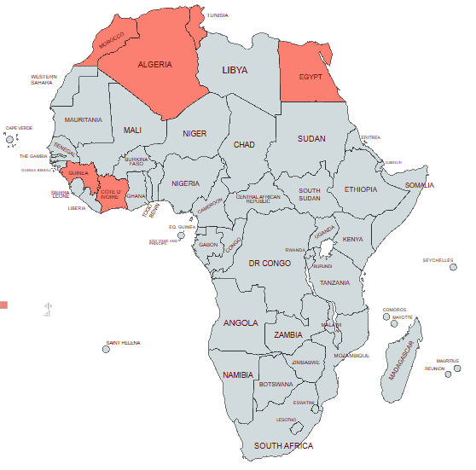
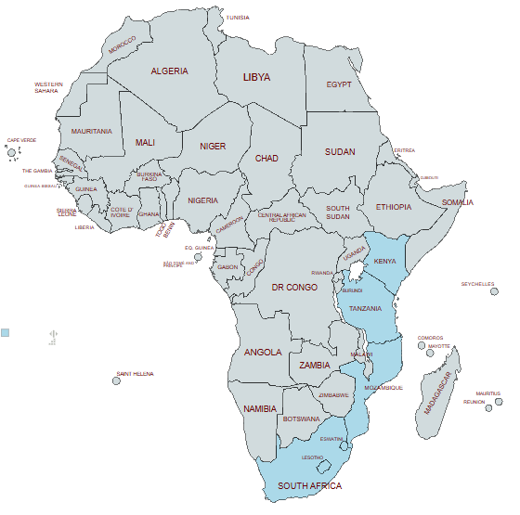
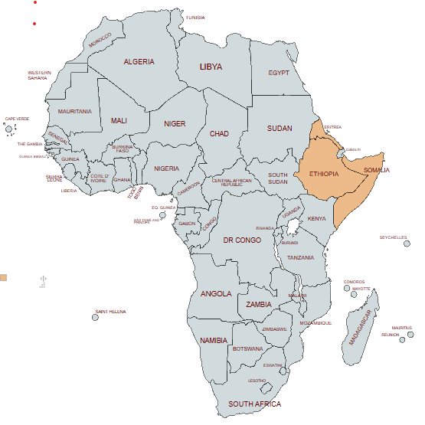
Migration Routes
Northern Route
Southern Route
Eastern Route
Notes:
According to the African Center for Strategic Studies migrants have 3 travel routes to escape Africa; The eastern route into the Middle East, the Southern Route seaward, and the Mediterranean/Atlantic route into Europe and the Americas.
The Eastern Route originates in Ethiopia, Eritrea, and Somalia toward the Gulf States of Bahrain, Kuwait, Oman, Qatar, Saudi Arabia and the United Arab Emirates. In 2023, over 93,500 migrants left the Somali Peninsula in East Africa for Yemen. Between March 2022 and June 2023, hundreds of migrants were killed by Saudi border guards at the Yemen border
The Southern Route stretches along the east coast of Africa down toward South Africa via Kenya and Tanzania. Here, Somali migrants often travel to South Africa for employment, hoping to provide for their families back home. It’s estimated that nearly 68% of these migrants face sexual abuse, torture, and physical assault. Many make this journey with little supplies for survival.
Migrants from Guinea, Côte d’Ivoire, Tunisia, Morocco, Egypt, and Algeria often follow the Mediterranean and Atlantic Routes into Europe. Many North African countries have agreements with the European Union to relocate migrants away from costal cities, often resulting in deadly consequences. In a 2023 United Nations report, the Libyan Special Naval Forces was accused of sinking a fishing boat carrying several hundred migrants heading towards Italy near the Greece border.

Slide 5
Demographic Survey Results
Instance | # contacted | Surveys Handed out | Surveys returned | Interviews Conducted
Household 1 | 3 | 3 | 3 | 1
Household 2 | 2 | 2 | 2 | 2
Household 3 | 2 | 1 | 1 | 1
Household 4 | 3 | 1 | 1 | 1
Business 1 | 4 | 3 | 0 | 0
Business 2 | 3 | 3 | 0 | 0
Business 3 | 8 | 2 | 4 | 0
Business 4 | 2 | 0 | 0 | 0
Business 5 | 3 | 0 | 0 | 0
TOTAL | 30 | 15 | 11 | 5
Notes:
I surveyed and interviewed African immigrants from across Pierce County Washington, survey results so far show a large amount of distrust of people outside of their community. Households and businesses I visited were very hesitant to participate in surveys or interviews.
I reached out to 5 African owned businesses and 4 African house holds, contacting 25 potential participants, of which 15 agreed to receive a survey. I received 11 of those surveys and 5 people agreed to sit down for an interview.

Slide 6
Immigrant Survey Demographics
Home Country | Gender | Immigration Age Range | Current Age Range | Education obtainment | Immigration Status | Marriage Status
Dem Rep Congo | Female | 18-24 | 45-54 | High School | Naturalized | Single
Tanzania | Female | 25-34 | 45-54 | High School | Refugee | Single
Tanzania | Female | 18-24 | 25-34 | High School | n/a | Single
Kenya | Male | 35-44 | n/a | College | n/a | Married
Kenya | Female | n/a | n/a | Bachelors | n/a | Married
Nigeria | Male | 25-34 | 45-54 | Associates | Naturalized | Married
Nigeria | Female | 35-44 | 45-54 | Bachelors | Naturalized | Single
Nigeria | Female | 25-34 | 35-44 | Associates | n/a | Single
Nigeria | Female | 25-34 | 45-54 | Masters | Naturalized | Married
Nigeria | Female | 65+ | 65+ | Primary school | Green card | Married
Nigeria | Male | 18-24 | 18-24 | Trade School | Naturalized | Single
Notes:
Immigrant demographics included their home country, gender, age ranges at immigration and current age range, educational obtainment, immigration status, and marriage status.
Approximately half of those surveyed were from Nigeria. Other countries included Kenya, Tanzania, and the Democratic Republic of Congo.
Most of the participants were women, there were 9 women and 3 men who returned surveys. Age ranges varied throughout those surveyed.
Most of the participants had college degrees. Three had selected high school as their highest level of education, and one had completed trade school.
Immigration status of those surveys varied, 5 were naturalized citizens, 1 was a green card holder, and 1 was a refugee. However, some chose not to disclose their immigration status out of fear that they could be deported.
Marriage status also varied among participants, with 6 immigrating when they were single, and 5 immigrating while married.

Slide 7

Voices from around Pierce County
What was your reason for leaving your home country?
“My main reason was my country have a war, like a civil war. So because of that, that's when I decided to come to the United States, to flee my country and come to the United States.”

Slide 8
Voices from around Pierce County
What resources do immigrants in Washington State need?
“Um..most immigrants, African immigrants just would want an environment where they could get a job, to work and make a decent income. So, availability of that information, it could be um, a staffing agency.”

Slide 9
Voices from around Pierce County
What advice would you have for immigrants arriving in Washington?
“Actually, I don’t know what to tell them, because coming out here, it’s a lot of challenges that someone have to go through. Um, finding resources is one of the problems, like because if someone comes to the United States and you don’t know where to go it will be very tough and challenging for that person.”

Slide 10



“They’re bringing drugs, they’re bringing crime, they’re rapists, and some, I assume, are good people.” – Donald Trump
“We need to deport every single person who invaded our country illegally.” – JD Vance
“We are not stopping. I don't care what the judges think. I don't care what the Left thinks. We're coming,“ – Tom Hamon
Notes:
We have an administration that has declared war on immigrants.
Harmful statements such as these have left many immigrants feeling scared.
Afraid of being deported back to countries where they may not be safe.
Afraid to seek help.

Slide 11
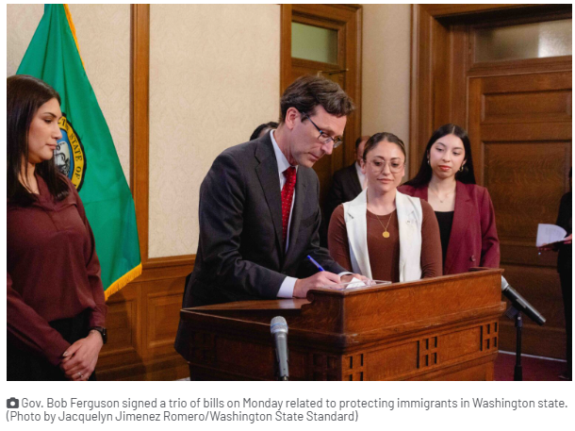
How is Washington Helping?
House Bill 1232
Senate Bill 5104
Senate Bill 5714
Notes:
House Bill 1232, effective immediately, established standards for sanitation, ventilation, and medical care in detention centers. This bill is an effort to get the states Department of Health to inspect the Northwest Detention Center and force it to comply with state and federal law.
Senate Bill 1232, effective July 1st will help protect immigrants from workplace harassment by requiring the states DOL to investigate complaints of coercion and impose penalties for violations.
Senate Bill 5714, effective July 27th will add ICE enforcement to the list of unprofessional conducts for bail bond agents, preventing them sharing defendant’s immigration status with anyone outside their business.

Slide 12
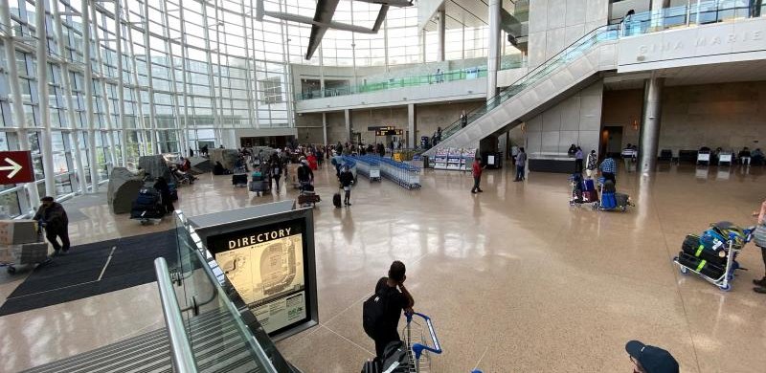
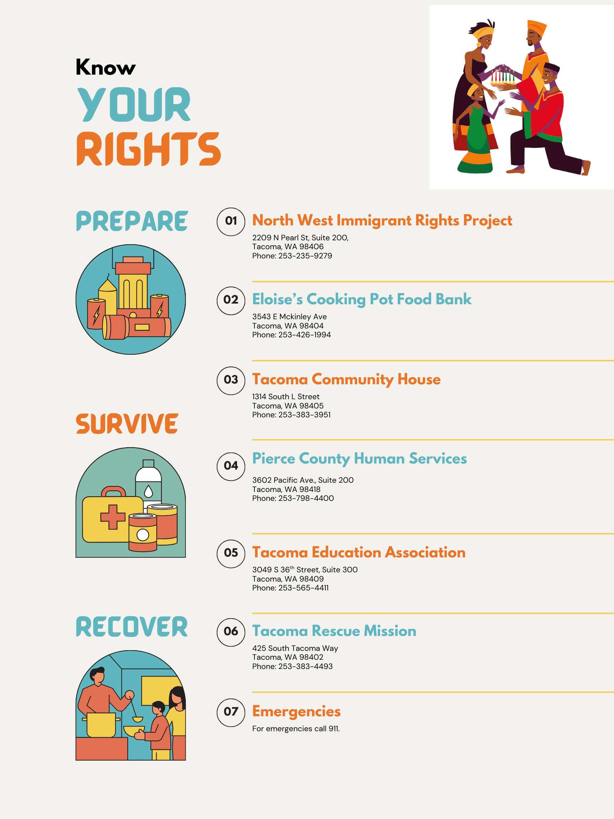
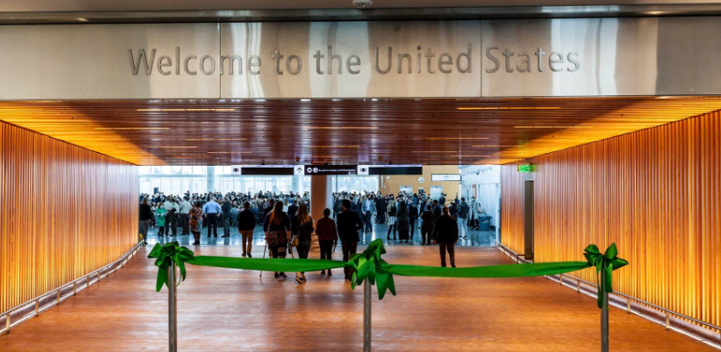
More Solutions
Notes:
What’s missing from the pristine clean walls of the Seattle International Airport.
Information for Arriving Immigrants.
Considering the current state of our Federal Government. I think the best solution will be to get as much information out to immigrants as they arrive in Washington State. Getting posters with resources at airports, bus stops and in public buildings will help spread the information about available resources to immigrants who need them most.
Additionally, the state should continue to limit support to federal agencies that are conducting investigations based on race or possible immigration status.

