Slide 1
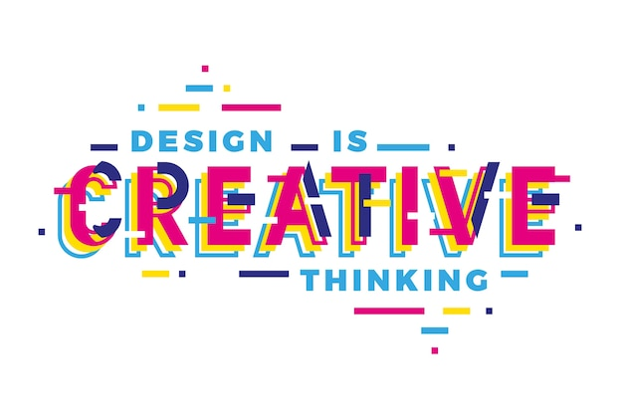



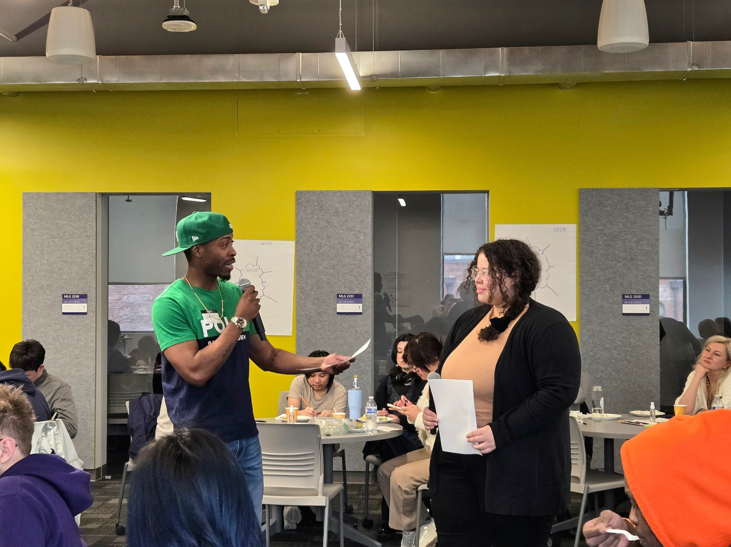
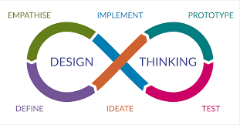
Empathy and the Non-Linearity of the Design Process
Cathy Jackson
Creative Writing, Innovation & Design
THE WORKSHOPS
ABSTRACT
STRACT
INTRODUCTION AND PURPOSE
“Human centered design is a process that starts with the people you’re designing for and ends with new solutions that are purpose-built to suit their needs.”
GTCF:
They proved that acknowledging past work before designing is vital.
  This plays into design justice principle #10, “Before seeking new design solutions, we look for what is already working at the community level. We honor and uplift traditional, indigenous, and local knowledge and practices.”
Collaboration played an important role during the design process.
Workshop Group #2:
Groups diligently worked together, showing that the design process is centered in community and collaboration.
Participants empathized with each other later on in the workshop during feedback stages, proving that it is not a linear process.
Shared Futures:
While co-designing the workshop, we kept the students in mind, empathized with them, as they are the target user.
  We know that students appreciate free food (incentive) so we made sure to incorporate that idea while brainstorming for the event.
Before I began my internship with the Global Innovation and Design Lab, I had little idea how certain design thinking steps, such as empathy, could play such a huge role in design. And when I was introduced to the design thinking process, I thought it would stay a linear process.
The design thinking process is as follows:
Empathize
Problem definition
Ideation
Prototyping
Testing
In Winter quarter I engaged in 3 design thinking workshops and through these workshops I was able to:
See the design thinking process in action.
See which steps were more relevant than others.
Get hands on experience with note-taking and event photography.
CONCLUSIONS AND TAKE AWAYS
Good design caters to multiple people and is accessible to everyone, has multiple uses.
The people you are designing for always come first.
Every step plays an important part in the design process, yet design thinking is not a linear process. Certain steps can come out at any time during the design process. For example:
  Empathy helps define problem
  Learn about users through testing
  Tests create new ideas for project
  Prototypes sparks a new idea
  Tests reveal insights that redefine the problem
Moving forward I have a new way of viewing design, with empathy always being at the center.

