Slide 1

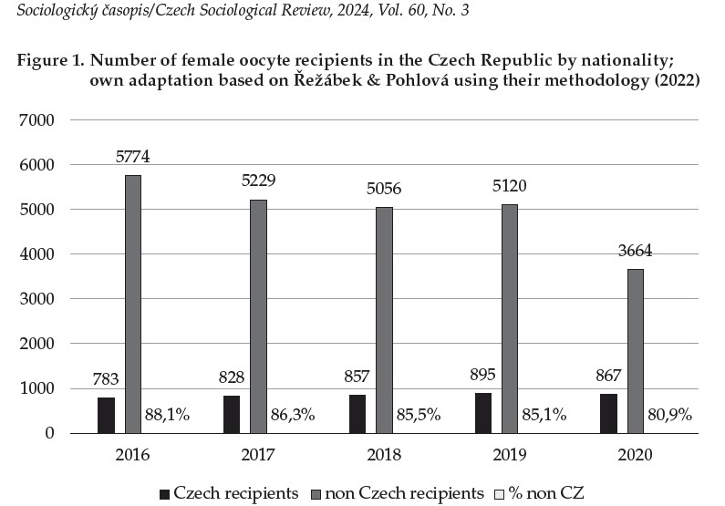
IVF Tourism in Czechia
Gregory Esters
Biomedical Science and Psychology
ABSTRACT
STRACT
INTRODUCTION AND PURPOSE
PROPOSED SOLUTION/
RECOMMENDATIONS
METHOD(S)
IVF is a range of techniques utilized by people, its purpose is to create the possibility of having children. It is a complicated, intensive, and prolonged set of procedures that requires a vigilance from the medical professionals and full cooperation from the patients. There are many variables as to the why, where, and how IVF is performed. Some of these questions are answered by politics and laws, some by money and expertise. Czechia specializes in solving many of the problems involved with IVF.
IVF stands for In vitro fertilization
ART stands for assisted reproductive technologies
A procedure that involves fertilizing an egg with sperm in a laboratory dish
Expensive, invasive, an emotional option to conceive
First IVF child born in 1982 in Brno
Over 30,000 IVF cycles performed yearly, over have from foreigners
Completing the entire treatment regimen can prevent and reduce further complications.
Providing patient support and treatments to those trying to conceive
Early diagnosis of complications with IVF
Accessible and preventative treatment for individuals at high risk of rejecting IVF
Global leadership to expand IVF procedures
Motivation is to explore some of the seeming causes and effect of Prague and/or Czechian culture on the health of people as it’s an interesting perspective that may not have been studied very much; there is a gap in knowledge on the subject
Observer in another country. Research done outside of class. Practicing cultural humility.
Global Health – Historical influences on health such as pandemics, imperialism, industrial revolution.
Social determinants of health – Health disparities recognizing historical, social, economic, and political contexts
.
RESULTS AND DISCUSSION
CONCLUSIONS
IVF costs less in Czechia than the U.S.
Liberal legislation facilitates fertility methods
Cutting edge methods of IVF
Need for gamete donation
Different medical situations that lead to infertility
Prevalence of infertility
Legislation that hinders IVF
Access to IVF
Prague is a beautiful city to holiday in
IVF treatments are more accessible in Czechia
IVF treatments are safer in Czechia
IVF treatments are more affordable in Czechia
IVF treatments are more advanced in Czechia
Table 1: IVF with donated eggs (Sanchez et. Al, 2024)
REFERENCES
Bryndová, Lucie & K, Pavloková & Roubal, Tomas & M, Rokosová & Gaskins, Matthew & Van Ginneken, Ewout. (2009). Czech Republic: Health System review. Health systems in transition. 11. 1-176.
De Bayas Sanchez, A., Fialová, J., Konečná, H., & Güell, F. (2024). Evaluating Egg Donor Recruitment Strategies in Czech ART Clinics: A Critical Analysis of Informed Consent and Ethical Considerations. Sociologický časopis / Czech Sociological Review, 60(3), 321-346. doi: 10.13060/csr.2024.019
European IVF Monitoring Consortium (EIM) for the European Society of Human Reproduction and Embryology (ESHRE) , Smeenk, J., Wyns, C., De Geyter, C., Kupka, M., Bergh, C., Cuevas Saiz, I., De Neubourg, D., Rezabek, K., Tandler-Schneider, A., Rugescu, I., & Goossens, V. (2023). ART in Europe, 2019: results generated from European registries by ESHRE†. Human reproduction (Oxford, England), 38(12), 2321–2338. https://doi.org/10.1093/humrep/dead197
Fialova, Ludmila. (2018). Health Education and Lifestyles in the Czech Republic. 10.5772/intechopen.77364.
Hübelová,D.,Ptáček,P. & Šlechtová,T.(2021).Demographic and socio-economic factors influencing health inequalities in the Czech Republic. GeoScape,15(1) 53-65. https://doi.org/10.2478/geosc-2021-0005
Kocourková, J., Šťastná, A. & Burcin, B. The influence of the increasing use of assisted reproduction technologies on the recent growth in fertility in Czechia. Sci Rep 13, 10854 (2023). https://doi.org/10.1038/s41598-023-37071-7
Nemec, Juraj & Medveď, Jozef & Vítek, Leoš. (2005). Social Health Insurance and Its Failures in the Czech Republic and Slovakia: The Role of the State. Prague Economic Papers. 2005. 64-81. 10.18267/j.pep.253.
Rumpíková, Taťána & Oborna, Ivana & Bělašková, Silvie & Konecna, Hana & Rumpik, David. (2017). The attitudes of IVF patients treated in the Czech Republic towards informing children born after gamete donation. Biomedical Papers. 162. 10.5507/bp.2017.050
Žáková,J.,Crha,I.,Jelínková,L.,Mardešic,T.,Pastor,Z.,Trávník,P.,Kempisty,B.,Ventruba,P. & Ješeta,M.(2018).Current Topics in Assisted Reproduction in the Czech Republic. Medical Journal of Cell Biology,6(2) 61-65. https://doi.org/10.2478/acb-2018-0011

