Slide 1
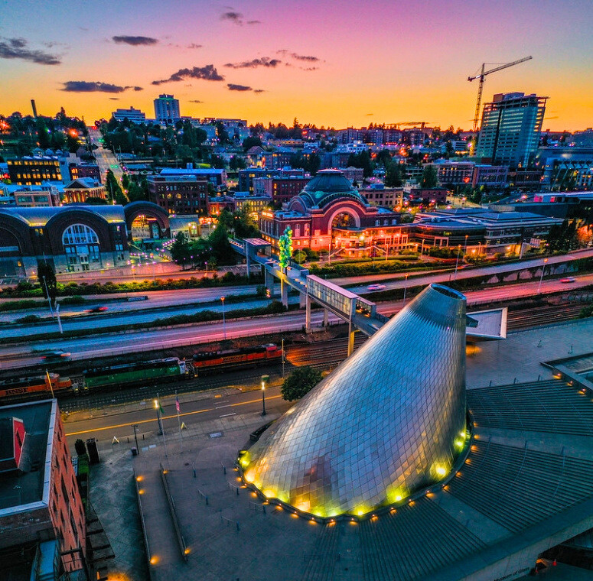

UW TACOMA
MASTER OF
SOCIAL WORK
INFORMATION SESSION

Slide 2
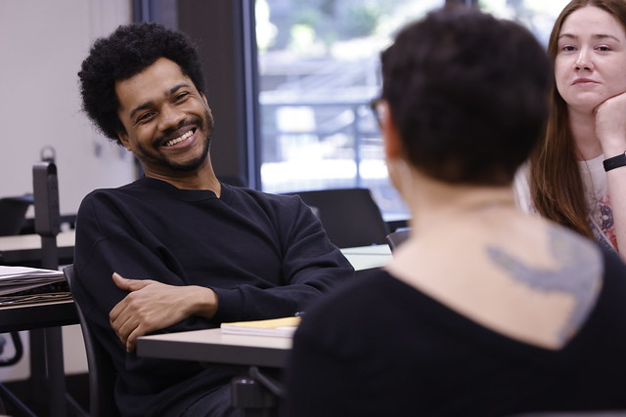
WHY MSW AT UWT?
BE THE CHANGE YOU’RE WAITING FOR.
Integrative Practice Specialization
Cohort Model - Support system
Small Class Size
Part-time Program
CSWE Accredited
Ranked #2 in the nation by US World News
Amazing Instructors
Community Focus
Notes:
- Engage students in active learning.
- Connect students to resources.
- Build supportive and inclusive communities.
- Help students learn and grow outside of the classroom through events, activities, and services intentionally designed to support learning, community building, and personal development.
We live, workand learn in Seattle and will help others make the most out of the city!

Slide 3
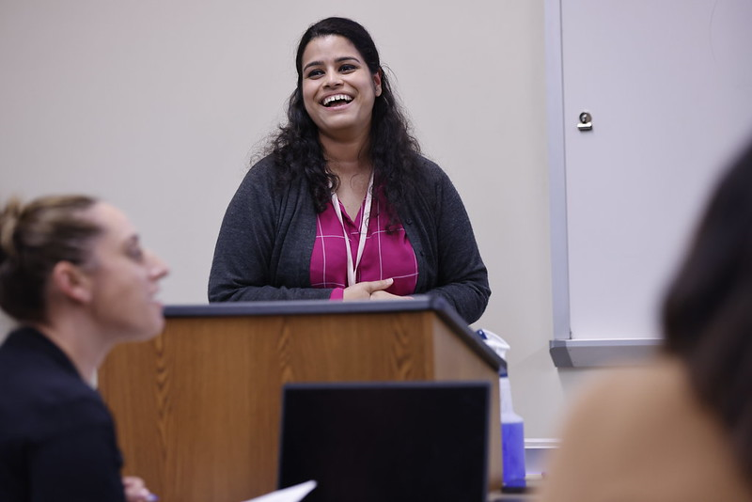
MSW PROGRAM OPTIONS
3-year Part-time MSW Program
18-month Part-time Advanced Standing MSW Program

Slide 4
3-YEAR MSW
18-MONTH MSW
Part-time program
Typically admits 50 students a year
Autumn Quarter admission only
Classes typically meet 2 night a week at 6:30PM
Any four-year baccalaureate degree from an accredited institution
Part-time program
Typically admits 15-20 students a year
Winter Quarter admission only
Classes typically meet 2-3 nights a week at 6:30PM
BSW or BASW from CSWE-accredited program required
Notes:
Goal: to provide an enriching and holistic graduate experience.
Not sure who to contact with your questions? Start with us!
We're also the people who put on or help out with many of the programs you'll see below!

Slide 5
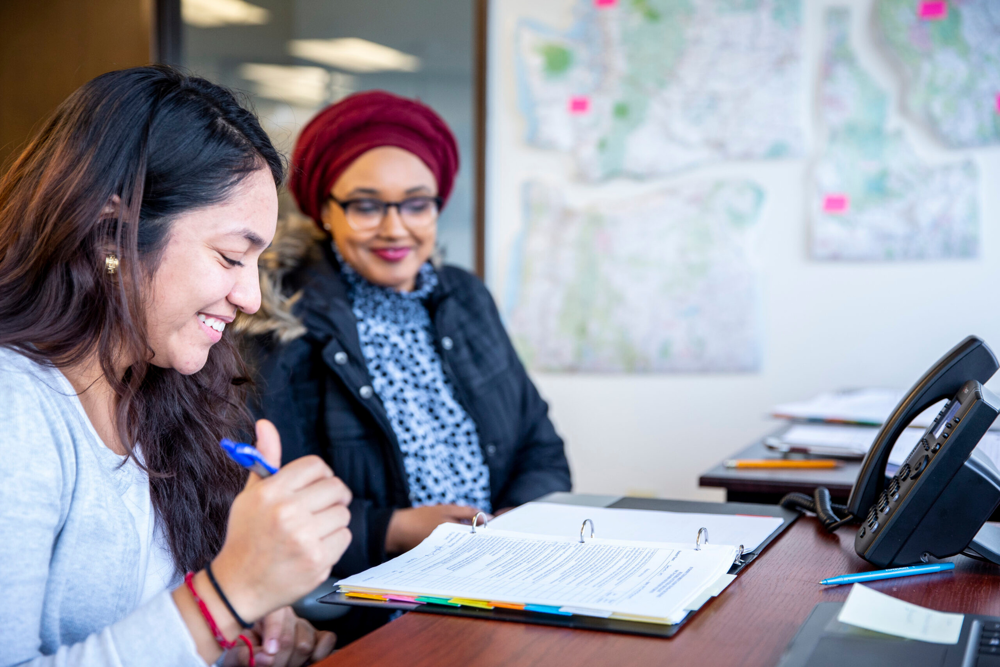
PRACTICUM
LEARNING OUTSIDE THE CLASSROOM
Just like an internship where you register and receive academic credit for your field experience.
GENERALIST PRACTICUM
400 hours (10 credits)
Spans 3 quarters
Begins the Summer of the first-year
SPECIALIZATION PRACTICUM
680 hours (17 credits)
Spans 4 quarters
Begins the Summer of the second-year curriculum

Slide 6
PRACTICUM EXAMPLES
Anger Control Treatment & Therapies, Tukwila | Asian Counseling & Referral Services, Seattle | Behavioral Health Resources, Olympia | Bethel Community Services | Bethel School District | Cascade Behavioral Hospital, Seatac | Cascade Mental Health, Centralia | Catholic Community Services | Tahoma Indian Center | Unaccompanied Minor Services | Drexel House, Olympia | Center for Independence | Children's Home Society | City of Seattle | Comprehensive Life Resources | Consejo Counseling Services | Crystal Judson Family Justice Center | Downtown Emergency Services Center, Seattle | Department of Child and Family Services | Department of Social and Health Services (DSHS) | Fairfax Hospital | Friends of Youth | Full Life Care, Seattle | Greater Lakes Mental Healthcare | Helpline House, Bainbridge Island | Interfaith Works Emergency Shelter, Olympia | Kent School District | King County Prosecutor's Office, Kent | Kitsap County Juvenile Department, Port Orchard | Life Wire, Bellevue | Lutheran Community Services | Multicare | Native American Community & Child Welfare Association | NeighborCare, Seattle | Neighborhood Clinic, Tacoma | Oasis Youth Center | Olympia School District | Peninsula School District | Gig Harbor High School | Pierce County Aging & Longterm Care (Pierce Community Connections) | Pierce County AIDS Foundation, Tacoma and Olympia | Pierce County Juvenile Court | Pacific Lutheran University Center for Gender Equity | Puyallup Tribe of Indians | Rainbow Center | Serenity Counseling Services, Fife | South Sound Parent to Parent | Sumner-Bonney Lake School District | TACID | Tacoma Community House | Tacoma School District | Eugene Tone Center | Therapeutic Health Services, Seattle | Thurston County Court | UW Autism Center, Tacoma Clinic | UW Tacoma Office of Student Advocacy and Support | Valley Cities Behavioral Health Care, Federal Way | Washington State Department of Health | Youth Eastside Services, Bellevue and Kirkland | YWCA Pierce County | Building Changes, Seattle | HopeSparks Family Services | Kaiser Permanente, Olympia | Multicare Health Systems, Tacoma, Puyallup, and Auburn | National Alliance on Mental Illness, Seattle | The NW Network Support for Survivors | UW Medicine | Veteran's Administration of the Puget Sound, American Lake and Seattle
Notes:
Team of Ambassadors:
fostering engagement,
promoting resources/services &
advocating for the needs and interests of graduate students within the Northeastern community.
Many colleges and departments also have their own ambassadors

Slide 7
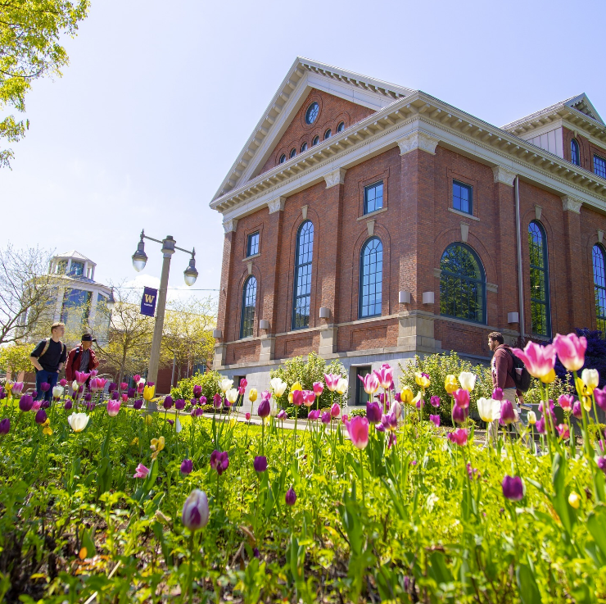
UW GRADUATE SCHOOL ADMISSION REQUIREMENT
GRAD.UW.EDU
Hold a baccalaureate degree from an accredited college or university in the U.S. or its equivalent from a foreign institution (Please note Advanced Standing Only: Must have a BSW or BASW from a U.S. program accredited by the Council on Social Work Education)
Have a minimum 3.0 cumulative GPA in your last 90 graded quarter credits or 60 graded semester credits. (Students with below a 3.0 gpa are encouraged to apply. Admission is subject to UW Graduate School departmental petition approval.)
Notes:
Give examples of what the SIGs have done for campus (events hosted, professional development opps such as Coding Night or corporate office visit to Google, support groups such as debrief after last year's Grace Hopper Conference)

Slide 8
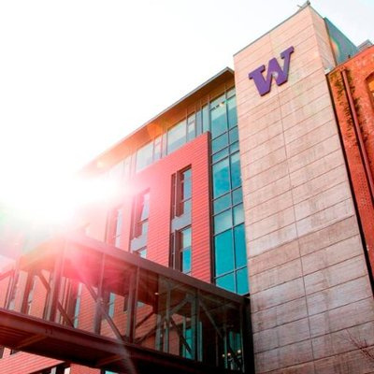
APPLICATION PROCESS
IN TWO EASY STEPS!
1.Start an application with the UW Graduate School
https://grad.uw.edu/admission/apply-now/
2.Apply to the UW Tacoma MSW program- select Social Work - Tacoma Campus (Master of Social Work-Part Time Program or Advanced Standing)
**Application materials are submitted via the application portal.
Essay, Resume and unofficial transcripts must be uploaded as part of the process
Notes:
Give examples of what the SIGs have done for campus (events hosted, professional development opps such as Coding Night or corporate office visit to Google, support groups such as debrief after last year's Grace Hopper Conference)

Slide 9
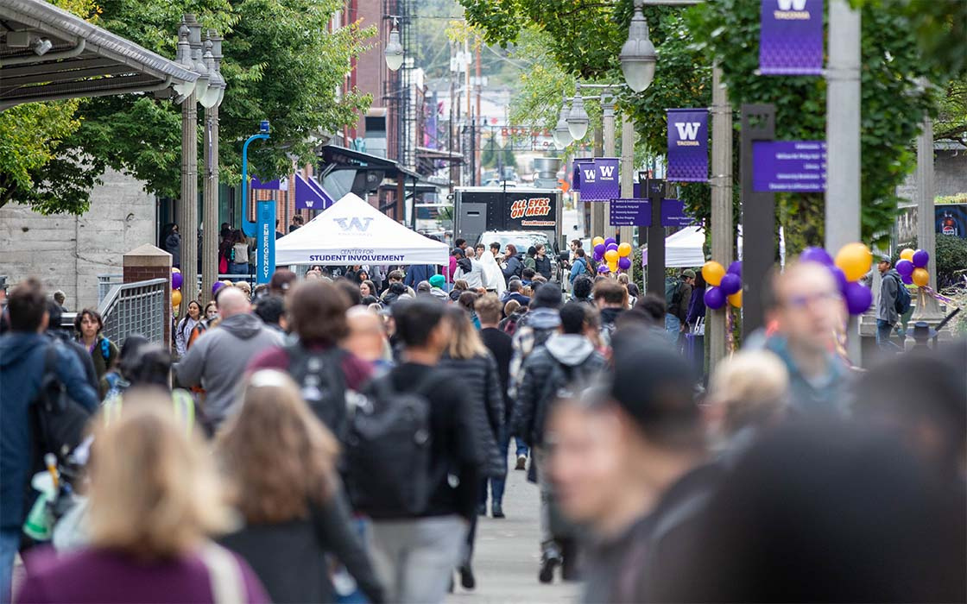
APPLICATION REQUIREMENTS
UW Tacoma MSW Application for the appropriate year
Admission Essay (Essay questions provided online)
Unofficial Transcripts from each college or university attended
Resume
Social Service Experience Hours
Three professional and/or academic references (For Advanced Standing program, one must be from the field)
UW HSIP, background check, social work program and Commitment Acknowledgements
NO GRE NEEDED!
Notes:
§If you graduated within the last two years from an undergraduate institution, one of the three recommendations is required to come from an academic reference. If you have been out of school for more than two years, the three recommendations can come from any combination of academic or professional experiences.

Slide 10
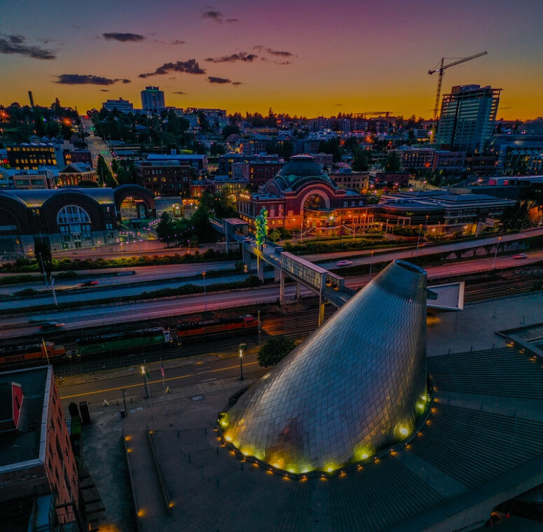
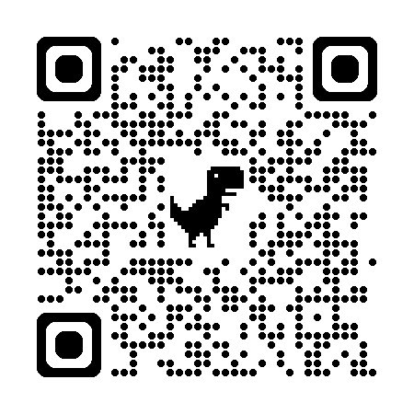
DEADLINES
3-YEAR MSW PROGRAM
FEBRUARY 15, 2026
ADVANCED STANDING PROGRAM
JUNE 30, 2025
Notes:
Examples of past events includes:
Fall Fest
KPOP Dance Class
Culture Week
Movie Nights
Monthly Game Night
Lunar New Year Celebration
Diwali

Slide 11
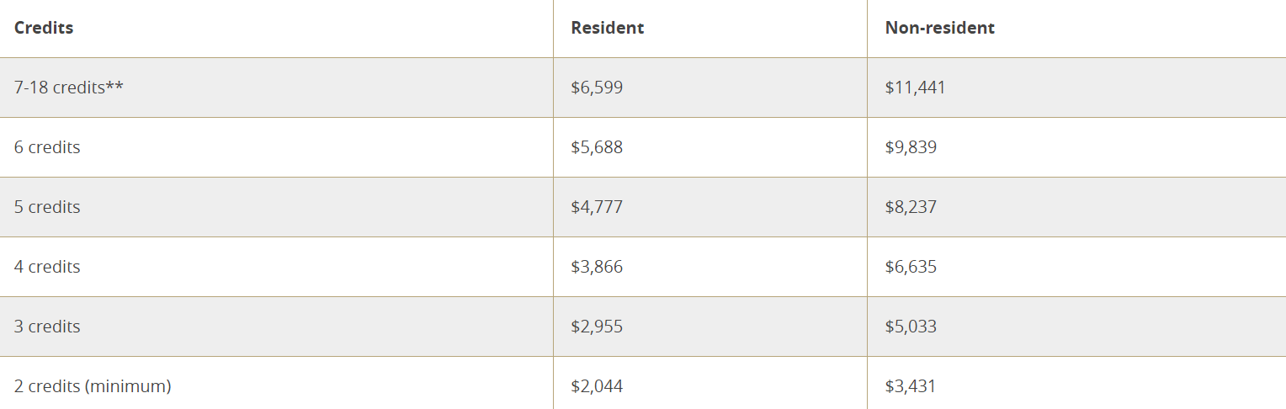
ESTIMATED COST
*QUARTERLY RATES -SUBJECT TO CHANGE WITHOUT NOTICE
3-YEAR MSW (11 QUARTERS)
$62,572
(2024-25 resident rates)
18-MONTH AS MSW (6 QUARTERS)
$35,692
(2024-25 resident rates)
More info at tacoma.uw.edu/registrar/tuition-rates
Notes:
3-Year MSW (11 quarters)
$62,572 (2024-25 WA resident rates)
18-Month Advanced Standing (6 quarters)
$35,692 (2024-25 WA resident rates)
Please note that financial aid funding for part-time graduate students is typically limited to student loans and scholarships. No full-time MSW option is available at UW Tacoma. We strongly urge you to speak with one of our Financial Aid representatives so that they can give you an idea of what financial aid you would be eligible for. To schedule an appointment with Financial Aid, please contact their office at 253-692-4374.

Slide 12
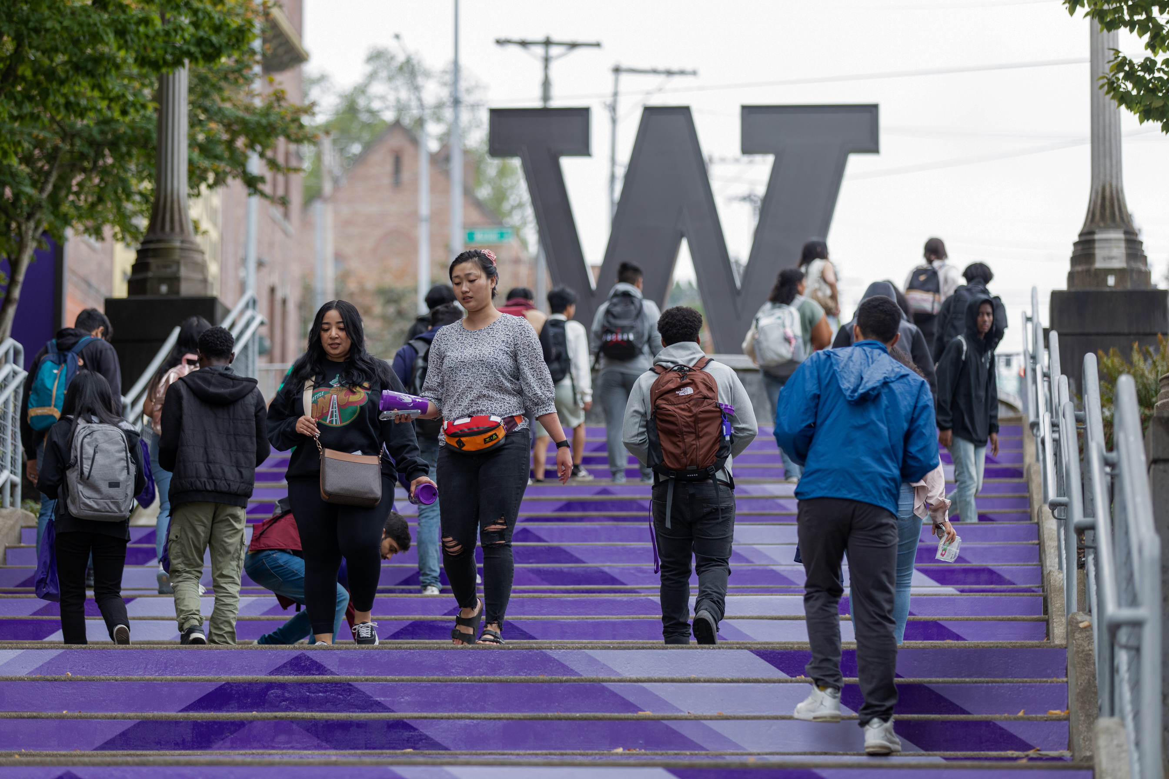
FUNDING YOUR EDUCATION
COMPLETE THE FAFSA OR WASFA
Complete the Free Application for Federal Student Aid (FAFSA) or the Washington Application for State Financial Aid (WASFA)
UW Title IV Code: 003798
Student Loans and Scholarships are the primary source of funding in part-time graduate programs
Many grants may require a full-time student status
Reach out to Financial Aid early for assistance: uwtfa@uw.edu
Notes:
Examples of past events includes:
Fall Fest
KPOP Dance Class
Culture Week
Movie Nights
Monthly Game Night
Lunar New Year Celebration
Diwali

Slide 13
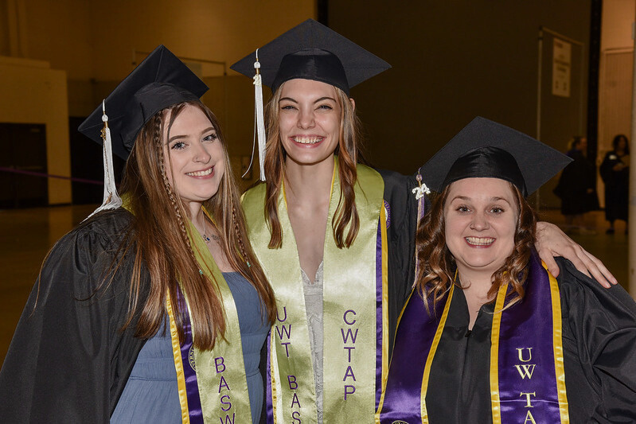
CWTAP PROGRAM
CWTAP offers specialized educational seminars and tuition assistance to students accepted into the MSW program who are interested in working in public child welfare.
Promotes professionalization and recruitment of social workers in public child welfare across Washington State.
Subsidizes the cost of the CWTAP student’s BASW (partial) or MSW education. In return, after graduation students will work for the Department of Children, Youth and Families (DCYF) for an equal amount of time they received financial assistance.
Provides educational seminars, mentoring support and clinical supervision to accepted CWTAP students.
Offers professional development opportunities through the annual Student Institute.
Assists CWTAP students in gaining employment with the Department of Children, Youth and Families.
Notes:
Examples of past events includes:
Fall Fest
KPOP Dance Class
Culture Week
Movie Nights
Monthly Game Night
Lunar New Year Celebration
Diwali

Slide 14
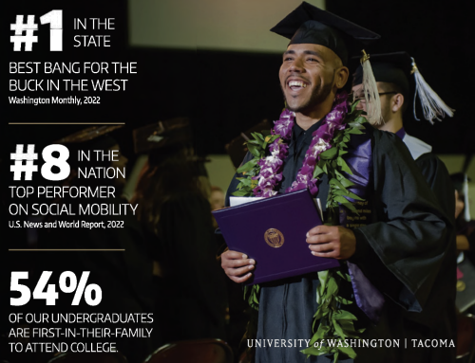

PUBLIC SERVICE LOAN FORGIVENESS
If you’re employed by a government or not-for-profit organization, you might be eligible for the PSLF Program.
The PSLF Program forgives the remaining balance on your Direct Loans
studentaid.gov/manage-loans/forgiveness-cancellation/public-service
Notes:
Examples of past events includes:
Fall Fest
KPOP Dance Class
Culture Week
Movie Nights
Monthly Game Night
Lunar New Year Celebration
Diwali

