Slide 1
UW Tacoma
Bachelor of Arts in Social Welfare (BASW)

Slide 2
What is Social Work?
Social Workers…
Empower individuals, relieve suffering, and affect social change
Are advocates for social change
Care about human dignity and social justice
Help people identify and manage factors that contribute to their problems
Work in a wide variety of settings but have common core values, techniques, and principles

Slide 3
Careers in Social Work
Administration
Advocacy & community organizations
Aging & gerontology
Child welfare & families
Health care
Justice & corrections
Mental health
Public welfare
Research
…and more!
Visit www.socialworkers.org for further info on careers in social work!

Slide 4
Program Overview
Accredited by the Council on Social Work Education (CSWE)
Sequenced Cohort Model
2 year full-time, day, on-campus program
Field experience completed in second year applying classroom knowledge and skills to real-world settings.
Admits approximately 60 students yearly
Priority application deadline March 15 (Autumn Quarter admission only) - often admit students after the deadline

Slide 5
Program Curriculum
68 credit program of study
Includes 440 hours of Field Experience (Practicum) in the second year of the program
Foundation Courses focus on:
Social Work Practice Foundations
Policy and Advocacy
Cultural Diversity and Societal Justice
Human Behavior and the Social Environment
Social Work Research
Professionalism in Social Work
History of Social Work

Slide 6
Social Welfare Electives
TSOCWF 350 Biopsychosocial Human Services
TSOCWF 351 Applied Statistics for Social and Human Services
TSOCWF 353 Mental Illness and Recovery
TSOCWF 355 HIV/AIDS: Global and National Issues
TSOCWF 356 Disabilities: Individuals and Community Perspectives
TSOCWF 361 Substance Abuse and Mental Health in Criminal Justice
TSOCWF 363 Criminalization of Immigration
TSOCWF 374 Human Trafficking
TSOCWF 409 Readings in Social Welfare
TSOCWF 420 Interpersonal Violence and Society
TSOCWF 421 Cross-Cultural Grieving
TSOCWF 422 Aging in American Society
TSOCWF 427 Disproportionality Across Systems
TSOCWF 430 Children of Incarcerated Parents
TSOCWF 433 Crisis and Trauma Interventions with Crime Victims
TSOCWF 436 Social Work in Criminal Justice Settings
TSOCWF 490 Research in Social Welfare

Slide 7
Practicum
Practicum is like an internship, in which you register and receive academic credit for your field experience.
440 hours (11 credits)
Spans three quarters your second year
Practicum agencies include those that serve:
K-12 students and schools
Behavioral health needs
Foster youth and families
LGBTQIA+
Unhoused population
Aging population
Individuals living with HIV/AIDS
Individuals with disabilities
Individuals connected to the criminal justice system

Slide 8
Program Requirements
Health Sciences Immunization Policy
All students in the Bachelor of Social Welfare Program must abide by the Health Sciences Immunization Policy (HSIP).
Students must document immunity to Measles (Rubeola), Mumps, Rubella, Hepatitis B, Tetanus-Diphtheria-Pertussis, Varicella (chicken pox), TB screening, and seasonal influenza vaccine. The influenza vaccine must be renewed each year you are in the program.
Learn more: wellbeing.uw.edu/imms-req/hsip/

Slide 9
Program Requirements, cont.
Authorization for Repeat Background Check form is a required document to complete your BASW application.
If you are offered admission, and you accept, you will order a background check through CastleBranch, a third-party vendor. You will pay the background check fee of $53.00. Additional background checks and fees may apply if needed.

Slide 10
Who are our faculty?
Faculty have research interests which include:
Violence prevention
Disapportionality in the child welfare system
Disabilities
LGBTQIA+
Gender studies
Arts and humanities in social work practice
Animal assisted therapy
Race and transnational adoption
Health disparities and elder care
Social work within the criminal justice system
Justice involved youth
Many faculty also come with practice experience working with the homeless, immigrants, substance abuse, mental health, healthcare, etc.

Slide 11
Admission Criteria

Slide 12
BASW Prerequisites
Successful completion (minimum grade of 2.00)
Intro to English Composition
Intro to Sociology*
Intro to Psychology*
Minimum of 75 college-level and transferable credits
* Applicants can be considered for admission if one or both of these courses are planned for an upcoming quarter and are encouraged to apply.

Slide 13
Essay and Resume
You will write a two page essay which will provide autobiographical information and discuss your experiences with human and/or social services.
The essay is the most important element of your application.
You will provide a current resume. If you have social service experience (paid or unpaid), please highlight this on your resume in addition to any special skills or certifications.

Slide 14
Who is a strong candidate?
Articulate a strong commitment to social justice
Articulate a desire to work with diverse populations in a social service capacity
Has experience (paid or unpaid) in social or human services – experience is NOT required however.

Slide 15
How do I apply?

Slide 16
UWT Application & Admission Process
Transfer and Running Start Students
Start an application with the university
Applications must be submitted online
https://www.tacoma.uw.edu/admissions/transferstudents//www.tacoma.uw.edu/admissions/transfer-students
A $60.00 application fee must be paid at the time of submission.
2. Once admitted to UW Tacoma, complete the BASW Application
Application must be submitted online
https://www.tacoma.uw.edu/swcj/basw-application
Personal Statement
Resume
Authorization for Repeat Background Check/HSIP Acknowledgement form

Slide 17
UWT Application & Admission Process
Current UW Tacoma Students
Complete the BASW Application:
Application must be completed online
https://www.tacoma.uw.edu/swcj/basw-application
Personal Statement
Resume
Authorization for Repeat Background Check/HSIP Acknowledgement form

Slide 18
Questions?
Phone: (253) 692-5820
Email: swcj@uw.edu
Web: https://www.tacoma.uw.edu/swcj

Slide 19
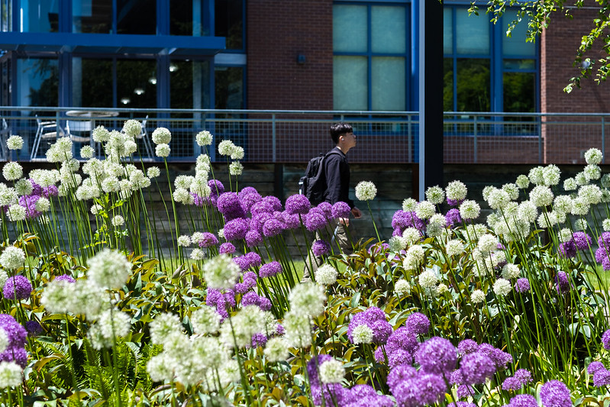
Thank you for your interest in the UW Tacoma BASW Major!

