Slide 1
Bachelor of Arts in Criminal Justice

Slide 2
Presentation Overview
Criminal Justice (CJ) Overview
Options - On campus or Online
CJ major admission
How to Apply and Next Steps

Slide 3
Criminal Justice Overview
An innovative approach to criminal justice emphasizing:
Diversity and social justice
Focus on harm reduction, rehabilitation and restorative approaches to crime and justice.
Community partnerships
Systems thinking
Skill developments

Slide 4
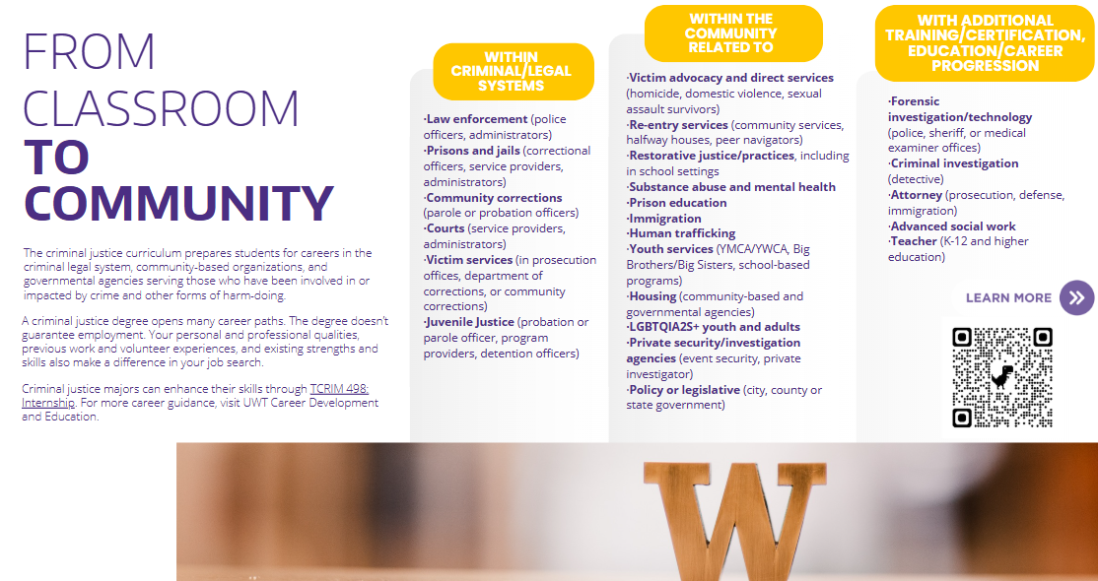
What are careers in Criminal Justice?

Slide 5
Options
CJ on campus:
admits Autumn and Winter quarters
CJ online:
a cohort, sequenced model, admits Autumn quarter.
Review: CJ Online Sequence Per Quarter

Slide 6
Prerequisites for Admission
to the Criminal Justice Major
Required:
English composition 2.00 grade or higher 5 credits
Minimum Criminal Justice Major Admission Standards
Criminal Justice Criminal Justice | Campus Major Online Major | 45 college-level quarter credits 90 college-level quarter credits

Slide 7
CJ Core Courses 45 credits
T CRIM 225:
Diversity and Social Justice in Criminology
prerequisite for T CRIM 371
T CRIM 361:
Mental Health, Substance Use and the Criminal Justice System
T CRIM 362:
Introduction to Criminological Theory
T CRIM390: Introduction to Criminal Justice Research
prerequisite: Successful ( 2.0 grade or higher) completion of a course in statistics or TSOCWF 351
T CRIM 370:
Police and Society
T CRIM 371:
Helping Skills in the Criminal Justice System
requires completion of T CRIM 225 ( 2.0 grade or higher)
T CRIM 372:
Adult Corrections
T CRIM 395:
American Criminal Courts
T CRIM 441:
Senior Seminar: Professionalism and Ethical Issues in Criminal Justice
requires completion of T CRIM 371 and T CRIM 390
(2.0 grade or higher)
All core courses require a 2.00 (C) grade or higher.

Slide 8
CJ Core Electives 20 credits
SAMPLE
T SOCWF 351 Applied Statistics
T CRIM 271 Intro to the Sociology of Deviance and Social Control
T CRIM 156 Criminal Justice and the War on Drugs
T CRIM 360 Youth and Juvenile Justice Systems
T CRIM 363 Criminalization of Immigration
T CRIM 374 Human Trafficking
T CRIM 435 Terrorism and the U.S. Criminal Justice System
Any course from the CJ Core Elective Approved List will count as a CJ core elective
All core electives require a 2.0 grade or higher
Please note: Not all core electives from the list are offered every quarter. The CJ major offers CJ core electives (T CRIM) quarterly. You can review the other course offerings in the Quarterly Time Schedule by course prefix, i.e. T PSYCH

Slide 9
CJ Graduation Credit Summary
College-level transfer credits On-campus major: 45+
Online major: 90+
CJ Core Courses 45
CJ Core Electives 20
General “free” Electives varies
______________________________________________________________
Total to Graduate 180

Slide 10
HOW TO APPLY
Complete admission prerequisites:
Credit minimums
English composition (2.0 grade or higher required)
Submit:
Criminal Justice Program Application

Slide 11
NEXT STEPS
Current UW Tacoma Students:
Submit a CJ Program application located on the SSWCJ website
Upload a copy of your UW Tacoma unofficial transcript
www.tacoma.uw.edu/swcj/bachelor-arts-criminal-justice
Transfer Students:
Apply to UW Tacoma, www.tacoma.uw.edu/admissions/transfer-admissions-requirements
Submit all official transcripts
Include Criminal Justice as your intended major and include all planned coursework on the university application.
Visit the SSWCJ website and submit CJ Program application
https://www.tacoma.uw.edu/swcj/bachelor-arts-criminal-justice

Slide 12
Need More Information?
Please contact us!
Email: swcj@uw.edu
Phone: 253.692.5820
Website: www.tacoma.uw.edu/criminal-justice

Slide 13
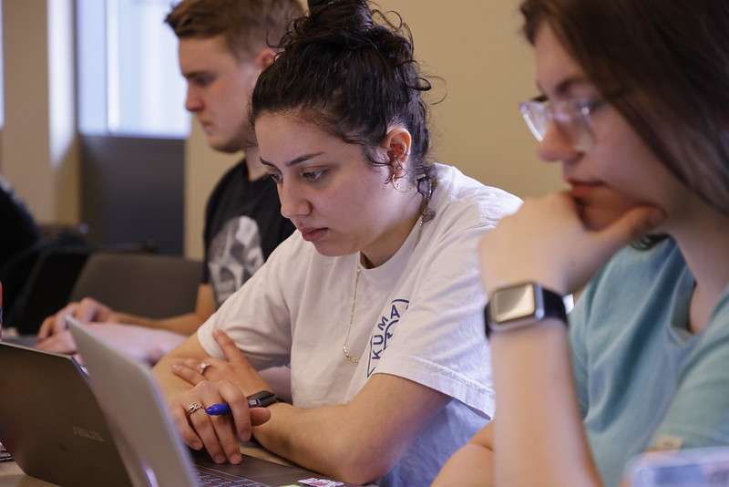

Thank you for your interest in the Criminal Justice Majors at the University of Washington Tacoma!
Thank

