Slide 1

ESSENTIALS OF PROPOSAL DEVELOPMENT
Kara Luckey, PhD
Proposal Development Consultant
kluckey@uw.edu
16. January 2026

Slide 2
Six big ideas to walk away with
Big Idea!
Engage your team! UWTOR staff are here to help at all stages of the process
The sponsor’s goal is to advance their priorities (not yours)
A proposal is a sales pitch
A proposal is not a journal article
Use structure and language to make reviewers’ work easier
Persistence is key to success
Notes:
--I IMAGINE ALL OF YOU HAVE BEEN EXPOSED TO THESE IDEAS THROUGHOUT YOUR CAREER, AND WE RECOGNIZE THAT YOU ALL ARE IN DIFFERENT PLACES IN YOUR CAREER AND HAVE DIFFERENT LEVELS OF EXPERIENCE WITH GRANT-WRITING
--BUT WE HOPE THAT THIS PROVIDES A ‘REFRESHER’/’REMINDER’ OF SOME OF THE PRINCIPLES OF SUCCESSFUL PROPOSAL WRITING, AND PERHAPS SOME NEW WAYS OF THINKING ABOUT THE BASICS
--THERE ARE THE BIG THINGS WE REALLY WANT YOU TO WALK AWAY WITH TODAY…

Slide 3
Why external funding?
Student researchers – providing (equitable) student research experiences
Faculty salary – course release, summer salary
Direct costs – supplies, equipment, participant incentives
Dissemination / Travel – publication costs, conferences, fieldwork
Non-tangibles – process of articulating objectives, framing arguments
Rich feedback (sometimes)

Slide 4

Engage your team!
https://www.tacoma.uw.edu/or
Notes:
One of the best things about UWT is the OR – access to resources and level of support not available at other institutions – engage with the team and leverage their support!

Slide 5

Positioning for funding success
Better positioning = increased competitiveness
Notes:
Sponsors are risk-adverse, look to collaborate with experienced PIs
Collaborators with track records can increase confidence / competitiveness
And can be helpful for your development as a PI
Seek opportunities to build your own track record, even with small roles
‘Lone PI’ approach increasingly less common

Slide 6
Positioning for funding success
Better positioning = increased competitiveness
Do the work! – publications / scholarly products
Notes:
Sponsors are risk-adverse, look to collaborate with experienced PIs
Collaborators with track records can increase confidence / competitiveness
And can be helpful for your development as a PI
Seek opportunities to build your own track record, even with small roles
‘Lone PI’ approach increasingly less common

Slide 7
Positioning for funding success
Better positioning = increased competitiveness
Do the work! – publications / scholarly products
Establish strategic collaborations / partnerships – experienced investigators, community partners, populations of interest, connect with campus resources
Notes:
Sponsors are risk-adverse, look to collaborate with experienced PIs
Collaborators with track records can increase confidence / competitiveness
And can be helpful for your development as a PI
Seek opportunities to build your own track record, even with small roles
‘Lone PI’ approach increasingly less common

Slide 8
Positioning for funding success
Better positioning = increased competitiveness
Do the work! – publications / scholarly products
Establish strategic collaborations / partnerships – experienced investigators, community partners, populations of interest, connect with campus resources
Think in building blocks – start small, build record
Notes:
Sponsors are risk-adverse, look to collaborate with experienced PIs
Collaborators with track records can increase confidence / competitiveness
And can be helpful for your development as a PI
Seek opportunities to build your own track record, even with small roles
‘Lone PI’ approach increasingly less common

Slide 9
Positioning for funding success
Better positioning = increased competitiveness
Do the work! – publications / scholarly products
Establish strategic collaborations / partnerships – experienced investigators, community partners, populations of interest, connect with campus resources
Think in building blocks – start small, build record
Consider ’hitching your wagon’ to experienced PIs –
helpful to development as PI and increasing
competitiveness / competency
Notes:
Sponsors are risk-adverse, look to collaborate with experienced PIs
Collaborators with track records can increase confidence / competitiveness
And can be helpful for your development as a PI
Seek opportunities to build your own track record, even with small roles
‘Lone PI’ approach increasingly less common

Slide 10

Positioning for funding success
Better positioning = increased competitiveness
Be strategic – Avoid throwing spaghetti!
  Pursuing a ‘reach’ can pay dividends
  (even if not awarded)
  But, consider the likely ROI –
  your time/energy is a limited resource!
Notes:
Sponsors are risk-adverse, look to collaborate with experienced PIs
Collaborators with track records can increase confidence / competitiveness
And can be helpful for your development as a PI
Seek opportunities to build your own track record, even with small roles
‘Lone PI’ approach increasingly less common

Slide 11
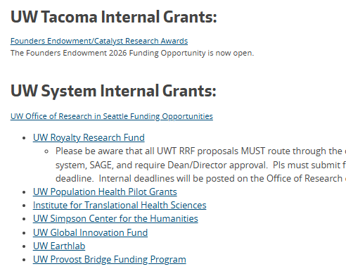
Positioning for funding success
Leverage internal funding!
https://www.tacoma.uw.edu/or/funding-sources
Notes:
Sponsors are risk-adverse, look to collaborate with experienced PIs
Collaborators with track records can increase confidence / competitiveness
And can be helpful for your development as a PI
Seek opportunities to build your own track record, even with small roles
‘Lone PI’ approach increasingly less common

Slide 12
Positioning for funding success
Leverage internal funding!
Royalty Research Fund (RRF) - due:
1st Monday in March → March 2, 2026
Last Monday in Sept → Sept 28, 2026
https://www.washington.edu/research/or/royalty-research-fund-rrf/
https://www.tacoma.uw.edu/or/funding-sources
Notes:
Sponsors are risk-adverse, look to collaborate with experienced PIs
Collaborators with track records can increase confidence / competitiveness
And can be helpful for your development as a PI
Seek opportunities to build your own track record, even with small roles
‘Lone PI’ approach increasingly less common

Slide 13

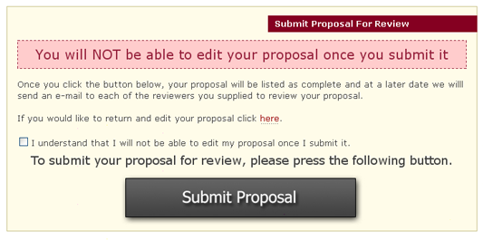

Positioning for funding success
The best way to understand what happens in the black box?
Serve as a reviewer!

Slide 14
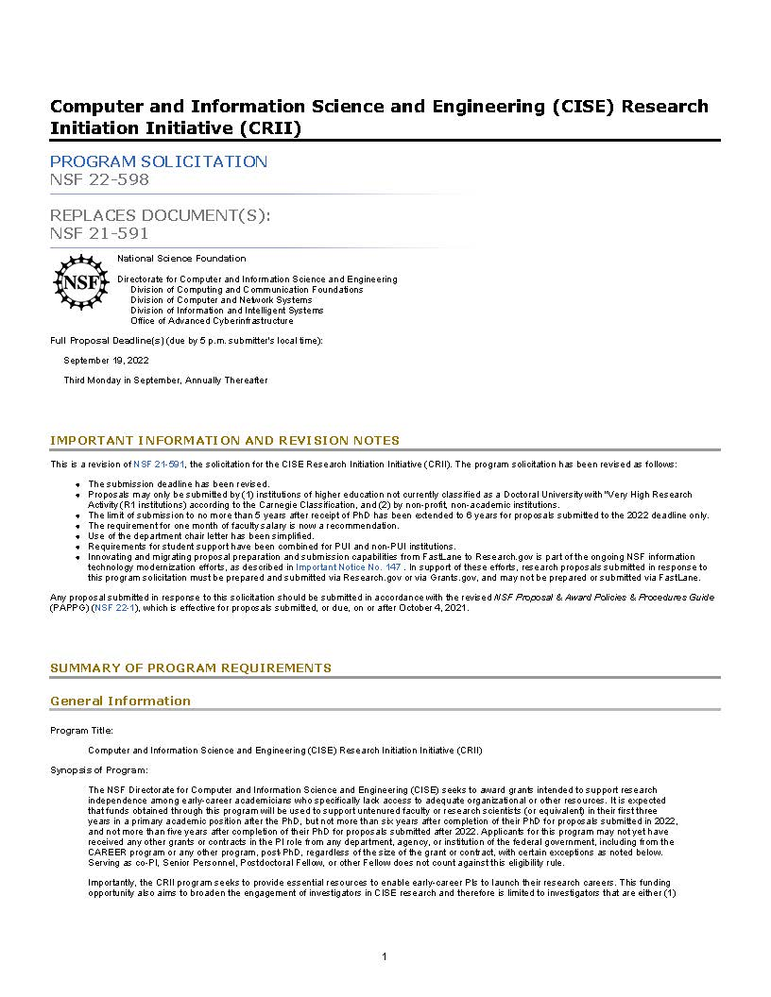
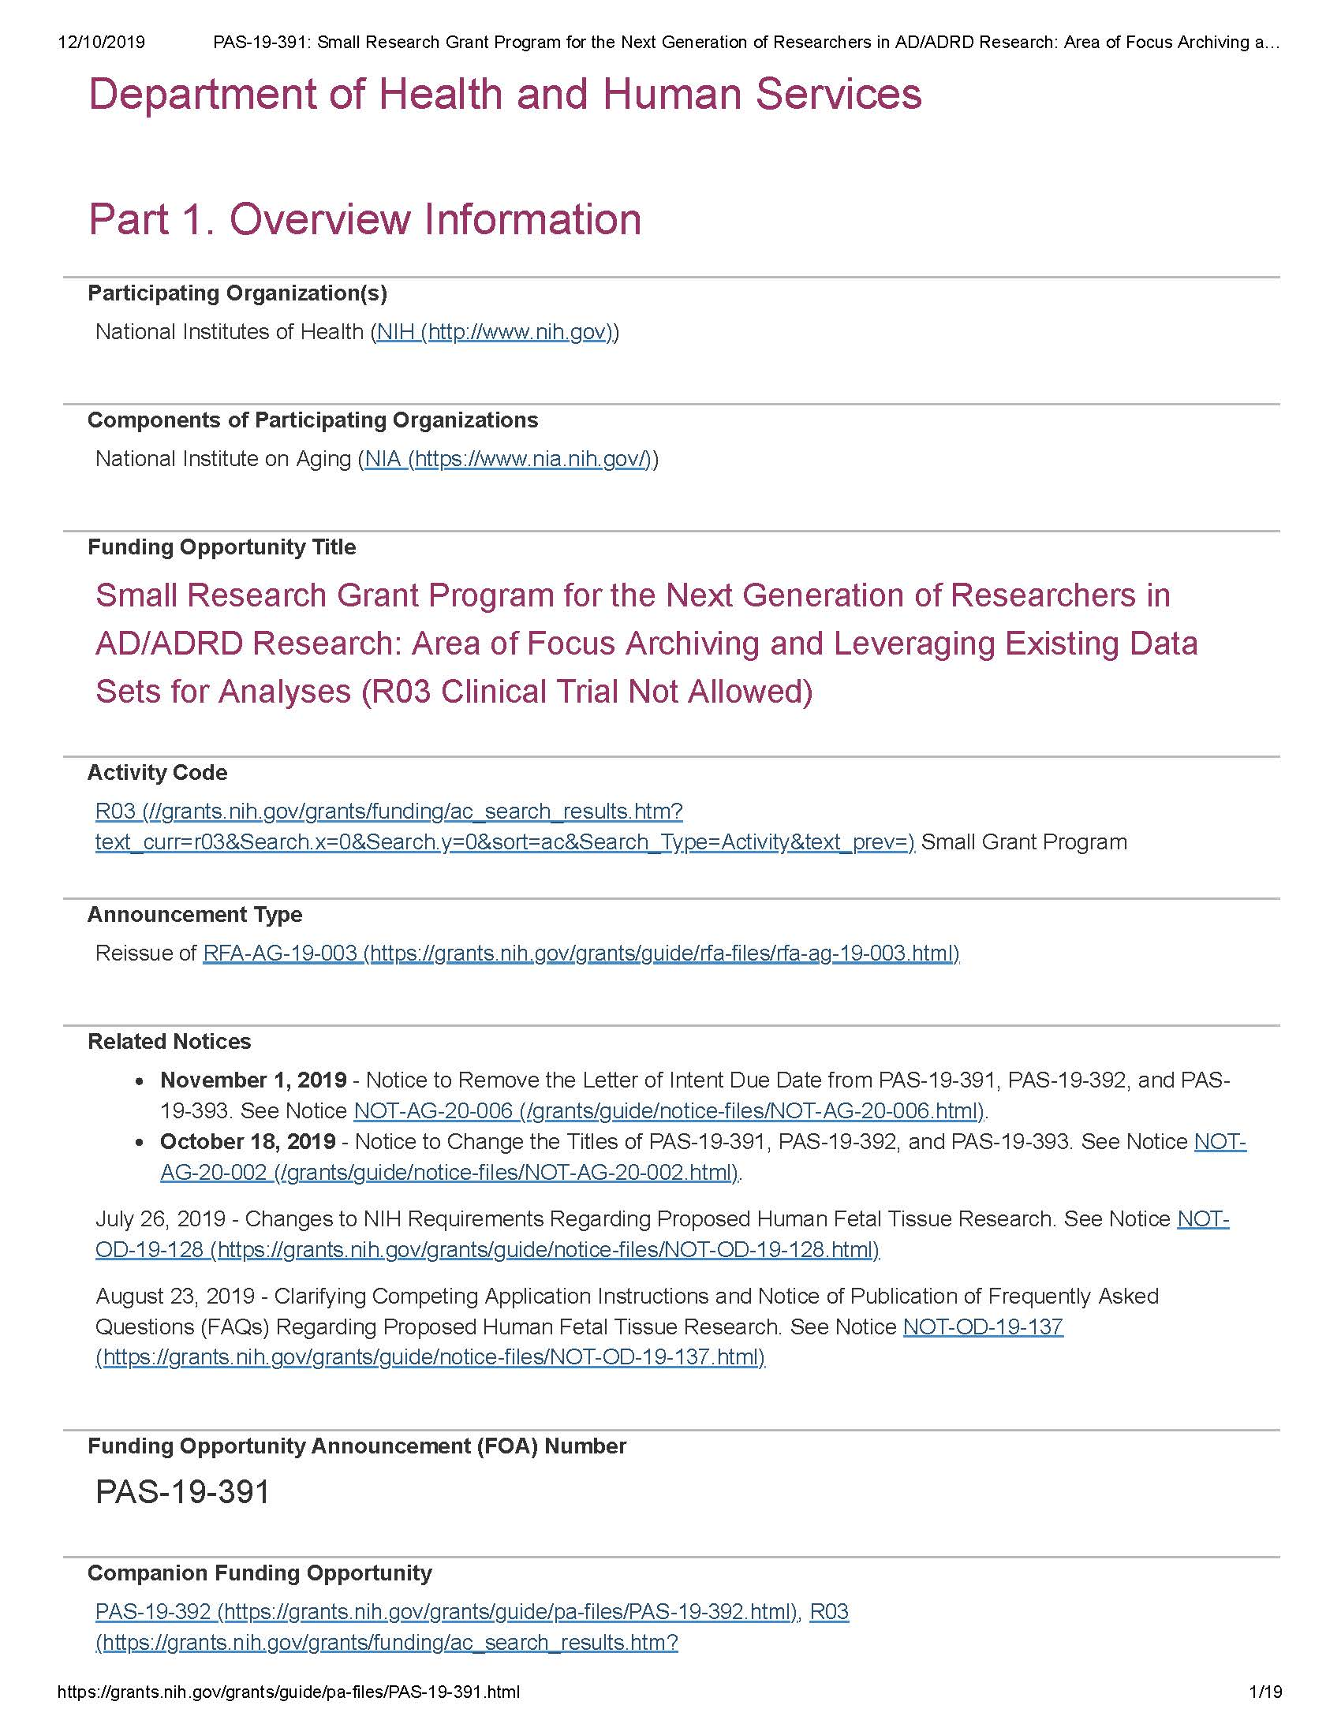
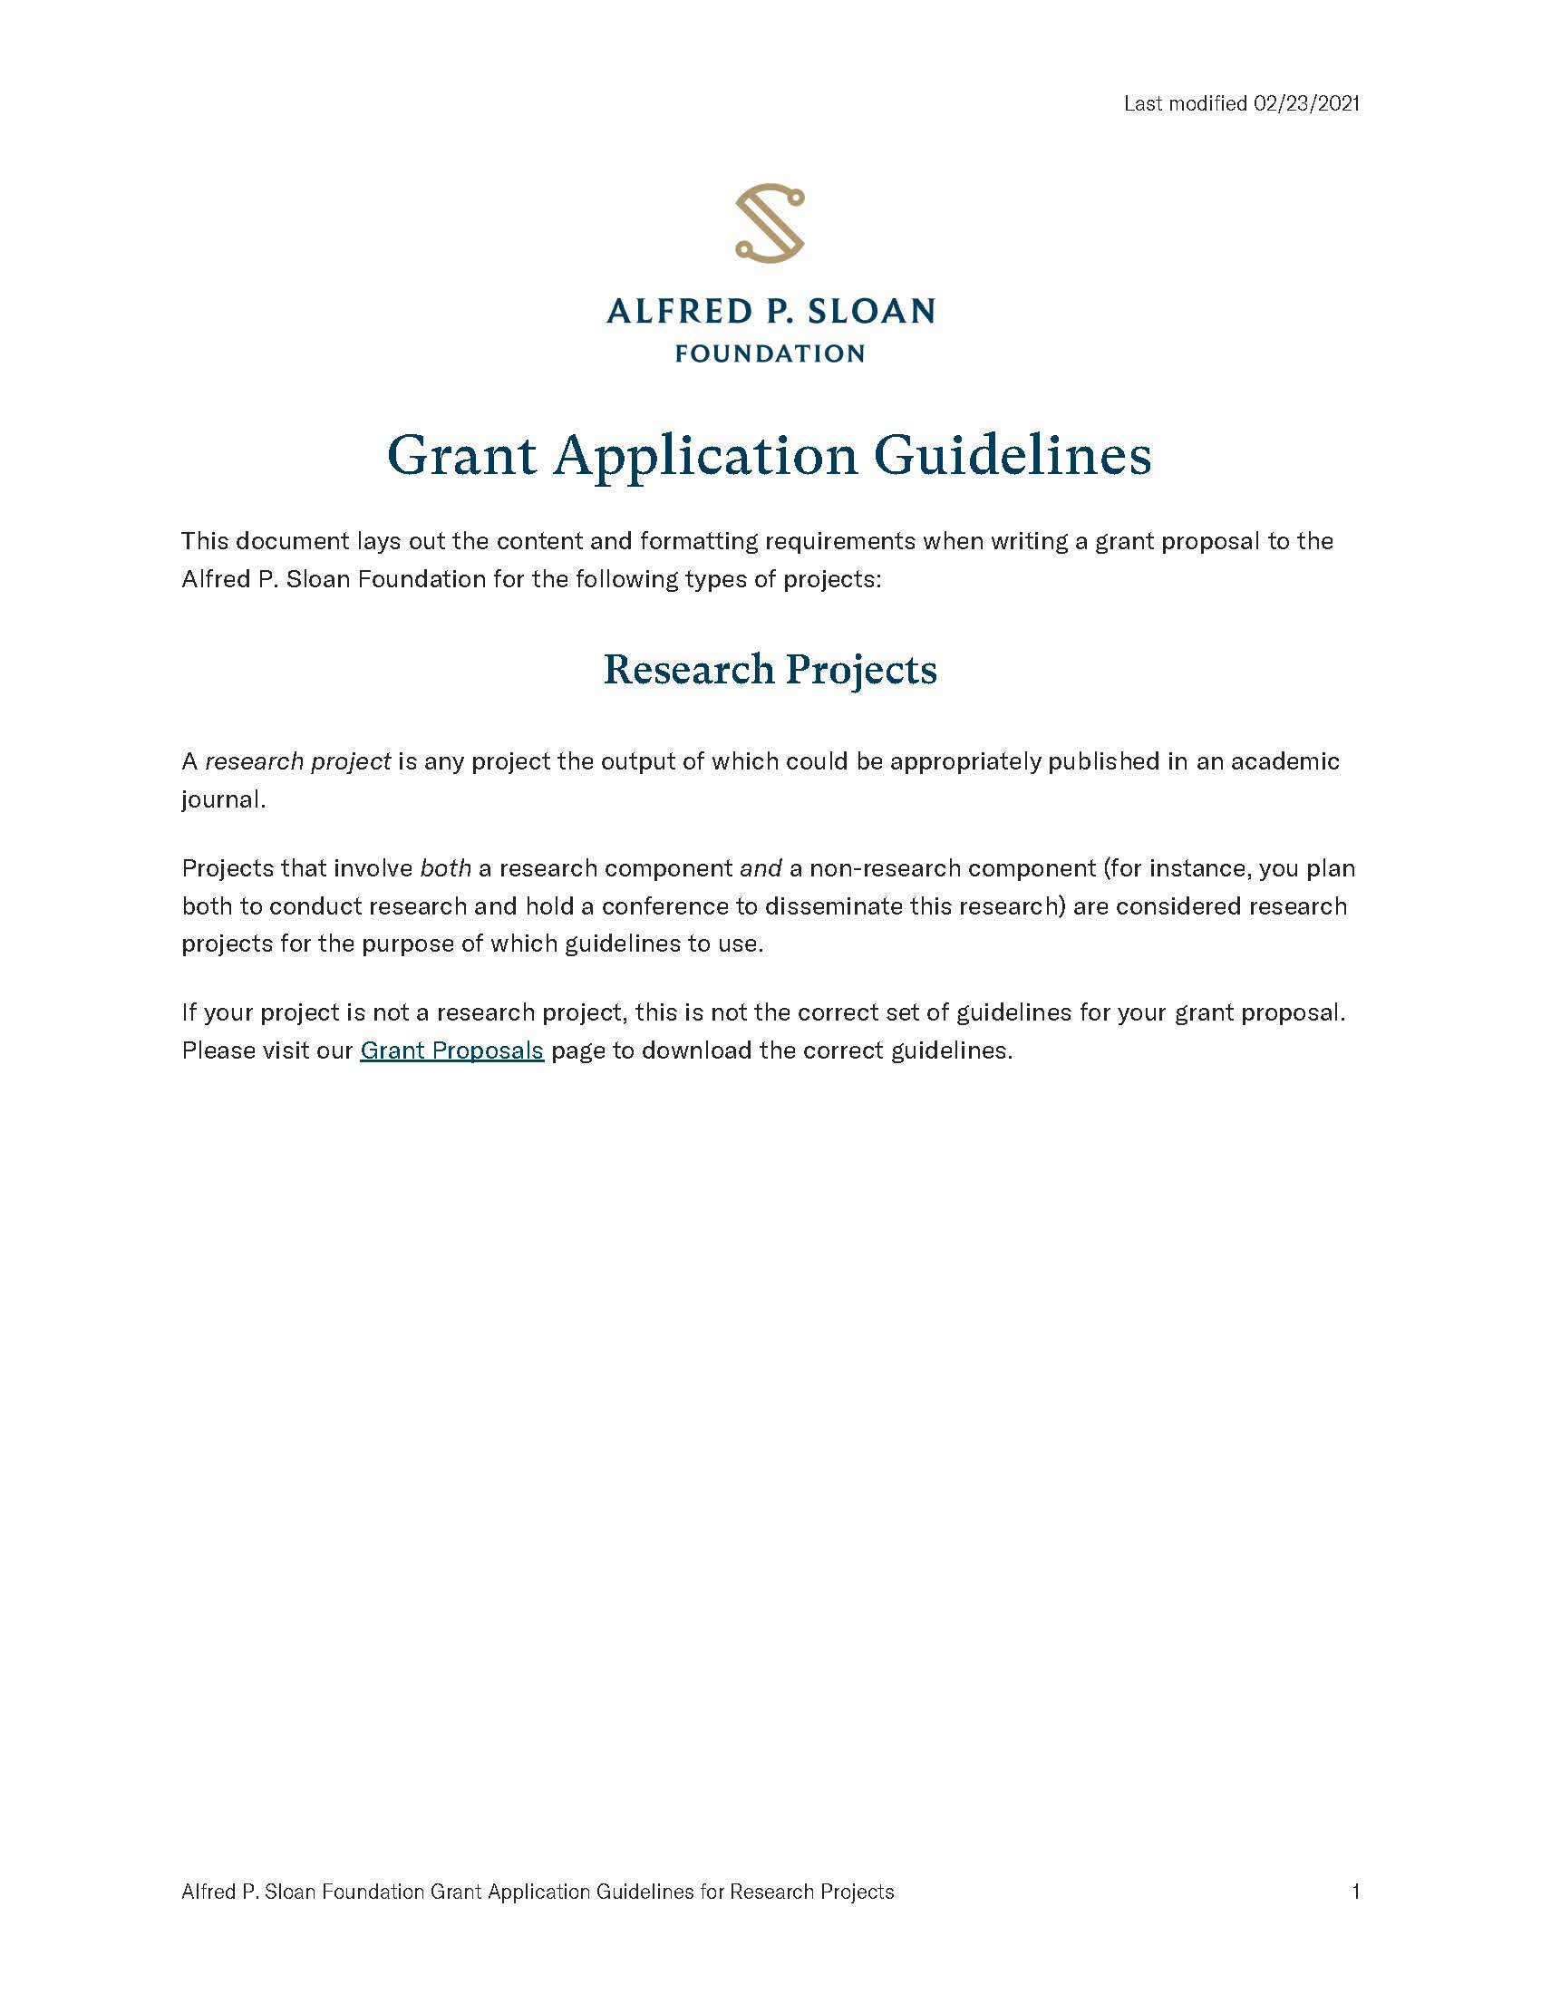
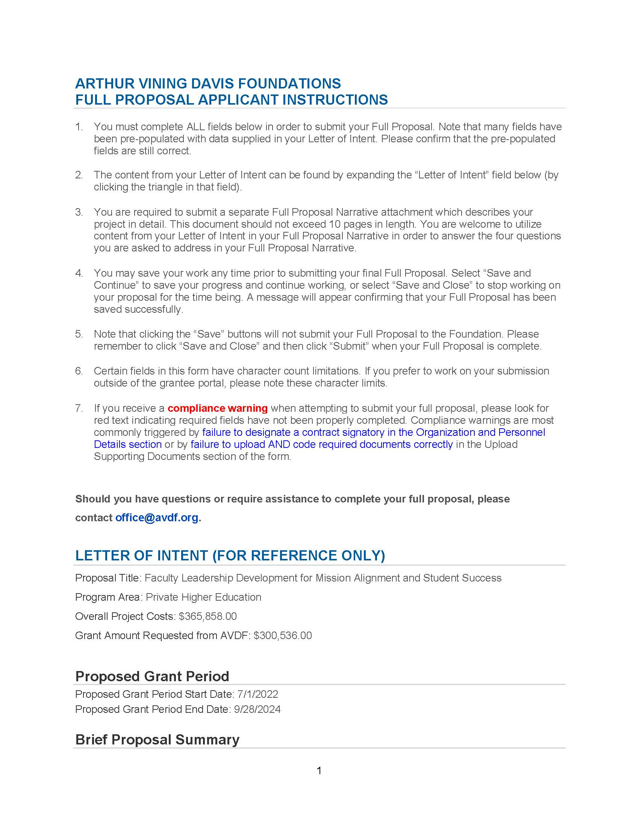
Positioning for funding success
Funding opportunity in hand, ready to write… Right?

Slide 15

Preparing to write

Slide 16

Understanding Sponsor Objectives
Big Idea!
Sponsor exists to fund work that achieves their (not your) objectives/priorities
Notes:
--SO, YOU’VE DECIDED IT’S A GO, AND YOU’RE BUCKLING IN TO PURSUE
--THE FIRST THING TO DO IS TO GET A SOLID HANDLE ON THE SPONSR’S OBJECTIVES
--THESE – NOT YOUR PROJECT AIMS - WILL BE YOUR GUIDING NORTH STAR THROUGHOUT THE PROPOSAL DEVELOPMENT AND WRITING PROCESS – ALWAYS COMING BACK TO THESE

Slide 17

Understanding Sponsor Objectives
Big Idea!
What the sponsor wants to achieve
What institution can support
What you
want to do
Notes:
--BASICALLY YOU’RE LOOKING FOR THAT SWEET SPOT BETWEEN…

Slide 18
Understanding Sponsor Objectives
Sponsor exists to fund work that achieves their objectives/priorities
Look for objectives throughout call for proposals and in...
  Mission statements, stated priority areas, strategic plans

Slide 19
Understanding Sponsor Objectives
Sponsor exists to fund work that achieves their objectives/priorities
Look for objectives throughout call for proposals and in...
  Mission statements, stated priority areas, strategic plans
Objectives vary widely by funder / type of proposal
  Federal: Very specific funding priorities
  Foundations: Carrying on the legacy of the founder
  Focused on supporting project or investigator or both

Slide 20
Understanding Sponsor Objectives
Sponsor exists to fund work that achieves their objectives/priorities
Look for objectives throughout call for proposals and in...
  Mission statements, stated priority areas, strategic plans
Objectives vary widely by funder / type of proposal
  Federal: Very specific funding priorities
  Foundations: Carrying on the legacy of the founder
  Focused on supporting project or investigator or both
As a prospective investigator, your work is:
  To demonstrate how you will achieve sponsor’s priorities
  To gain sponsor’s confidence that you have an achievable plan and ability

Slide 21
Understanding Review Criteria
Typical Review Criteria – usually boils down to:
Is it a ‘good’ idea? – Scientific / Intellectual Merit
Will it make a ‘difference’? – Need / Impact
Do you have a solid plan for carrying it out? – Plan / Procedures
Why are you uniquely qualified to do the work? - Qualifications

Slide 22
Understanding Review Criteria
As you review sponsor
objectives and review criteria:
List of key language used in
the call for proposals
A ‘checklist’ to guide writing
Mirror this language
Example: Key Language Checklist
“Advance new directions in research”
Provide support in “disciplines where external funding [is] minimal”
Increase “competitiveness for subsequent funding”
Support “junior faculty” in laying groundwork for long-term success
Support your “professional development” as a scholar
Support ‘capable investigators’ with ‘technically sound’ approaches
Will “lead to new discoveries or fundamental advances in the field”
Will “achieve societal/educational goals that are extrinsic to the field”

Slide 23
Conceptualizing the project
Logic models – can help to translate good idea
...into a fundable and actionable idea
…that achieves sponsor objectives
Budget/
Timeline
Project Activities
Actual ‘things’ you will do as part of the project
Project Objectives
Specific
Measurable
Attainable
Relevant
Time-bound
Project Aims
Broad outcomes that are anticipated to result from the project
Sponsor Objectives
Program goals that the project will ultimately advance
Notes:
Visually maps project activities to expected results and sponsor objectives
Saves time, frustration in the long-run – particularly if working with a team
Often most valuable when ‘Reverse Engineered’

Slide 24
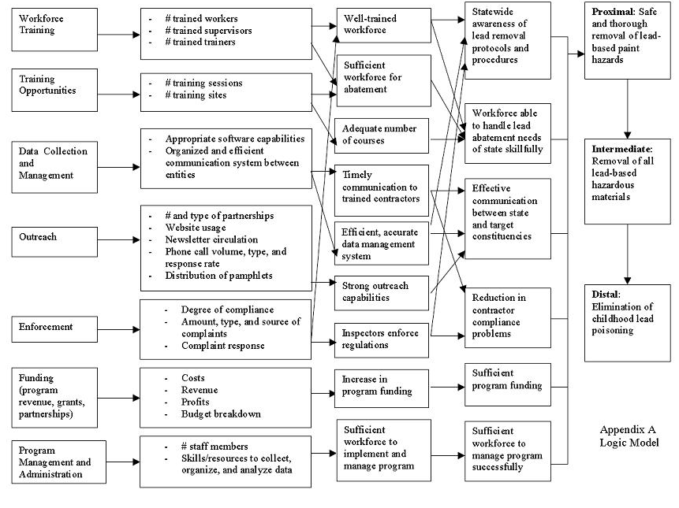
Budget/
Timeline
Project
Activities
Project Objectives
Project Aims
Sponsor Objectives
https://www.cdc.gov/nceh/lead/training/harvard/2008/al_lm.htm

Slide 25
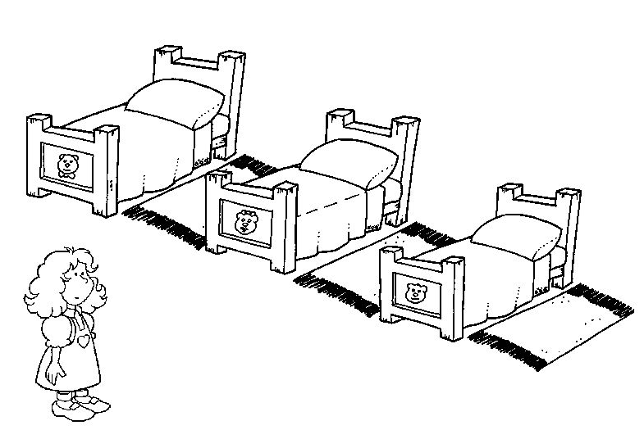
Conceptualizing the project
Defining Scope: The Goldilocks Principle
Too large = overpromising, spreading too thin?
Just right = can be reasonably achieved given budget, time, expertise, skillset
Too small = lack of experience / competence?
Notes:
--We can also help with SCOPE – one of the more common reviewer comments we see - overcommitted

Slide 26
Conceptualizing the project
Contacting the Program Officer
Private sponsors: Approach varies, strategize with UWTOR

Slide 27
Conceptualizing the project
Contacting the Program Officer
Private sponsors: Approach varies, strategize with UWTOR
Most federal sponsors are open to correspondence about project fit
  May be less responsive than in past
Develop 1-page overview:
  Brief motivation / gaps in existing knowledge, research questions, proposed activities, anticipated impact
Ask specific questions:
  Does the project fall within agency’s current priorities? Recommendations to increase likelihood of a favorable review? Common reasons for rejected proposals?

Slide 28
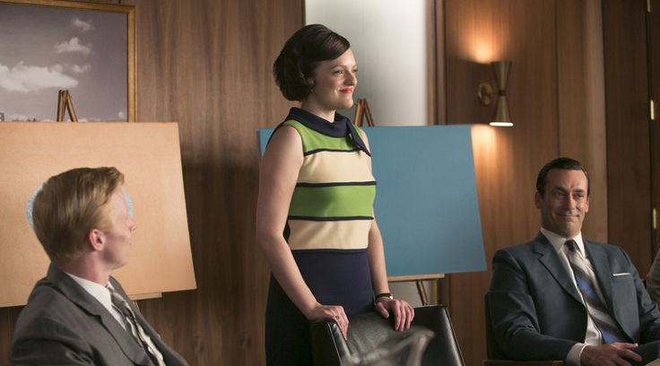
Big Idea!
Every proposal is a sales pitch.
Notes:
If there’s one thing I want you to come away from today it’s: EVERY PROPOSAL IS A SALES PITCH
-So you CAN’T APPROACH AS YOU WOULD A PEER-REVIEW PAPER
-You are SELLING STOCK IN YOUR IDEA and to various extents depending on the funder – YOURSELF
-Sponsor needs to TRUST THAT YOU WILL DELIVER HIGH ROI

Slide 29

Good place to start: The elevator pitch –
you’ll have an opportunity to work on your pitch shortly!

Slide 30
Proposal components
Also a business plan
  Fits the need of the client
  Realistic and can be implemented
  Clearly identifies responsibilities
  Clearly identifies assumptions
  Metrics of success – can track results against a plan
  Substantiated by evidence of success
  Kept alive by regular review and follow-up
Effective proposals sell by telling a coherent, compelling story…
…in a very specific format

Slide 31
Proposal components
1) Title / Cover Page
2) Project Summary / Abstract
3) Project Narrative / Description
Background/Motivation
Existing Literature
Research Questions/Objectives/
Specific Aims
Research Plan/Procedure
Contributions/Broader Impacts
Evaluation/Assessment Plan
4) References
5) Curriculum Vitae / Biosketches
6) Timeline
7) Budget and Budget Justification
8) Supplementary Documents
Current and Pending Support
Facilities and Equipment
Letters of Recommendation/Support
Data Management Plan
Institutional Certifications
Impact Statement

Slide 32
Proposal components
Every component contributes to the sales pitch
1) Title / Cover Page
2) Project Summary / Abstract
3) Project Narrative / Description
Background/Motivation
Existing Literature
Research Questions/Objectives/
Specific Aims
Research Plan/Procedure
Contributions/Broader Impacts
Evaluation/Assessment Plan
4) References
5) Curriculum Vitae / Biosketches
6) Timeline
7) Budget and Budget Justification
8) Supplementary Documents
Current and Pending Support
Facilities and Equipment
Letters of Recommendation/Support
Data Management Plan
Institutional Certifications
Impact Statement

Slide 33
Proposal components
Every component contributes to the sales pitch
Title
  Goal is to standout; Easily understandable – often used to assign reviewers

Slide 34
Proposal components
Every component contributes to the sales pitch
Title
  Goal is to standout; Easily understandable – often used to assign reviewers
Bibliography / References
  May be read first to situate in literature
  Shows that you understand the current state of field and will not duplicate others’ efforts
  Cite, don’t slight – reviewers may be the slighted!

Slide 35
Proposal components
Every component contributes to the sales pitch
Title
  Goal is to standout; Easily understandable – often used to assign reviewers
Bibliography / References
  May be read first to situate in literature
  Shows that you understand the current state of field and will not duplicate others’ efforts
  Cite, don’t slight – reviewers may be the slighted!
Curriculum Vitae / Biographical Sketch
  Use to bolster your story – don’t submit a multi-purpose CV

Slide 36
Proposal components
Every component contributes to the sales pitch
Title
  Goal is to standout; Easily understandable – often used to assign reviewers
Bibliography / References
  May be read first to situate in literature
  Shows that you understand the current state of field and will not duplicate others’ efforts
  Cite, don’t slight – reviewers may be the slighted!
Curriculum Vitae / Biographical Sketch
  Use to bolster your story – don’t submit a multi-purpose CV
Timeline
  Not always required, but a good idea; Consistency is key

Slide 37
Proposal components
Every component contributes to the sales pitch
Budget
  Drives the ‘story,’ roadmap for the project
  Reasonable, justifiable, and consistent with your narrative
  Ensure that you can afford to do what you say you will do

Slide 38
Proposal components
Every component contributes to the sales pitch
Budget
  Drives the ‘story,’ roadmap for the project
  Reasonable, justifiable, and consistent with your narrative
  Ensure that you can afford to do what you say you will do
Budget Justification
  Thoroughness builds credibility with sponsor
  Language should convey a sense of stewardship
  Think of as space to sell the project, not just report on project activities

Slide 39
Proposal components
Every component contributes to the sales pitch
Budget
  Drives the ‘story,’ roadmap for the project
  Reasonable, justifiable, and consistent with your narrative
  Ensure that you can afford to do what you say you will do
Budget Justification
  Thoroughness builds credibility with sponsor
  Language should convey a sense of stewardship
  Think of as space to sell the project, not just report on project activities
UWTOR is here to help!

Slide 40
Proposal components
Every component contributes to the sales pitch
Letters of support (when allowed)
  Often particularly important for foundation grants
  Beware of requirements / restrictions, especially among federal sponsors (e.g. NSF)
  Speak to your intellectual and collaborative contributions, strengths, and potential
  Get started well ahead of the deadline

Slide 41
Proposal components
The heart of the proposal
1) Title / Cover Page
2) Project Summary / Abstract
3) Project Narrative / Description
Background/Motivation
Existing Literature
Research Questions/Objectives/
Specific Aims
Research Plan/Procedure
Contributions/Broader Impacts
Evaluation/Assessment Plan
4) References
5) Curriculum Vitae / Biosketches
6) Timeline
7) Budget and Budget Justification
8) Supplementary Documents
Current and Pending Support
Facilities and Equipment
Letters of Recommendation/Support
Data Management Plan
Institutional Certifications
Impact Statement

Slide 42
Crafting a compelling proposal
Know your reviewers
Scientifically-literate, but possibly uninformed
  Do not assume existing knowledge about your topic
  But, be careful not to “talk down” to readers with more expertise

Slide 43

Crafting a compelling proposal
Know your reviewers
Scientifically-literate, but possibly uninformed
  Do not assume existing knowledge about your topic
  But, be careful not to “talk down” to readers with more expertise
Actual Humans!
  Volunteering their time, likely same constraints as you

Slide 44
Crafting a compelling proposal
Know your reviewers
Scientifically-literate, but possibly uninformed
  Do not assume existing knowledge about your topic
  But, be careful not to “talk down” to readers with more expertise
Actual Humans!
  Volunteering their time, likely same constraints as you
Empathize, seek to understand where they might be coming from
  What might they already know or think they know? What biases might they hold?
  What must they learn from you in order to be excited?

Slide 45
Crafting a compelling proposal
Know your reviewers
Scientifically-literate, but possibly uninformed
  Do not assume existing knowledge about your topic
  But, be careful not to “talk down” to readers with more expertise
Actual Humans!
  Volunteering their time, likely same constraints as you
Empathize, seek to understand where they might be coming from
  What might they already know or think they know? What biases might they hold?
  What must they learn from you in order to be excited?
Goal: To make them your champion – without a champion, likely declined

Slide 46
Crafting a compelling proposal
Know your reviewers
For federal grants - and some private – Program Officer is ultimate reviewer
  Have their own incentive structures and goals
  Understand their objectives and help to achieve them!
A well-crafted elevator pitch –
  Crucial to hooking the “PO” / program staff

Slide 47
Crafting a compelling proposal
What we know about recent changes to merit review (federal)
Program Officers likely to become more important – for example,
NSF Proposal and Awards Policies and Procedures Guide (PAPPG) Supplement 1 (Dec 8, 2025):
  POs encouraged to decline proposals when “does not contain sufficient content to permit effective merit review”
  Minimum number of reviewers reduced to 2 (from 3) – one of which can be “NSF staff”
  POs may be expected to “maximize their use of available automated merit review tools”
  (per leaked memo*)
“Senior Appointees” likely to be involved in approving grants**
*Leaked memo to NSF staff (December 1, 2025)
**Executive Order 14322: Improving Oversight of Federal Grant-making (August 7, 2025)

Slide 48
Crafting a compelling proposal
Big Idea!
Proposals are not manuscripts

Slide 49
Crafting a compelling proposal
Proposals are not manuscripts
Manuscripts: Reader is reading because they’re interested, wanting to learn
  Reader is patient
  Punch is in the conclusion – arguments build slowly throughout to “punch” at end

Slide 50
Crafting a compelling proposal
Proposals are not manuscripts
Proposals: Reader is reading because they owe it to the sponsor
  Reader quickly assessing where it stands among its peers, is it worth investing in
  Alert to fatal flaws so they can say ‘no’ and move on to the next one
  Punch is up front – do not have the luxury of slow build

Slide 51
Crafting a compelling proposal
Proposals are not manuscripts
Proposals: Reader is reading because they owe it to the sponsor
  Reader quickly assessing where it stands among its peers, is it worth investing in
  Alert to fatal flaws so they can say ‘no’ and move on to the next one
  Punch is up front – do not have the luxury of slow build
  The 20-minute / first-page rule: Must catch attention early and keep it

Slide 52
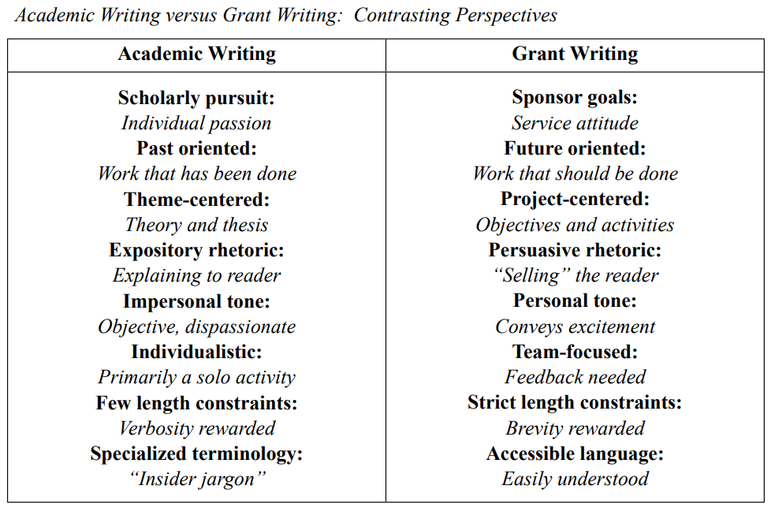
Crafting a compelling proposal
Source: Porter, R. (2007). Why Academics Have a Hard Time Writing Good Grant Proposals. Journal of Research Administration, 38(2), 37-43.

Slide 53
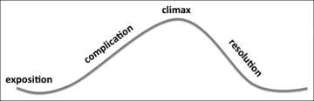
Crafting a compelling proposal
An effective sales pitch tells a coherent, compelling story….
Classic narrative arc
climax
complication
resolution
exposition
denouement
Notes:
I WANT TO GET BACK TO THIS IDEA THAT YOU ARE SELLING YOUR IDEA, AND THAT EFFECTIVE SALES PITCHES TELL A…

Slide 54

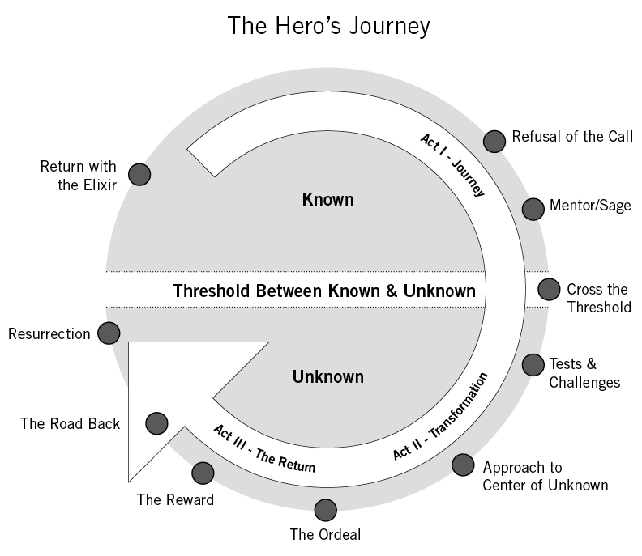
The Hero’s Journey
Notes:
-ANOTHER WAY TO THINK OF THIS is the classic Hero’s Journey TROPE
-NO TWISTS/TURNS
-Reviewer should know EXACTLY WHERE THE PROPOSAL IS GOING
-Goal is to REDUCE COGNITIVE LOAD – Feels formulaic because it is!

Slide 55
climax
complication
resolution
exposition
denouement
Motivation / Background
There is a Big Problem / Need
It’s really, really important because…

Slide 56
Create empathy & urgency for solving a clear ‘problem’
climax
complication
resolution
exposition
denouement
Motivation / Background
There is a Big Problem / Need
It’s really, really important because…

Slide 57
climax
complication
resolution
exposition
denouement
Existing Knowledge
We know some things about this problem / idea…
But we don’t know some other really important things about it
And it is critical that we fill these gaps in our knowledge because…

Slide 58
Establish a clear gap in knowledge, and the importance of filling it
climax
complication
resolution
exposition
denouement
Existing Knowledge
We know some things about this problem / idea…
But we don’t know some other really important things about it
And it is critical that we fill these gaps in our knowledge because…

Slide 59
climax
complication
resolution
exposition
denouement
Questions / Hypotheses / Objectives
Luckily, I/we have a brilliant idea for how to fill these gaps in our knowledge!
Here are the specific objectives I/will achieve in filling these gaps
Here is how my preliminary work will be leveraged towards the proposed work

Slide 60
Questions / Hypotheses that will address The Gap;
SMART Objectives
climax
complication
resolution
exposition
denouement
Questions / Hypotheses / Objectives
Luckily, I/we have a brilliant idea for how to fill these gaps in our knowledge!
Here are the specific objectives I/will achieve in filling these gaps
Here is how my preliminary work will be leveraged towards the proposed work

Slide 61
climax
complication
resolution
exposition
denouement
Plan / Procedure / Methods
This is the plan for how I/we will do so…
It is a good plan because…
I/we are the right people to carry out this plan because…

Slide 62
All pragmatic issues are addressed; Plan that establishes credibility
climax
complication
resolution
exposition
denouement
Plan / Procedure / Methods
This is the plan for how I/we will do so…
It is a good plan because…
I/we are the right people to carry out this plan because…

Slide 63
climax
complication
resolution
exposition
denouement
Expected Contributions / Broader Impacts
A happy ending! The proposal will have a considerable impact on…
The sponsor’s objectives!
State of knowledge in the field
Benefits to specific population(s) / society
Your scholarly trajectory

Slide 64
Demonstrate impact – state of knowledge, societal, professional
climax
complication
resolution
exposition
denouement
Expected Contributions / Broader Impacts
A happy ending! The proposal will have a considerable impact on…
The sponsor’s objectives!
State of knowledge in the field
Benefits to specific population(s) / society
Your scholarly trajectory

Slide 65
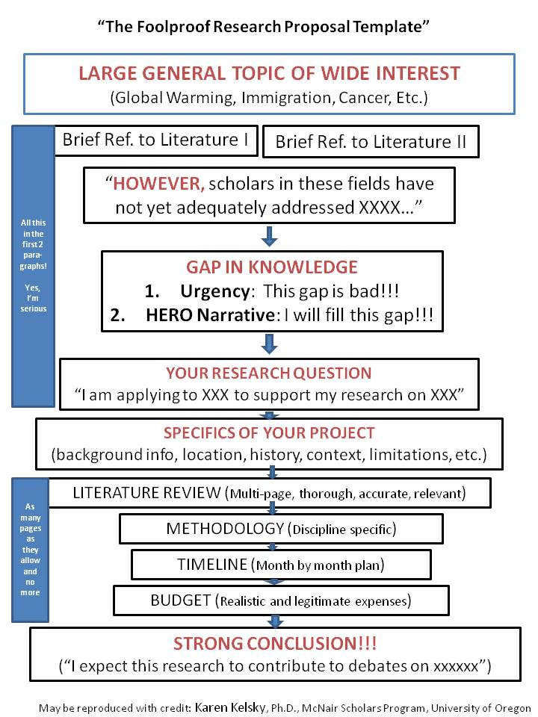
Source: https://theprofessorisin.com/2011/07/05/dr-karens-foolproof-grant-template/
Notes:
-Another, more precise way to think about this COMES FROM KAREN KELSKY - You might want to check out her website, THE PROFESSOR IS IN – some helpful tools
-PROVIDED THIS AS A HANDOUT – I think it can be a really useful template
-FEELS FORMULAIC – BECAUSE IT IS – funders want predictability

Slide 66
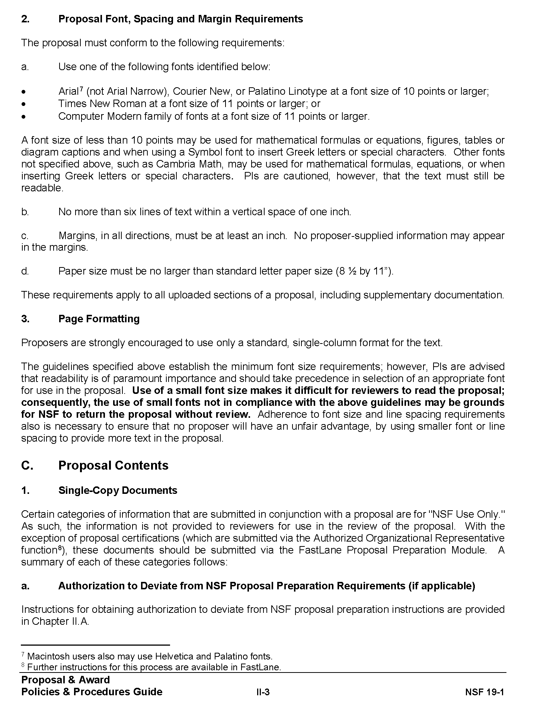
Formatting
Packaging your good idea well:
Follow the RFP directions precisely

Slide 67
Formatting
Packaging your good idea well:
Follow the RFP directions precisely
Don’t let formatting be the barrier to funding
  Maximize white space, legible fonts
  Declarative and consistent headings
  Typos make it easy to dismiss

Slide 68
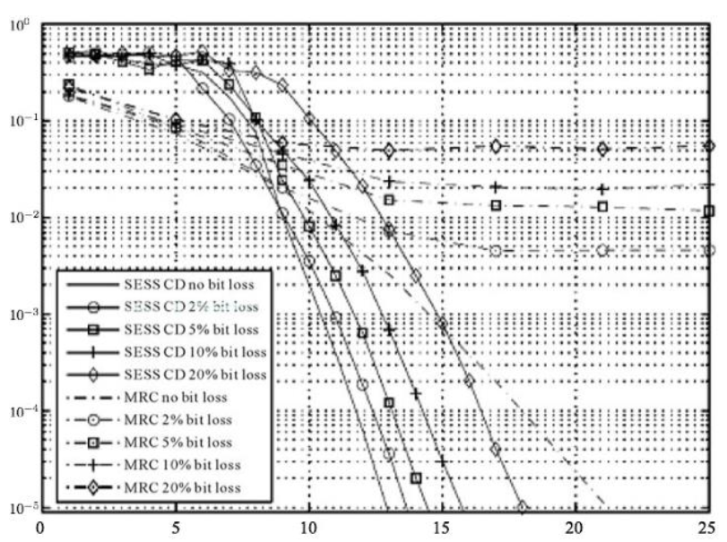
Formatting
Packaging your good idea well:
Follow the RFP directions precisely
Don’t let formatting be the barrier to funding
  Maximize white space, legible fonts
  Declarative and consistent headings
  Typos make it easy to dismiss
Figures that contribute, not distract
  Title/descriptions that add to narrative
  Legends that describe
  Don’t assume printed in color

Slide 69
Brevity matters!
Think critically about whether details help the story, or distract from it
  Reading aloud, or having read aloud to you can help
Every word serves a purpose – minimize unnecessary ‘fluff’
  e.g. “It has been shown that…”; “Indeed, one might argue…”
Do not use formatting to achieve brevity
Writing pro-tips
Big Idea!
Use structure to make reviewers’ work easier!
Language matters!
Confident (we will, I aim) vs. “hedging” (might, could, try)
  “We” only when accurate; if not, “I” – own your contributions!
  Jargon vs. Technical terms
    Would you use it in conversation? If not – don’t use in proposal
    Technical terms collapse complex concepts into a single term – DEFINE!
    Minimize acronyms to 3-4, even if they are common
    Avoid opportunities for reviewer feel uninformed
Never complain
  Don’t give reviewers a reason to dismiss your proposal

Slide 70
Brevity matters!
Think critically about whether details help the story, or distract from it
  Reading aloud, or having read aloud to you can help
Every word serves a purpose – minimize unnecessary ‘fluff’
  e.g. “It has been shown that…”; “Indeed, one might argue…”
Do not use formatting to achieve brevity
Writing pro-tips
Use structure to make reviewers’ work easier!
Use headings strategically – possibly mirror review criteria (if allowed)
Language matters!
Confident (we will, I aim) vs. “hedging” (might, could, try)
  “We” only when accurate; if not, “I” – own your contributions!
  Jargon vs. Technical terms
    Would you use it in conversation? If not – don’t use in proposal
    Technical terms collapse complex concepts into a single term – DEFINE!
    Minimize acronyms to 3-4, even if they are common
    Avoid opportunities for reviewer feel uninformed
Never complain
  Don’t give reviewers a reason to dismiss your proposal

Slide 71
Brevity matters!
Think critically about whether details help the story, or distract from it
  Reading aloud, or having read aloud to you can help
Every word serves a purpose – minimize unnecessary ‘fluff’
  e.g. “It has been shown that…”; “Indeed, one might argue…”
Do not use formatting to achieve brevity
Writing pro-tips
Use structure to make reviewers’ work easier!
Use headings strategically – possibly mirror review criteria (if allowed)
Leave ‘breadcrumbs’
  Use list of key language – make it easy to see you have “checked the boxes”
  Use bold (avoid italics/underline) for text that speaks directly to review criteria
Language matters!
Confident (we will, I aim) vs. “hedging” (might, could, try)
  “We” only when accurate; if not, “I” – own your contributions!
  Jargon vs. Technical terms
    Would you use it in conversation? If not – don’t use in proposal
    Technical terms collapse complex concepts into a single term – DEFINE!
    Minimize acronyms to 3-4, even if they are common
    Avoid opportunities for reviewer feel uninformed
Never complain
  Don’t give reviewers a reason to dismiss your proposal

Slide 72
Brevity matters!
Think critically about whether details help the story, or distract from it
  Reading aloud, or having read aloud to you can help
Every word serves a purpose – minimize unnecessary ‘fluff’
  e.g. “It has been shown that…”; “Indeed, one might argue…”
Do not use formatting to achieve brevity
Writing pro-tips
Use structure to make reviewers’ work easier!
Use headings strategically – possibly mirror review criteria (if allowed)
Leave ‘breadcrumbs’
  Use list of key language – make it easy to see you have “checked the boxes”
  Use bold (avoid italics/underline) for text that speaks directly to review criteria
Strong first and last paragraphs within each section – most likely to be read
Language matters!
Confident (we will, I aim) vs. “hedging” (might, could, try)
  “We” only when accurate; if not, “I” – own your contributions!
  Jargon vs. Technical terms
    Would you use it in conversation? If not – don’t use in proposal
    Technical terms collapse complex concepts into a single term – DEFINE!
    Minimize acronyms to 3-4, even if they are common
    Avoid opportunities for reviewer feel uninformed
Never complain
  Don’t give reviewers a reason to dismiss your proposal

Slide 73
Brevity matters!
Think critically about whether details help the story, or distract from it
  Reading aloud, or having read aloud to you can help
Every word serves a purpose – minimize unnecessary ‘fluff’
  e.g. “It has been shown that…”; “Indeed, one might argue…”
Do not use formatting to achieve brevity
Writing pro-tips
Use structure to make reviewers’ work easier!
Use headings strategically – possibly mirror review criteria (if allowed)
Leave ‘breadcrumbs’
  Use list of key language – make it easy to see you have “checked the boxes”
  Use bold (avoid italics/underline) for text that speaks directly to review criteria
Strong first and last paragraphs within each section – most likely to be read
Simple sentences = stronger arguments
Language matters!
Confident (we will, I aim) vs. “hedging” (might, could, try)
  “We” only when accurate; if not, “I” – own your contributions!
  Jargon vs. Technical terms
    Would you use it in conversation? If not – don’t use in proposal
    Technical terms collapse complex concepts into a single term – DEFINE!
    Minimize acronyms to 3-4, even if they are common
    Avoid opportunities for reviewer feel uninformed
Never complain
  Don’t give reviewers a reason to dismiss your proposal

Slide 74
Brevity matters!
Think critically about whether details help the story, or distract from it
  Reading aloud, or having read aloud to you can help
Every word serves a purpose – minimize unnecessary ‘fluff’
  e.g. “It has been shown that…”; “Indeed, one might argue…”
Do not use formatting to achieve brevity
Writing pro-tips
Use structure to make reviewers’ work easier!
Use headings strategically – possibly mirror review criteria (if allowed)
Leave ‘breadcrumbs’
  Use list of key language – make it easy to see you have “checked the boxes”
  Use bold (avoid italics/underline) for text that speaks directly to review criteria
Strong first and last paragraphs within each section – most likely to be read
Simple sentences = stronger arguments
Strong concluding paragraph – tell reviewers what to write in their review
Language matters!
Confident (we will, I aim) vs. “hedging” (might, could, try)
  “We” only when accurate; if not, “I” – own your contributions!
  Jargon vs. Technical terms
    Would you use it in conversation? If not – don’t use in proposal
    Technical terms collapse complex concepts into a single term – DEFINE!
    Minimize acronyms to 3-4, even if they are common
    Avoid opportunities for reviewer feel uninformed
Never complain
  Don’t give reviewers a reason to dismiss your proposal

Slide 75
Brevity matters!
Think critically about whether details help the story, or distract from it
  Reading aloud, or having read aloud to you can help
Every word serves a purpose – minimize unnecessary ‘fluff’
  e.g. “It has been shown that…”; “Indeed, one might argue…”
Do not use formatting to achieve brevity
Writing pro-tips
Big Idea!
Use language to make reviewers’ work easier!
Language matters!
Confident (we will, I aim) vs. “hedging” (might, could, try)
  “We” only when accurate; if not, “I” – own your contributions!
  Jargon vs. Technical terms
    Would you use it in conversation? If not – don’t use in proposal
    Technical terms collapse complex concepts into a single term – DEFINE!
    Minimize acronyms to 3-4, even if they are common
    Avoid opportunities for reviewer feel uninformed
Never complain
  Don’t give reviewers a reason to dismiss your proposal

Slide 76
Writing pro-tips
Use language to make reviewers’ work easier!
Eliminate ‘fluff’ – Read aloud to identify unnecessary words
Active and personal – Who will be doing this impressive work? You! (not “will be tested,” but “we will test”)
Confident and affirmative (not “try, ” but “will”) – Not the time for humility
Jargon-free / -light – Know your audience
Skillfully repetitive – Consistent use of ‘key language’
Minimize acronyms – Even known acronyms carry cognitive load
Language matters!
Confident (we will, I aim) vs. “hedging” (might, could, try)
  “We” only when accurate; if not, “I” – own your contributions!
  Jargon vs. Technical terms
    Would you use it in conversation? If not – don’t use in proposal
    Technical terms collapse complex concepts into a single term – DEFINE!
    Minimize acronyms to 3-4, even if they are common
    Avoid opportunities for reviewer feel uninformed
Never complain
  Don’t give reviewers a reason to dismiss your proposal

Slide 77
Writing pro-tips
A few words on the use of generative AI in proposal writing
Know sponsor policy – e.g.:
  NSF proposers are “encouraged to indicate in the project description the extent to which, if any, generative AI technology was used and how it was used to develop their proposal.”*
  NSF Research Misconduct Policy prohibits “fabrication, falsification, or plagiarism,” now “including by AI-based tools”**
  NIH applications that contain sections that are “substantially developed by AI” are considered to “not be the original ideas of applicants and will not be considered”***
Know your UW resources – e.g. AI@UW Community of Practice (join here)
UWTOR is here to help in navigating this quickly-evolving landscape!
*Notice to research community: Use of generative artificial intelligence technology in the NSF merit review process (Dec 14, 2023)
**NSF Proposals and Awards Policy and Procedures Guide 24-1 – Supplement 1 (Dec 8, 2025)
***NIH NOT-OD-25-132: Supporting Fairness and Originality in NIH Research Applications (July 17,2025)
Language matters!
Confident (we will, I aim) vs. “hedging” (might, could, try)
  “We” only when accurate; if not, “I” – own your contributions!
  Jargon vs. Technical terms
    Would you use it in conversation? If not – don’t use in proposal
    Technical terms collapse complex concepts into a single term – DEFINE!
    Minimize acronyms to 3-4, even if they are common
    Avoid opportunities for reviewer feel uninformed
Never complain
  Don’t give reviewers a reason to dismiss your proposal

Slide 78
Writing pro-tips
Language use in our new world
Avoid terminology that has been ‘politicized’ in favor or ‘neutral’ alternatives – e.g.
  “Open to all”
  “Increasing participation”
  “overcoming obstacles”
Language matters!
Confident (we will, I aim) vs. “hedging” (might, could, try)
  “We” only when accurate; if not, “I” – own your contributions!
  Jargon vs. Technical terms
    Would you use it in conversation? If not – don’t use in proposal
    Technical terms collapse complex concepts into a single term – DEFINE!
    Minimize acronyms to 3-4, even if they are common
    Avoid opportunities for reviewer feel uninformed
Never complain
  Don’t give reviewers a reason to dismiss your proposal

Slide 79
Writing pro-tips
Language use in our new world
Avoid terminology that has been ‘politicized’ in favor or ‘neutral’ alternatives – e.g.
  “Open to all”
  “Increasing participation”
  “overcoming obstacles”
Reframe to comport with federal priorities
  “workforce development”
  “economic competitiveness”
  “national security”
  benefits to “all”
Language matters!
Confident (we will, I aim) vs. “hedging” (might, could, try)
  “We” only when accurate; if not, “I” – own your contributions!
  Jargon vs. Technical terms
    Would you use it in conversation? If not – don’t use in proposal
    Technical terms collapse complex concepts into a single term – DEFINE!
    Minimize acronyms to 3-4, even if they are common
    Avoid opportunities for reviewer feel uninformed
Never complain
  Don’t give reviewers a reason to dismiss your proposal

Slide 80
Success requires persistence
If your submission is awarded: Congrats!
You are one of the lucky few!

Slide 81
Success requires persistence
Big Idea!
If your submission is not awarded: Do not despair!
You are in good company.

Slide 82
Success requires persistence
Big Idea!
If your submission is not awarded: Do not despair!
You are in good company.
Rejection is an inevitable part of the process – Expect to fail before you succeed
  Average NSF proposal awarded on 2nd / 3rd submission

Slide 83
Success requires persistence
If your submission is not awarded: Do not despair!
Rejection is an inevitable part of the process – Expect to fail before you succeed
  Average NSF proposal awarded on 2nd / 3rd submission
Reviewer comments (if provided) are an opportunity to grow, strengthen, clarify

Slide 84
Success requires persistence
If your submission is not awarded: Do not despair!
Rejection is an inevitable part of the process – Expect to fail before you succeed
  Average NSF proposal awarded on 2nd / 3rd submission
Reviewer comments (if provided) are an opportunity to grow, strengthen, clarify
Think of grants-personship as sport:
  Keep playing, Seek to better understand the rules and improve your skills
  Rely on your team – UWTOR, colleagues, network of mentors

Slide 85
Success requires persistence
If your submission is not awarded: Do not despair!
Rejection is an inevitable part of the process – Expect to fail before you succeed
  Average NSF proposal awarded on 2nd / 3rd submission
Reviewer comments (if provided) are an opportunity to grow, strengthen, clarify
Think of grants-personship as sport:
  Keep playing, Seek to better understand the rules and improve your skills
  Rely on your team – UWTOR, colleagues, network of mentors
Know when to move on
  ‘Rule of three’ – Likely not a good fit after three unsuccessful submissions

Slide 86
Proposal writing = Sales ‘person’ ship
Let’s work on your elevator pitch!

