Slide 1
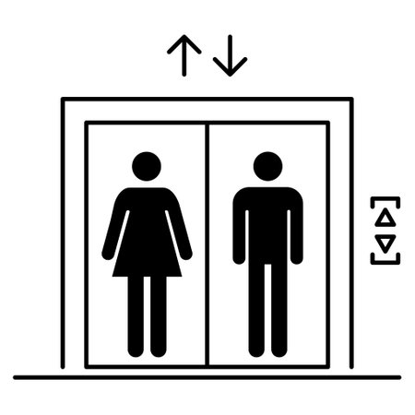

What’s Your Elevator Pitch?
What is an elevator pitch? An elevator, sales or quick pitch is a short introduction and description of your research or specific project that can be made in the time span of an elevator ride.

Slide 2

Aim for the 3 C’s
CLEAR - Keep it simple and Use jargon-free language
CONCISE - 30 to 60 seconds, about 75 words
COMPELLING - Tailor it to your audience, Hook them with a story, and do it with confidence and enthusiasm!

Slide 3
What are the benefits?
Where do I start?
Who is Your Audience? Could be a funder, a peer in academia, potential industry partner or even your neighbor ;
Introduction & Hook Tell them: Who you are, where you work, what you do, and the problem you aim to solve or the question you want to answer;
Focus on the “Why?” Why does your work matter? Who could it help?
Funding Opportunities Opportunity to highlight the significance and potential impact of your research and return on their investment, which makes it easier to persuade funders to support the work.
Raising Awareness Share issues and why finding solutions matter
Collaborations & Networking Opportunities for partnership and shared goals within and beyond academia; make an impression at conferences and networking sessions.

Slide 4
Quick Tips
Make Eye contact
Share your story with Enthusiasm & Energy
Make it Universal – leave out the jargon whenever possible
Think of it as a Highlight Reel – quick, crisp points
Practice Practice Practice!

