Slide 1
Interdisciplinary
Community Engaged
Public Impact Research
UW Tacoma
Finding Funding for Research & Scholarship
Inclusive
Basic & Applied Research
Urban Serving
Social Justice
Use Inspired Research
Scholarship of Teaching
Undergraduate Research

Slide 2
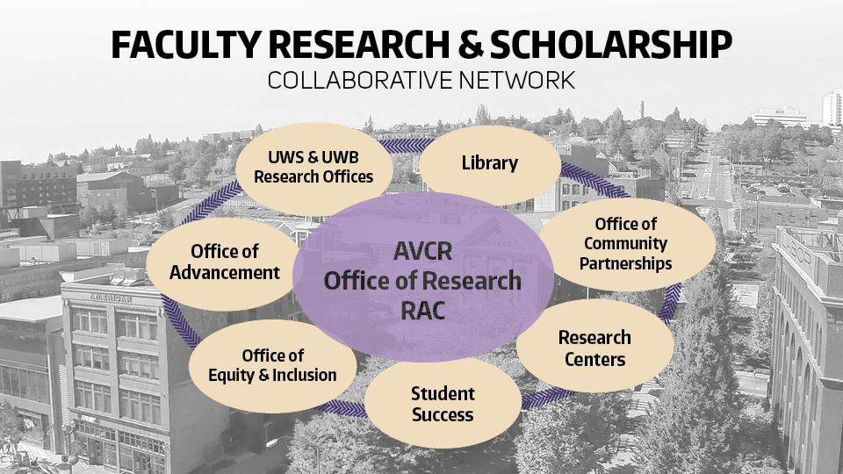
UWT
Gifts
Sponsored Programs
Service Contracts

Slide 3
UWT is a community engaged, urban and minority serving institution.
The UW Tacoma community acknowledges that we learn, teach, work and live on the ancestral land of the Coast Salish people. In particular, our campus is situated on traditional lands of the Puyallup Tribe of Indians.
Quick facts about UWT - https://www.tacoma.uw.edu/home/about-university-washington-tacoma
In 2020, UW was named a recipient of the Carnegie Community Engagement Classification, an elective designation that indicates institutional commitment to community engagement. This designation is supplemental to the Foundation’s main category (UW Tacoma and Bothell are both M1 institutions; UW Seattle is an R1).
UW Tacoma is also recognized as an Urban Serving campus by the Coalition of Urban Serving Universities.
In 2022, UWT was awarded an AANAPISI (Asian American and Native American Pacific Islander Student Serving Institution) grant from the U.S. Department of Education which designates our campus as a federally funded MSI (minority serving institution).
Best of both worlds – attached to an R1 with resources, but small class sizes

Slide 4
Your Research & Scholarship
at UWT
Create your research profile
Office of Research hosts a searchable faculty research website.
https://www.tacoma.uw.edu/or/faculty-research-profiles
If you would like your research profile to be included on the website, please fill out the information at the following link.
https://www.tacoma.uw.edu/or/faculty-research-profile
Your research career at UWT:
Participate in Office of Research faculty development workshops
Create a one-page research summary
Come talk to us in the Office of Research (uwtor@uw.edu)

Slide 5








Proposal Support: We provide direct assistance to UWT faculty with the proposal submission process for sponsored projects. We manage the SAGE eGC1, logistics, compliance and business process of proposal submission so the Principal Investigator can focus on the research. On behalf of UWT and the PI, our staff works directly with UW Office of Sponsored Programs.
Grant/Award Support: We work directly with OSP and in SAGE to manage all post-award processes related to the award agreement or sponsor requests and we provide support and guidance to PIs and academic units on post-award grant management.

Slide 6







Step 1: Outline: Create a 1-page project/or concept draft of a potential research project (this can include a basic timeline, budget considerations, and tentative project team, but these are not required at this stage.)
Step 2: Add a link to any funding opportunities you’ve found that might fit – even if they do not currently have an active submission date.
Step 3: Email us at UWTOR@uw.edu with your concept outline and we will schedule a meeting to learn more about your plans and help you build out possible project ideas and budget.

Slide 7








Step 1: Identify a funding opportunity that you are interested in with an upcoming, active Request for Applications/Proposals (RFA/RFP)
Step 2: Read through the RFP for submission deadlines and eligibility requirements to be sure you can reasonably meet both.
Step 3: Fill out the online Proposal Support Request form found on our website: https://www.tacoma.uw.edu/or/proposal- submission

Slide 8









PROPOSAL SUPPORT
KEY TAKEAWAYS!
Fill out the UWTOR Proposal Support Request form as early as possible -
Simple proposals - at MINIMUM 10 business days prior to submission deadline.
Complex proposals – at MINIMUM 15 business days prior to submission deadline.
Timelines are IMPORTANT because -
There are often multiple proposals, simultaneous submission deadlines in the queue and it takes LOTS of moving pieces and people to get a proposal through UWT to OSP and submitted to the sponsor.
YOU (the PI) are responsible -
We are here to support you and your work and you must remain available throughout the proposal process until submission to answer questions, provide documents, finalize budgets, etc.
We look forward to working with you!

Slide 9
Proposal Support: We provide direct assistance to UWT faculty with the proposal submission process for sponsored projects. We manage the SAGE eGC1, logistics, compliance and business process of proposal submission so the Principal Investigator can focus on the research. On behalf of UWT and the PI, our staff works directly with UW Office of Sponsored Programs.
Grant/Award Support: We work directly with OSP and in SAGE to manage all post-award processes related to the award agreement or sponsor requests and we provide support and guidance to PIs and academic units on post-award grant management.

Slide 10
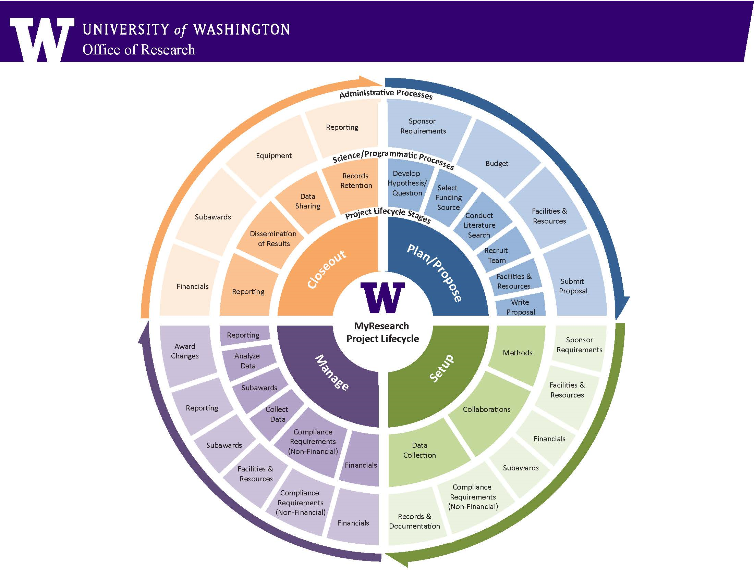
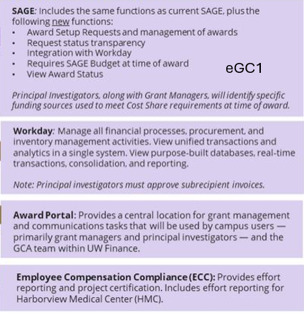
The Research Life Cycle
Where do award-related activities take place for external sponsored programs?
OSP
GCA
UWS Office of Research
https://www.washington.edu/research/

Slide 11
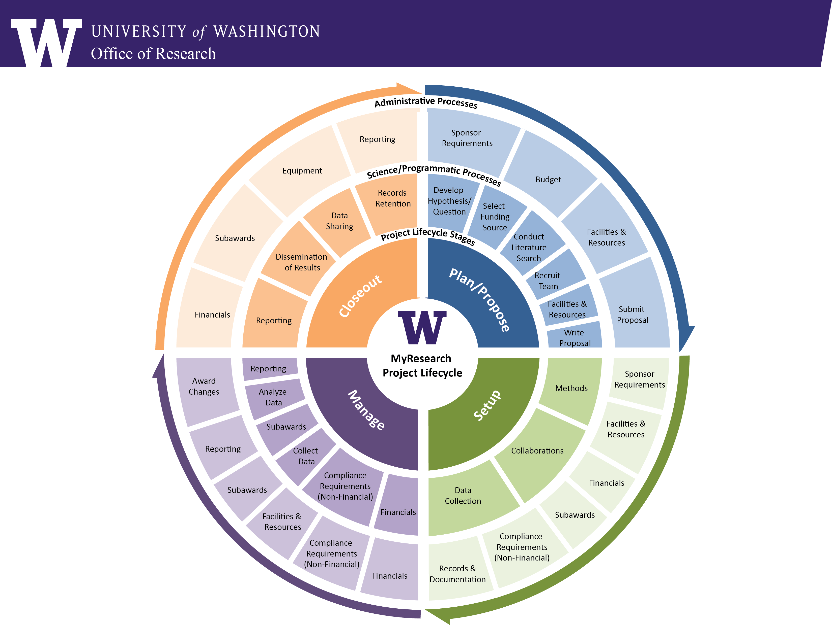
External Funding from Sponsored Programs
TRAINING REQUIRED
Resources for finding funding,
writing proposals &
managing grants through the whole Research Lifecycle
PI quick start – including required PI Grant Management Training
https://www.washington.edu/research/pi-resources-quick-start/
Required Training:
Grants Management for Investigators
https://www.washington.edu/research/required-training/faculty-grants-management/
Responsible Conduct of Research Compliance Training
https://www.washington.edu/research/compliance/responsible-conduct-of-research-rcrtraining/rcr-training-instructions/
UWS Office of Research
https://www.washington.edu/research/

Slide 12
Funding Sources for Research & Scholarship
(UWT Office of Research - https://www.tacoma.uw.edu/or)
Departmental Funding Opportunities – Professional Development Funds & other Dept. funds
UWT Internal funding
Endowment Funding for Research & Scholarship – varies annually - RAC
Community Partnerships - Office of Community Partnerships
UW Internal Funding Opportunities
Royalty Research Fund – proposals submitted thru OSP; workshops twice a year
Office of Global Affairs
Simpson Center for the Humanities
Population Health Initiative
EarthLab Innovation Grants
SEED-AI Grants
Co-Motion
Limited Submission Opportunities (LSO) – internal selection process for external grants
Externally Funded Sponsored Research Opportunities
(NSF, NIH, NEH, Dept. of Education, etc.)
Foundation & Gifts – UWT Advancement
Resources to Support Undergraduate Research at UW
https://www.washington.edu/undergradresearch/

Slide 13


Resources for Finding Funding
American Association of State Colleges & Universities
Grants Resource Center
https://aascu.org/
Central Corporate & Foundation Relations Funding Opportunities
Searchable Database
UW Central Corporate & Foundation Relations
Central Corporate & Foundation Relations maintains a searchable database: Central CFR open RFP page
UW Library Foundation Database - https://guides.lib.uw.edu/research/fdo
UWT Office of Research
https://www.tacoma.uw.edu/or

Slide 14
QUESTIONS – Contact the UWT Office of Research
Cheryl Greengrove – Associate Vice Chancellor for Research
cgreen@uw.edu
Yoko Furukawa – Director UWT Office of Research
yokofur@uw.edu
Karen Urlie
kurlie@uw.edu
Office of Research
uwtor@uw.edu
https://www.tacoma.uw.edu/or
THANK YOU!

