Slide 1
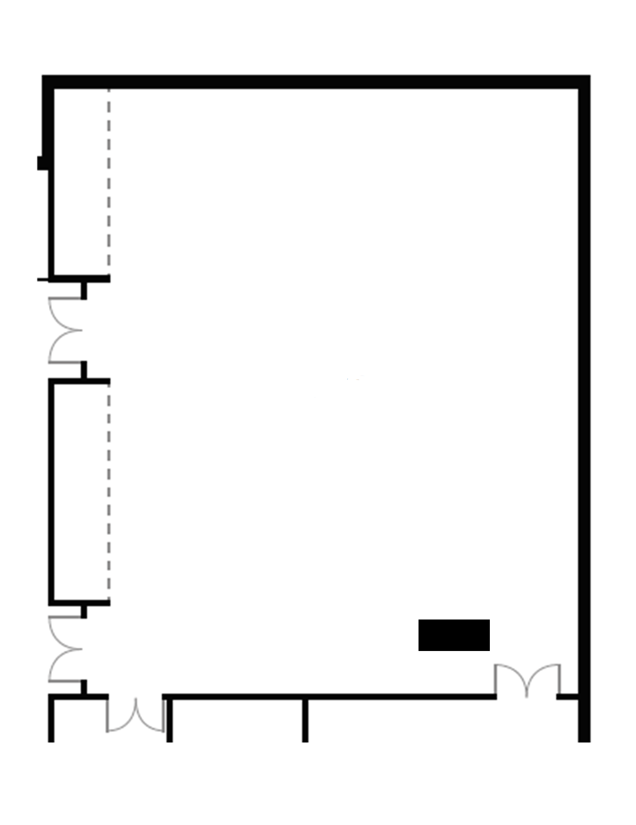


MILGARD 110 (MLG 110)
Please note: Diagram is not 100% up to scale. Actual furniture setup may have a few adjustments to accommodate spacing and adhere to fire code.
RESTRICTED AREAS:
Fire exits, entry ways, narrow hallways, and stairwells —
all of these areas must retain clearance.
NO furniture can be placed in these areas
(highlighted in red boxes).
Please note:
All custom layouts submitted will need to be reviewed and approved to ensure they meet fire code and ADA compliance.
Layout adjustments may be required.
Layouts should be finalized 15 business days from event date.
Customizable diagram
on next page
Computer and A/V Desk
SCREEN
www.tacoma.uw.edu/conference/MLG110

Slide 2
Event Name:
Event Date:
Please note: Diagram is not 100% up to scale. Actual furniture setup may have a few adjustments to accommodate spacing and adhere to fire code.
For layout samples + more info:
www.tacoma.uw.edu/conference/MLG110
Or scan the QR code
As tables are on wheels, furniture is allowed to be shifted by occupying group but must be reset in this configuration at end of event. Unless noted otherwise.
5’ Tables – 57 available
5’5” ADA Tables – 3 available
Computer and A/V Desk
SCREEN
Chairs – 117 Available
ADA Chairs – 3 Available
Copy and paste shapes into the diagram.
Do not resize them.
Shortcut: Hold Ctrl + left click and drag the shapes in place.
Chairs
ADA Chairs
5’ Tables on wheels
5’5” ADA Tables on wheels
Chairs (Not every chair needs to be depicted. Describe # of chairs per table, area, section, etc.)

